Slide 1
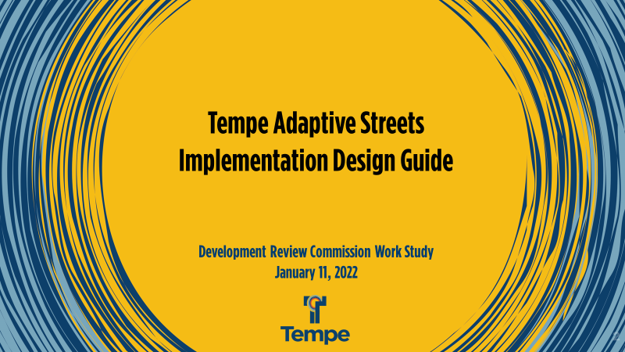

Slide 2



Tempe Adaptive Streets Implementation Design Guide
Presentation Outline
  Project Purpose
    Background and why this project is being pursued
  What are Adaptive Streets?
    Definition and Use Cases
  Project Process and Activities
    Activities completed and in process
    Public Engagement #1 – January 2022
  Questions and Next Steps

Slide 3
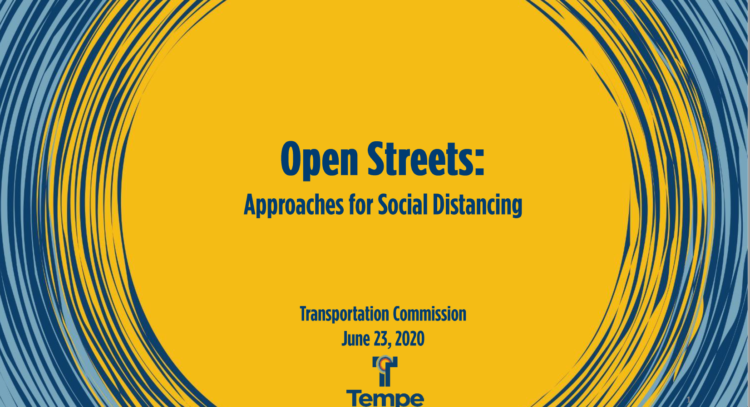
Background – ‘Open Streets’
June 2020 Commission Meeting – Open Streets as approaches for social distancing in response to COVID-19
Created a shift in what the community wanted/needed
Provided Local Governments a Chance to Respond . . . in a short period of time

Slide 4
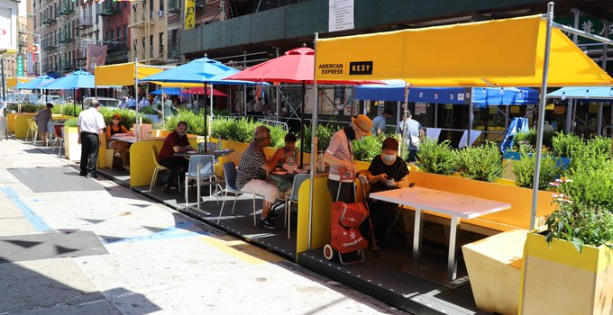
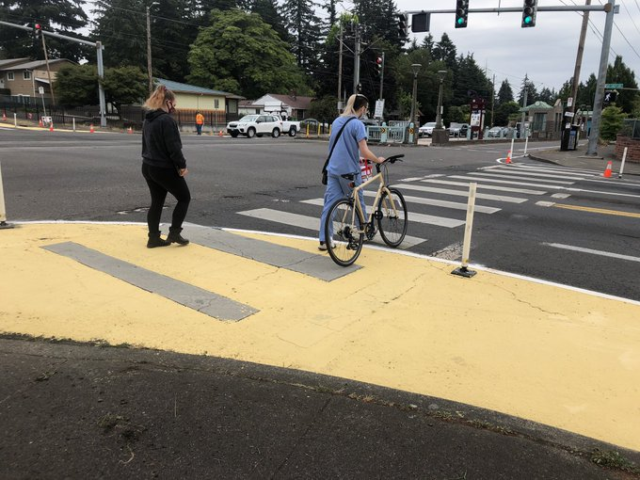
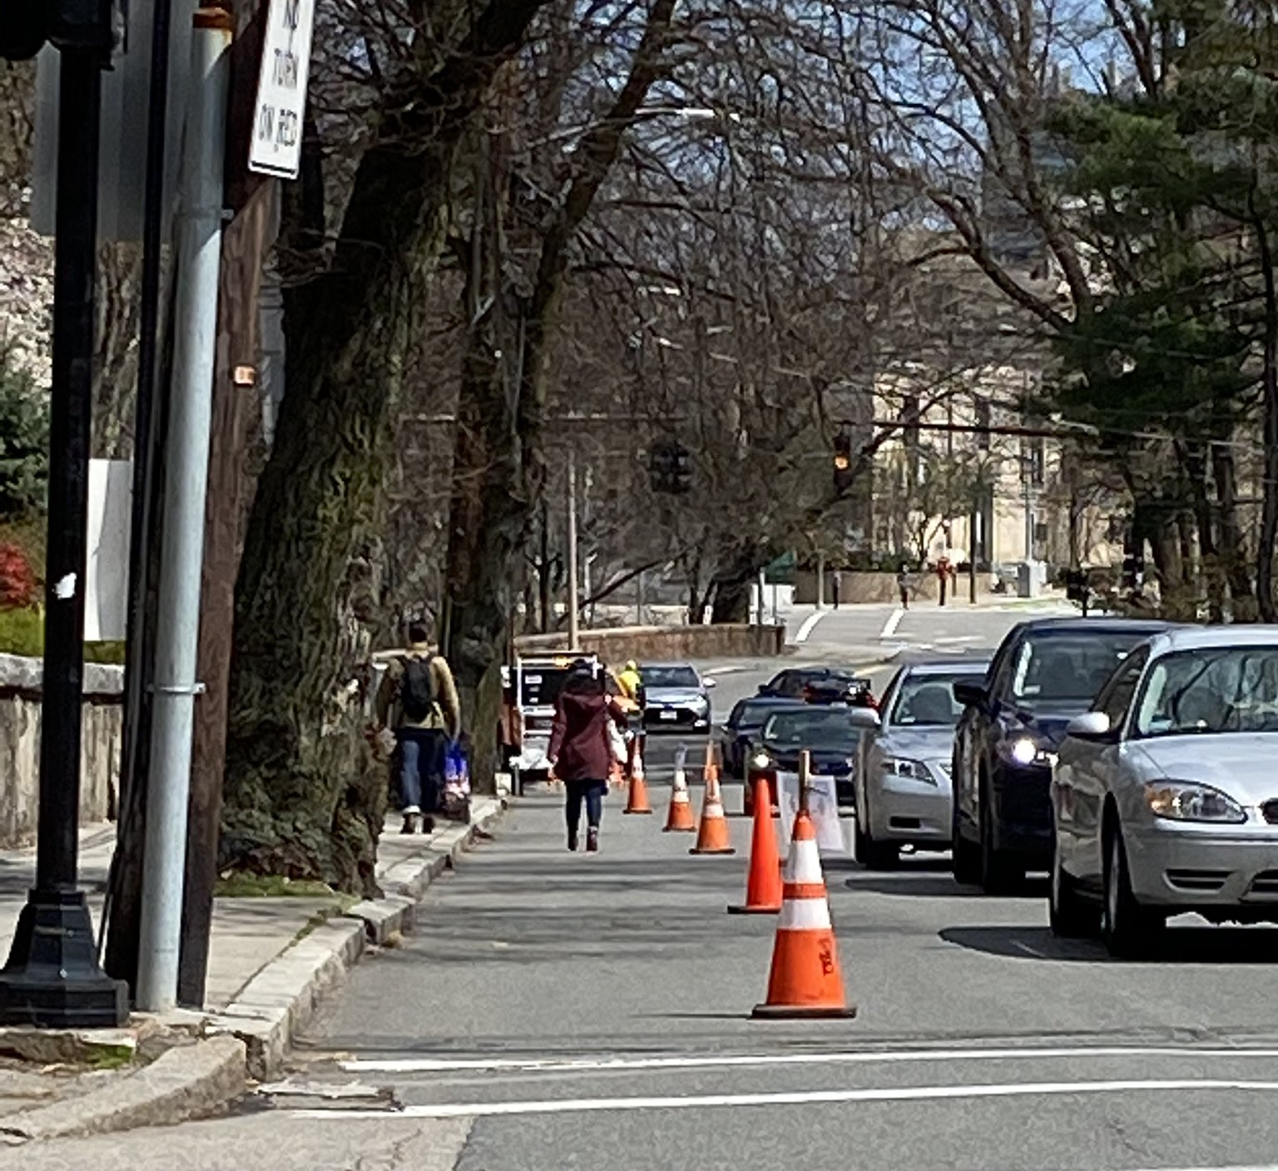
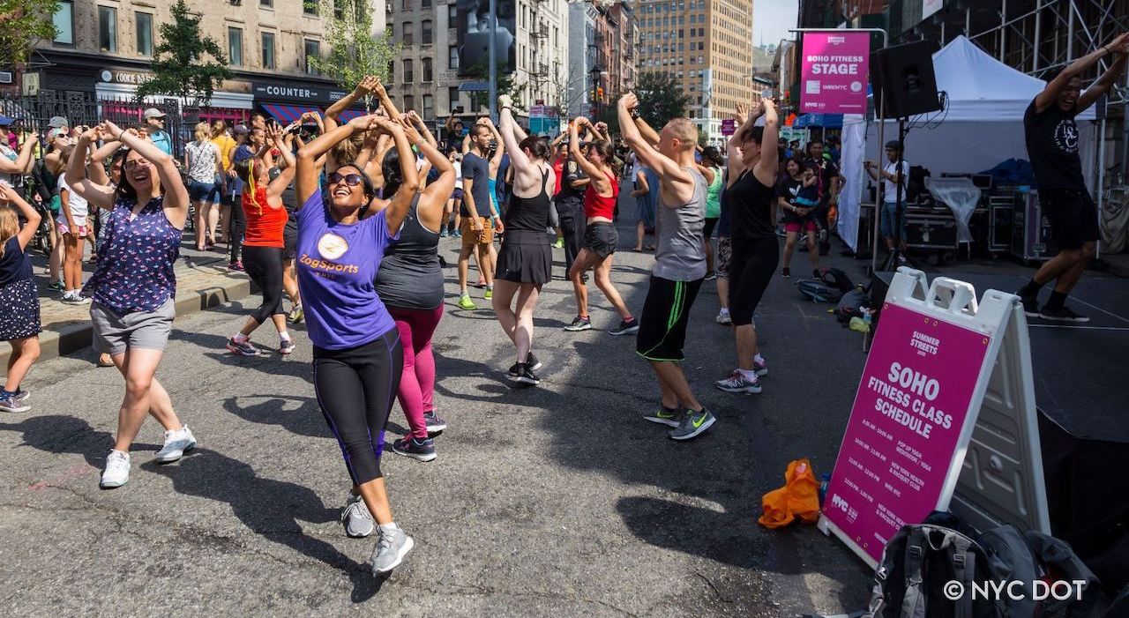
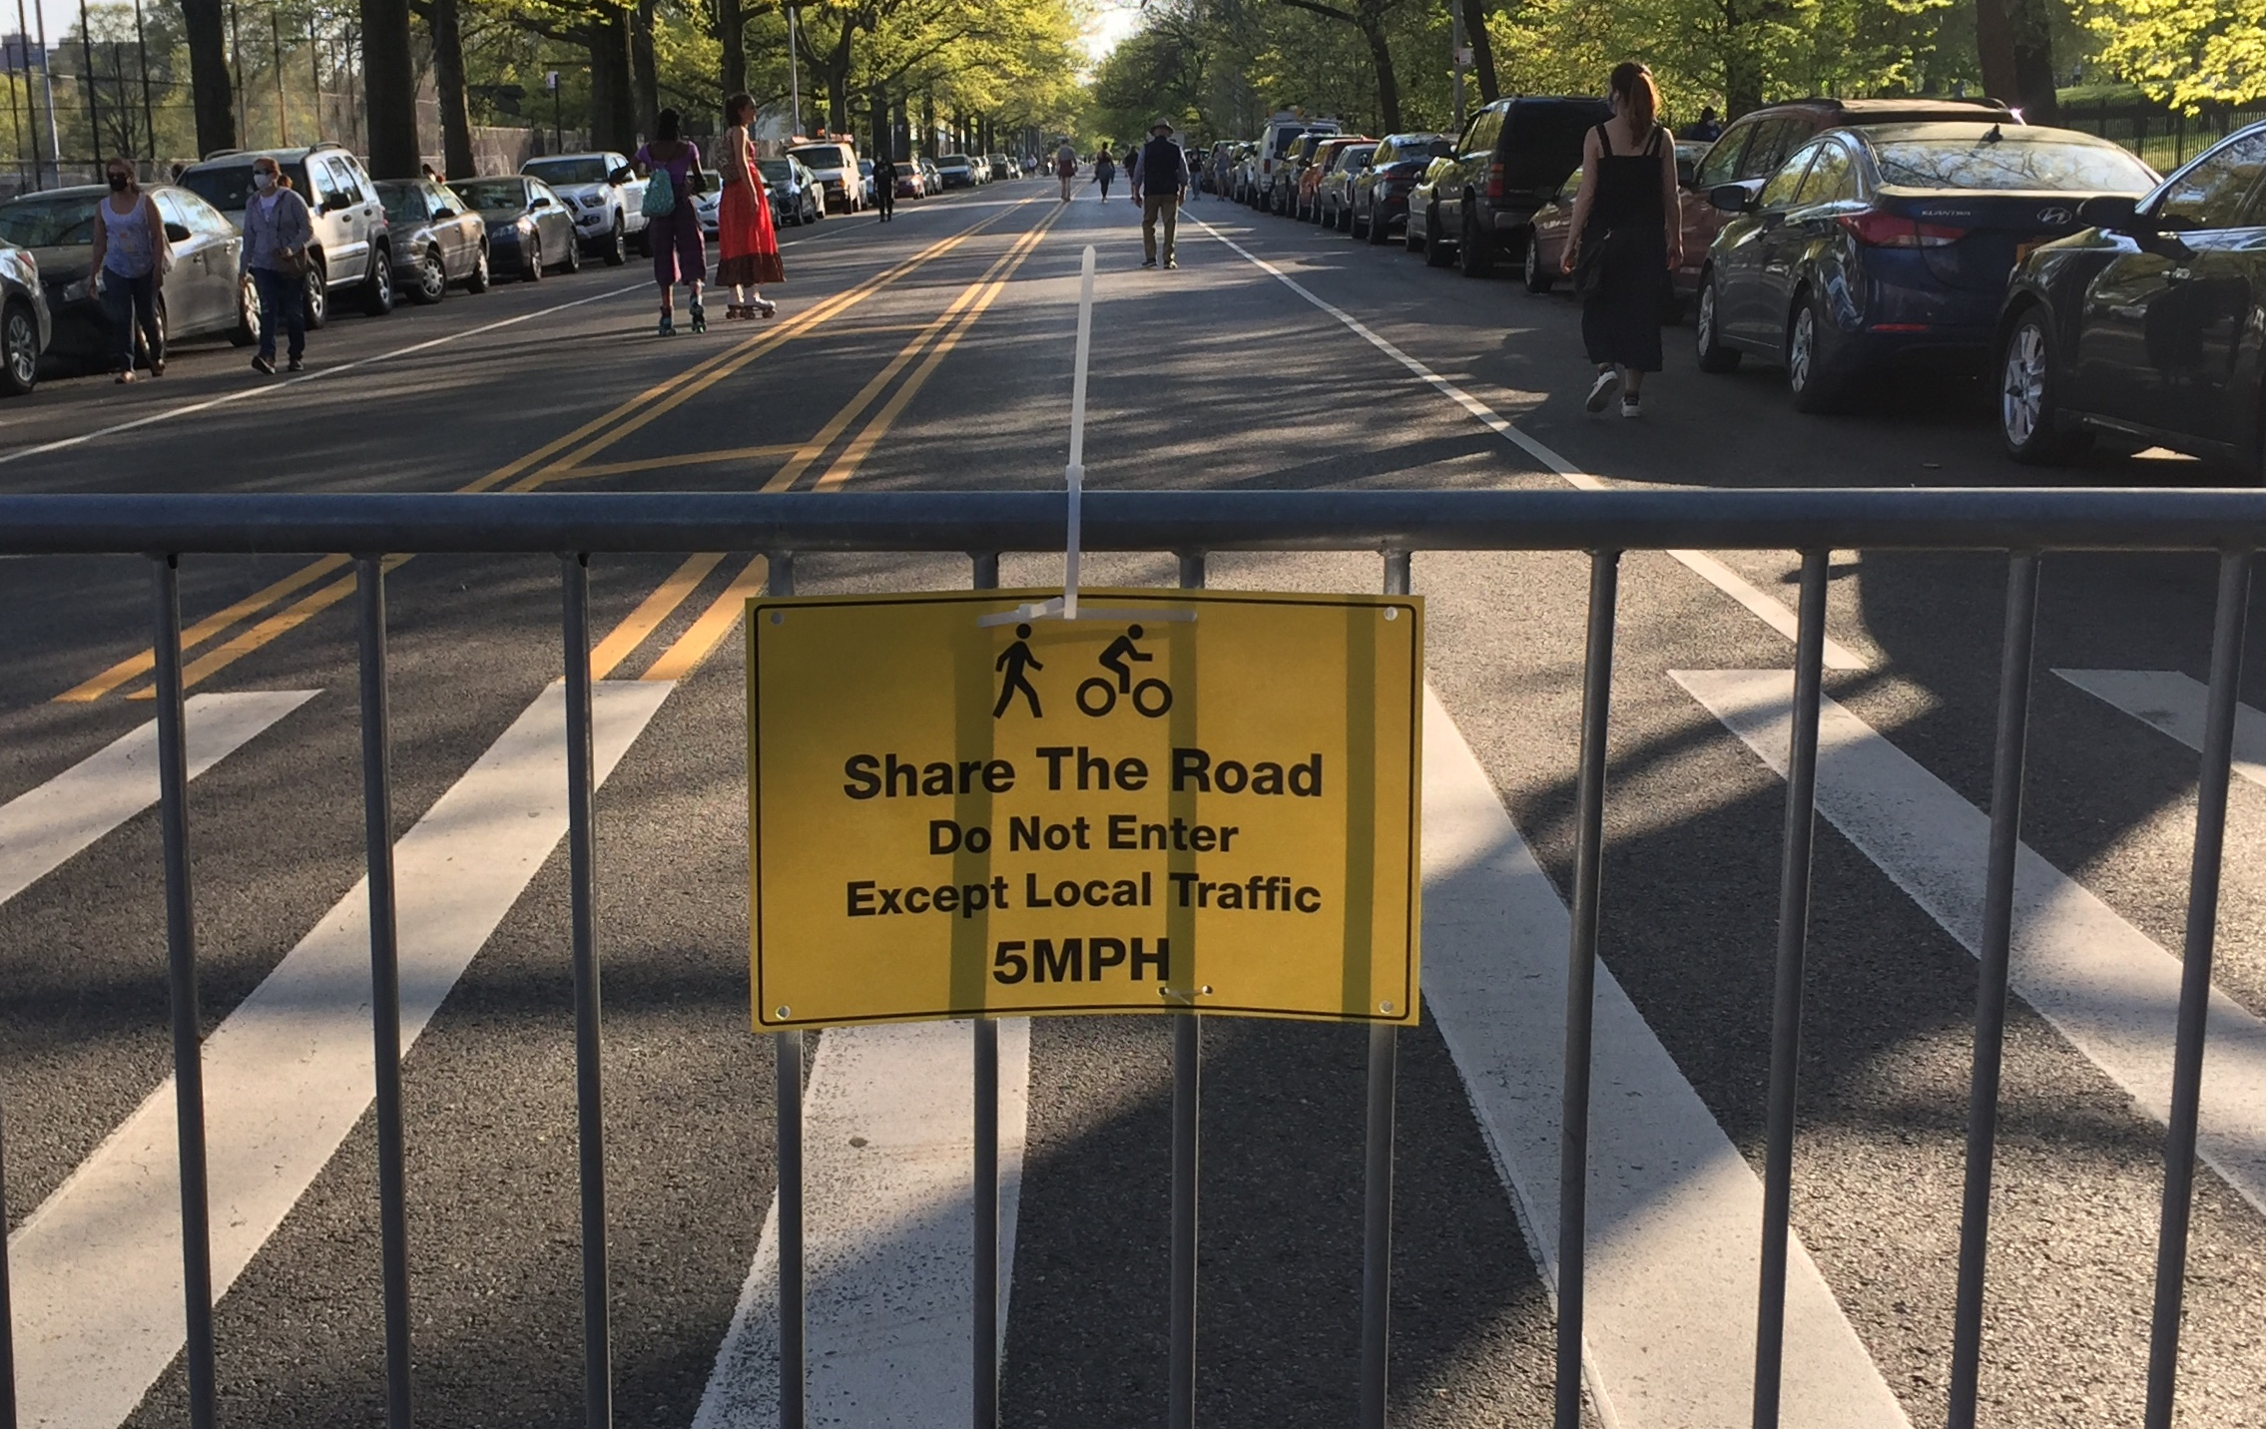
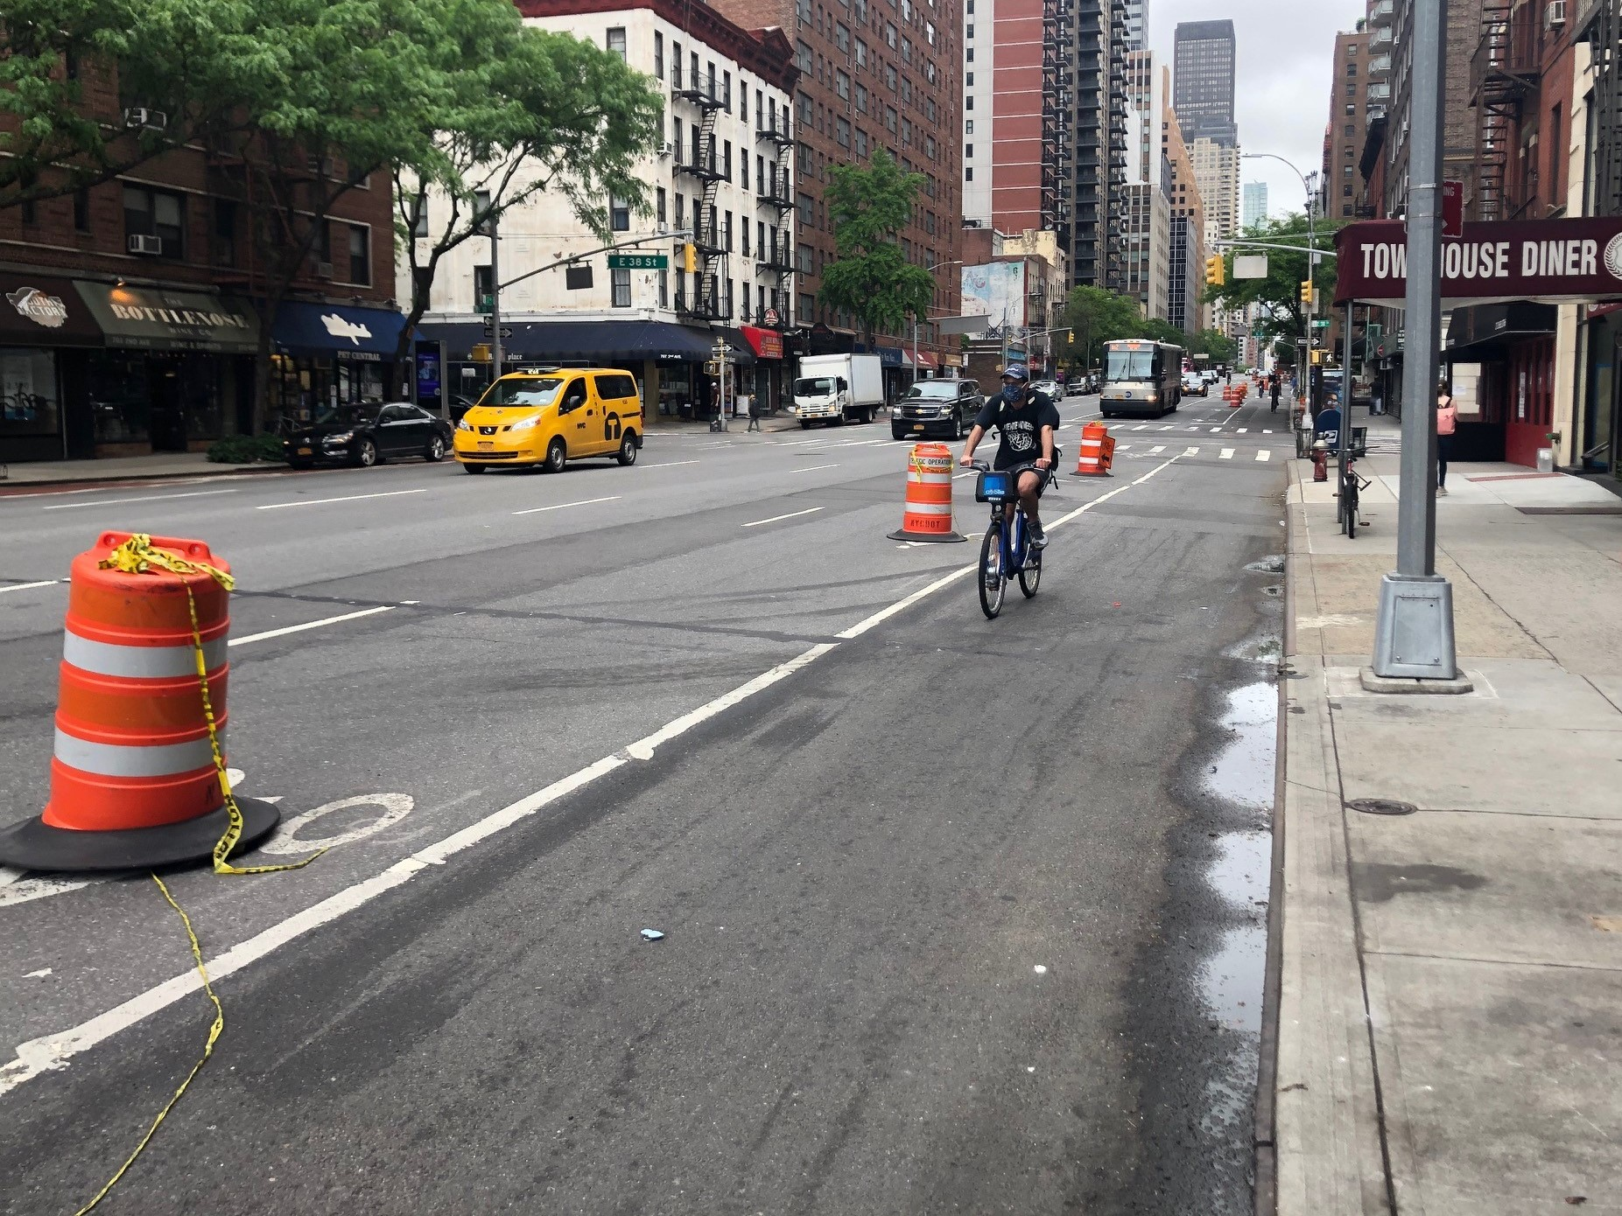
The Community Needs. . .
The Community needed . . .
More room to walk and bike
Safer streets
More room to dine and gather
Placemaking
. . . More Room to Walk and Bike
Photos from NACTO
Notes:
https://dirt.asla.org/2021/06/02/after-the-worst-of-the-pandemic-what-will-happen-to-all-the-open-streets/
Eileen

Slide 5
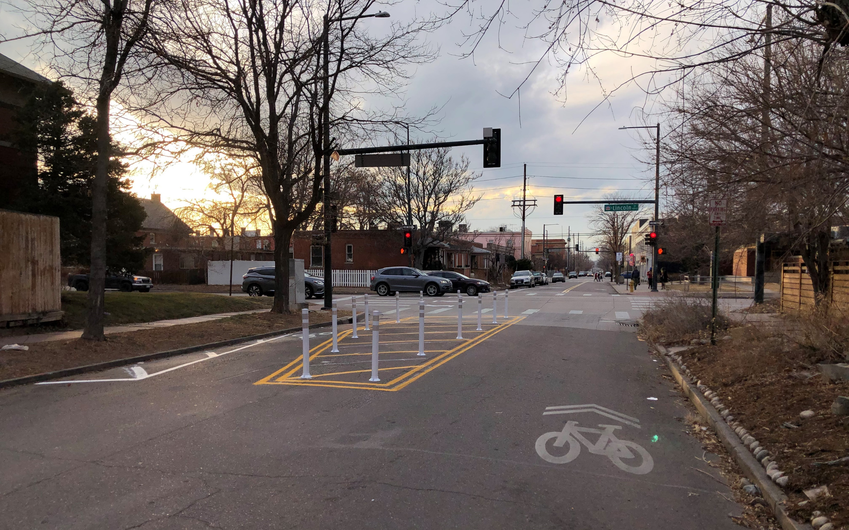
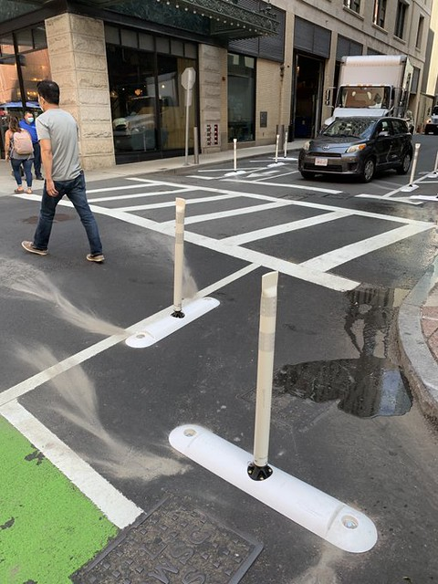
Project Purpose
Create a guidebook of low-cost strategies that change the use/allocation of the public right-of-way (ROW) to accommodate new/different demands
  Design guide
  Internal (City) and external (public) processes
Notes:
Amy

Slide 6
Adaptive Streets Definition for Tempe
An adaptive street application is a change to the public right of way (sidewalk, curb space, roadway, median) that:
Is implemented temporarily
Includes a new feature in the ROW that changes how some/all of the ROW is used
Is implemented at a specific location in response to a community need

Slide 7
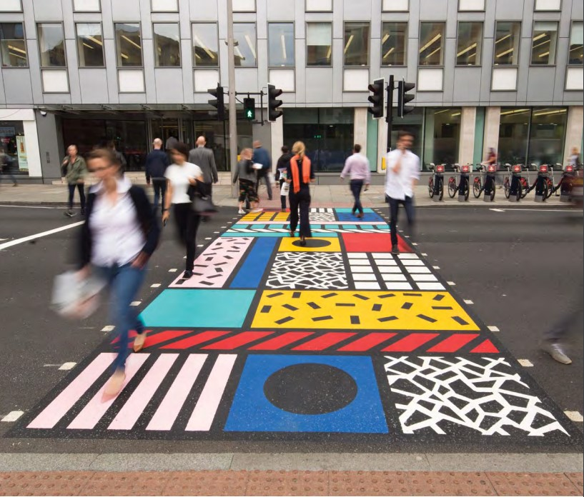
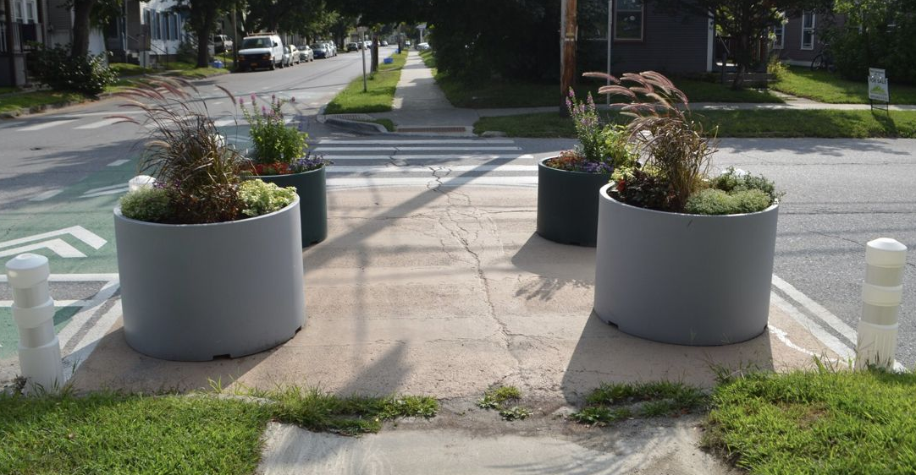
Potential Opportunity for Adaptive Streets
Bring attention to a feature or configuration at an intersection to improve safety

Slide 8
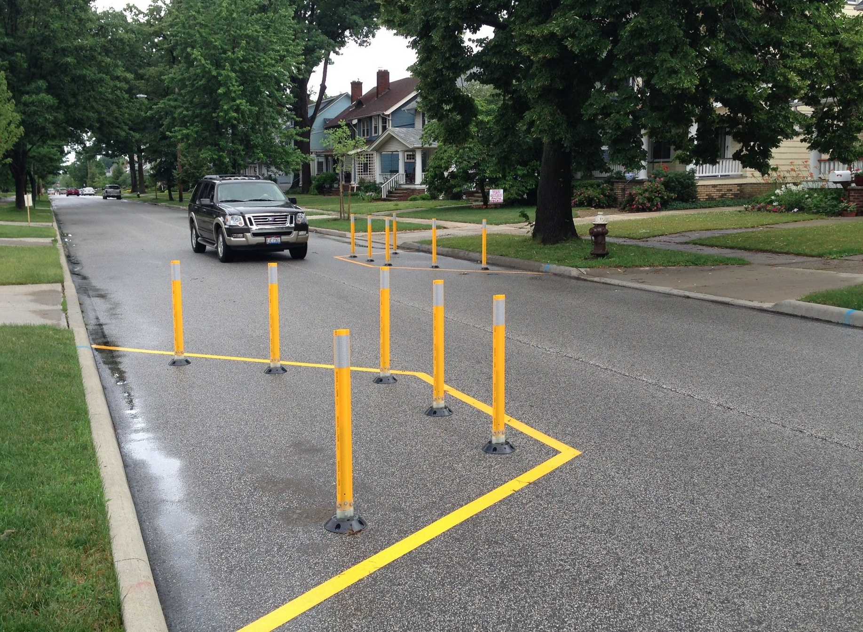
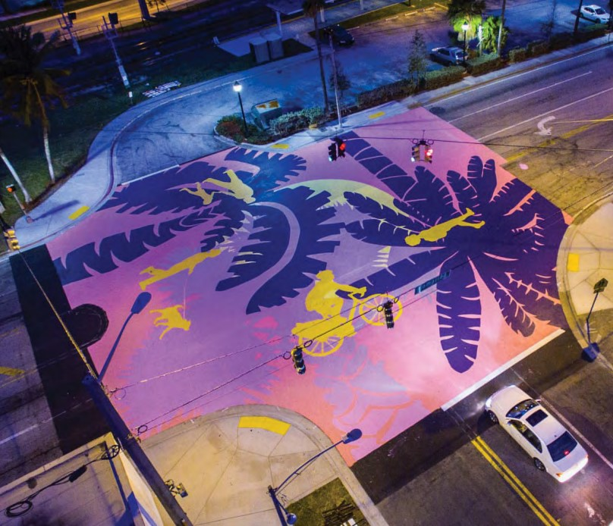
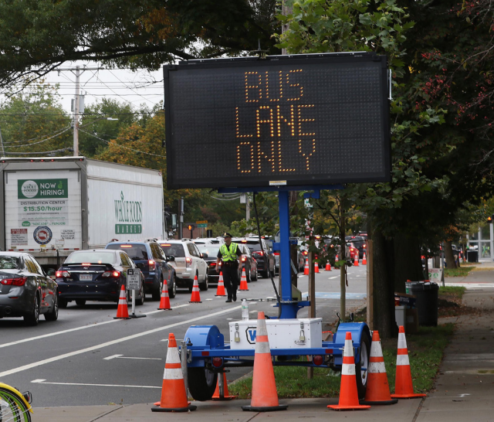
Potential Opportunity for Adaptive Streets
Support implementation of changes to circulation/mobility or community character resulting from an adopted plan or CIP project

Slide 9
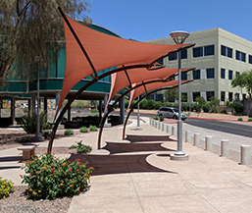
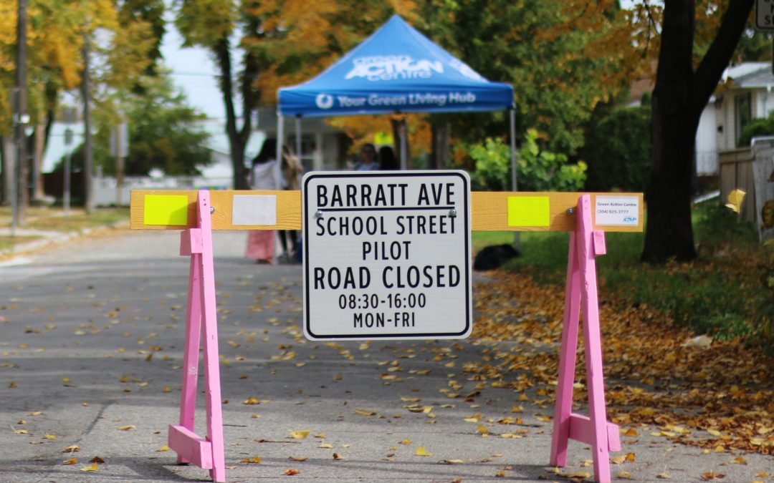
Potential Opportunity for Adaptive Streets
Support temporary/seasonal needs for travelers and community members

Slide 10


Project Process
Discover
Explore existing City process and projects
Define
Develop Adaptive Street strategy toolbox
Evaluate
Explore Adaptive Street opportunities
Integrate Assemble the Adaptive Street Implementation Design Guide
= Public Input
Fall 2021
Summer 2022
We are here
Notes:
Amy

Slide 11
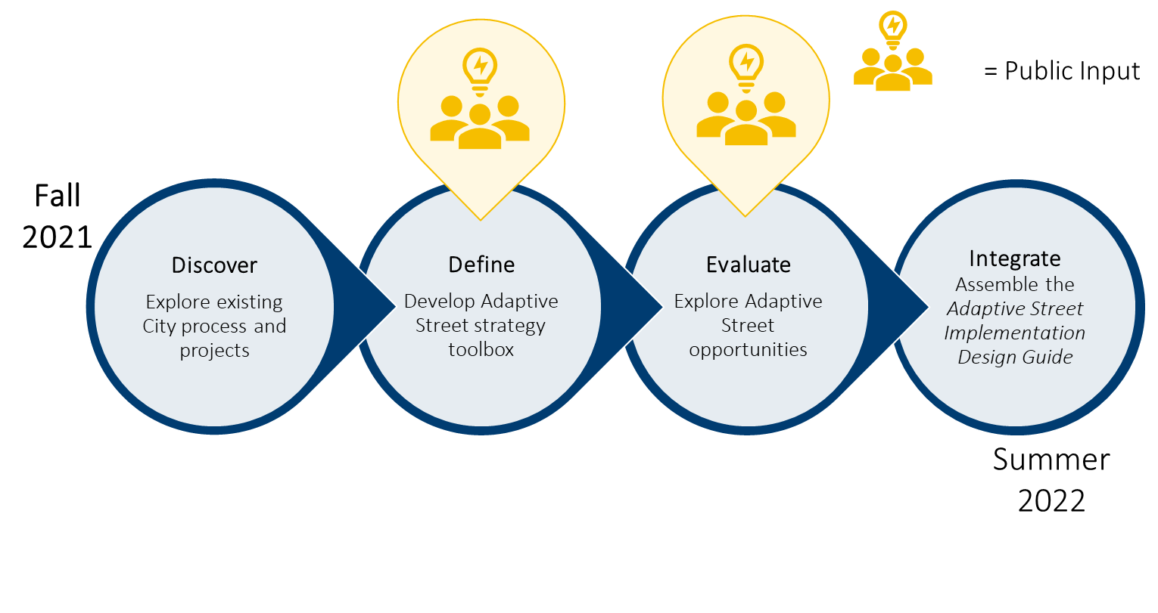
Project Activities
Discover:
Completed a review of City Plans, Initiatives, and Processes to identify connections or opportunities for Adaptive Streets
Completed two Focus Groups – 1. Internal City Staff; 2. Business and Resident Representatives
Define:
City project team is refining definition and use cases for adaptive streets
Beginning discussions around developing internal process for doing adaptive streets

Slide 12
Public Engagement #1
  Online Public Meeting – Wednesday, January 19, 2022; 12pm
  In-Person Public Open House – Saturday, January 29, 2022; 9am
  Online Digital Engagement Activity –active January 19 – February 13, 2022
Inform:
  Project Purpose and Background
  Project Timeline and Activities
  Concept/Definition of Adaptive Streets
Engage:
  Is the definition of Adaptive Streets understandable and clear?
  What are the top priority needs for modifying the operations of the street right of way?
  Which strategies are suitable in Tempe?
  Where could you see this application happening?

Slide 13
Next Steps
  January 2022 Public Outreach and Engagement #1
  February/March 2022 Assemble Tempe’s Adaptive Street Toolbox
  March/April 2022 – Define Adaptive Street Processes
  April/May 2022 – Public Outreach Engagement #2
            Transportation Commission Meeting
            Council Issue Review Session
  May 2022 Assemble Draft Adaptive Streets Implementation Design Guide

Slide 14
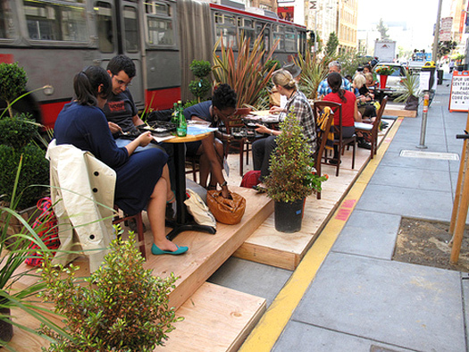
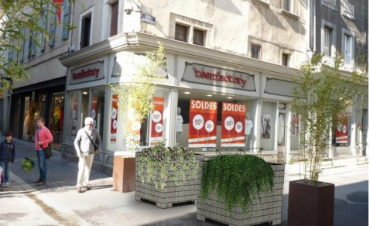
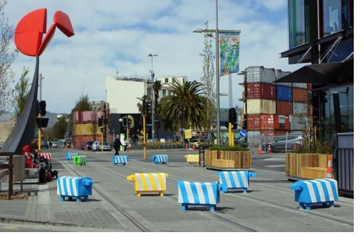
Questions?

Slide 15
Thank you!
  Bonnie Richardson
  City of Tempe Project Manager
  bonnie_richardson@tempe.gov
  Amy Garinger
  Kimley-Horn
  amy.garinger@kimley-horn.com
  Eileen Yazzie
  Y2K Engineering
  eyazzie@y2keng.com
Notes:
Amy

