Slide 1
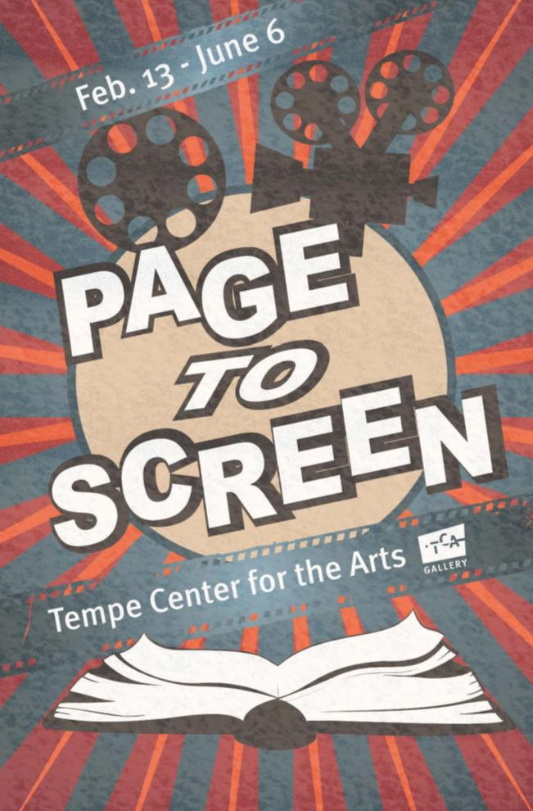
Exhibition Preview

Slide 2
The vast wealth of images and storylines that books offer have been major sources of inspiration for the film genre. Some adaptations are as well-loved as the original books. Dr. Lawrence and Holley Thompson have collected hundreds of pieces of art, memorabilia and toys from TV shows and films such as Zorro, M*A*S*H and James Bond and legends such as Dr. Seuss, Chuck Jones and Walt Disney. This exhibition is a reflection of their dedication to preserving and sharing the rich history of some of America’s favorite children’s books, comic books and fictional literature that have been adapted to film and television over the past 75 years.

Slide 3
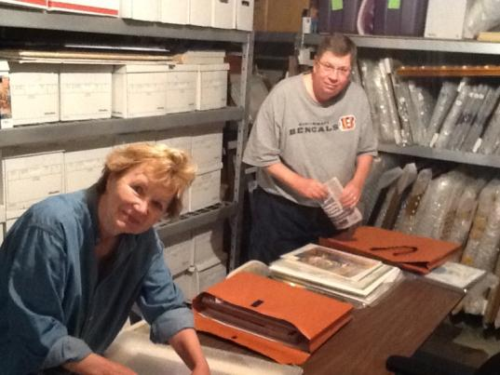
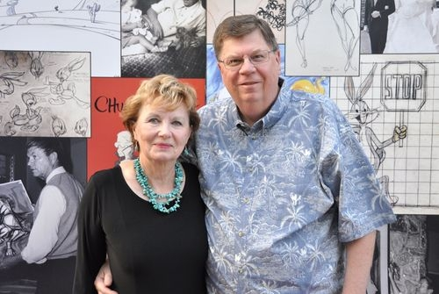
Collectors Dr. Lawrence “Larry” and Holley Thompson are now retired but worked in the corporate realm for many years. Larry also taught popular culture at the university level and Holley was a librarian. Each shared a love for books, the movies, theater and music. Some of their favorite items in this exhibition include personal favorites from childhood, especially those based on books including early television shows from the 1950s and 60s such as “Zorro” and “The Untouchables” as well as animated films from Walt Disney such as “Snow White” and “Cinderella.”

Slide 4
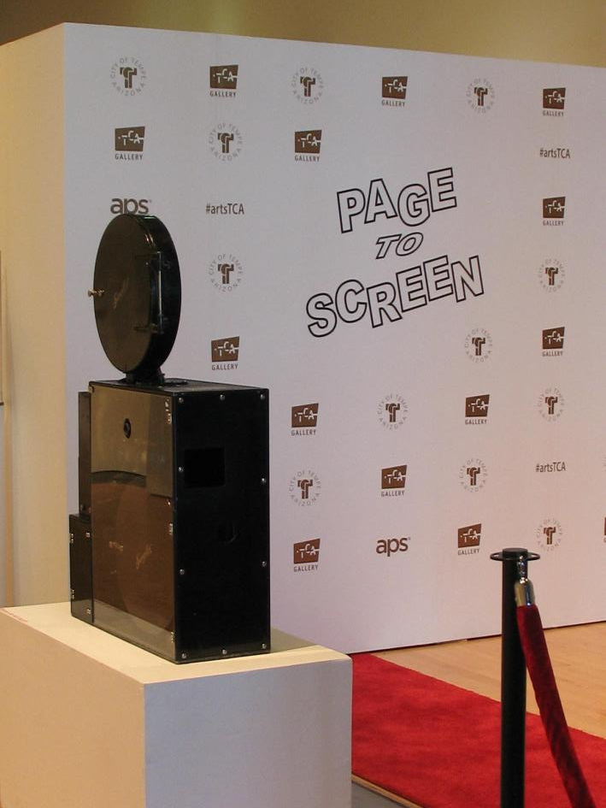
Red Carpet Entrance

Slide 5
Popular Book Genres in the Exhibition:
Crime & Mystery Westerns
Romance
Adventures & Biographies
Fairy Tales & Children’s Books

Slide 6
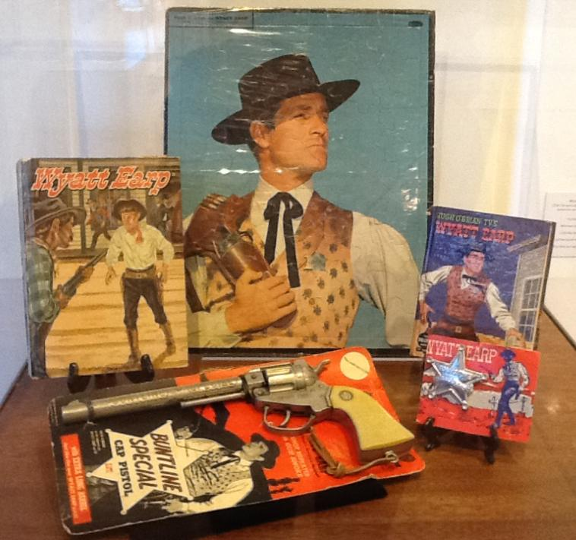
Collectible display The Life and Legend of Wyatt Earp, TV series, 1955-1961
Actor Hugh O’Brian played Wyatt Earp.
There have been many books written about Wyatt Earp including: The Life and Legend of Wyatt Earp by Monica Hill/Mel Crawford, 1958
About: Wyatt Earp (1848–1929) was a real American Sheriff, gambler and Deputy Town Marshall in Tombstone, AZ. He took part in the famous gunfight at the O.K. Corral.

Slide 7
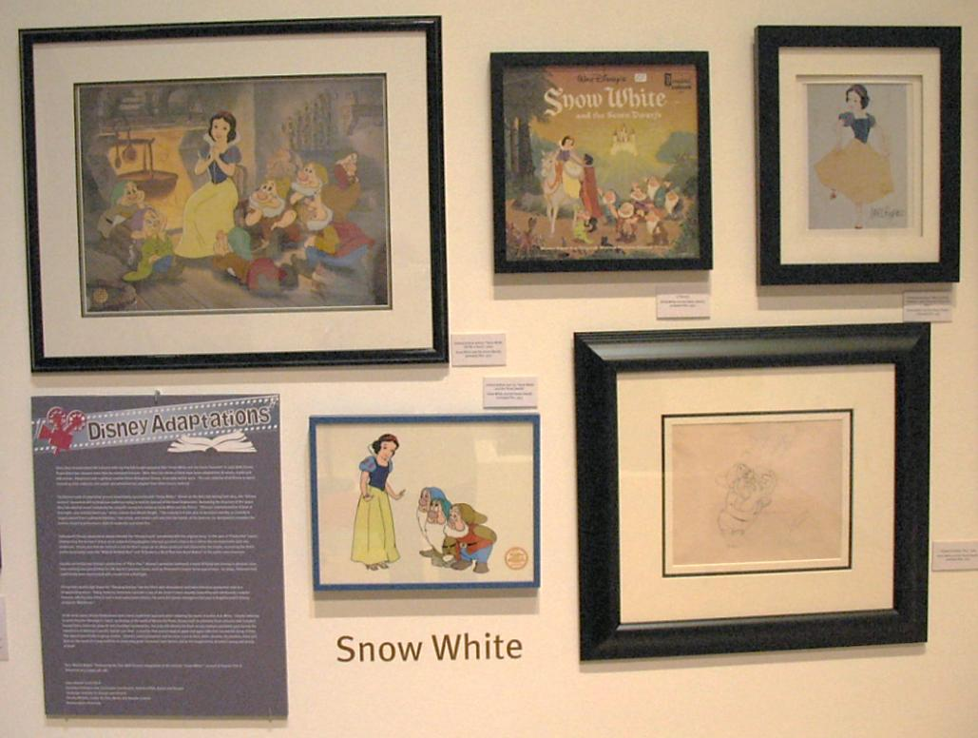
Memorabilia display: Snow White and the Seven Dwarfs Animated Film, 1937
Walt Disney Productions, Adriana Caselotti played the voice of Snow White.
The story of Snow White was an early folk tale. The famous “Brothers Grimm” adapted the story in the book: Grimm’s Fairy Tales in 1812.

Slide 8
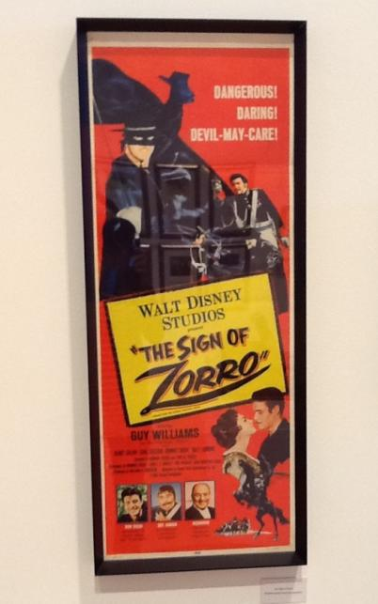
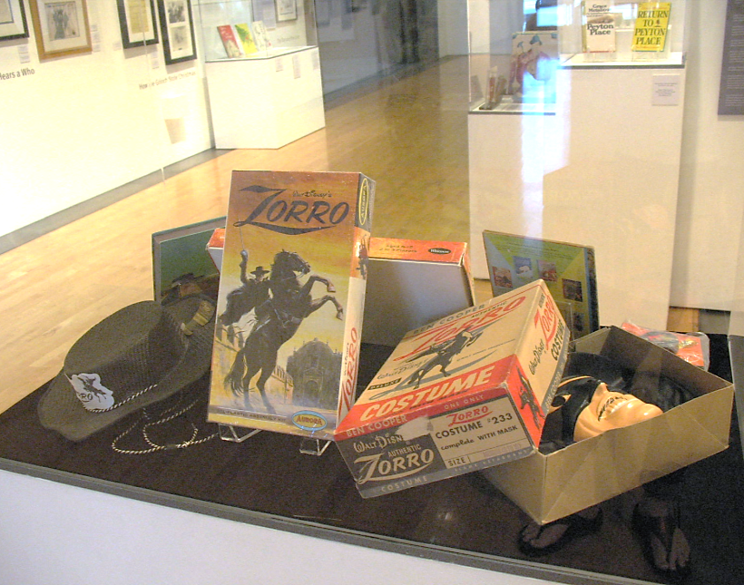
The first book: Zorro
The Curse of Capistrano, 1919
by Johnston McCulley
Character: Don Diego de la Vega masquerades as the vigilante, Zorro, fighting the corrupt tyrants of Spanish California.
The Sign of Zorro, feature film, 1958
Walt Disney Productions
Actor Guy Williams played Zorro There have been many Zorro films. This one was adapted from the the 1950s Disney television series.

Slide 9
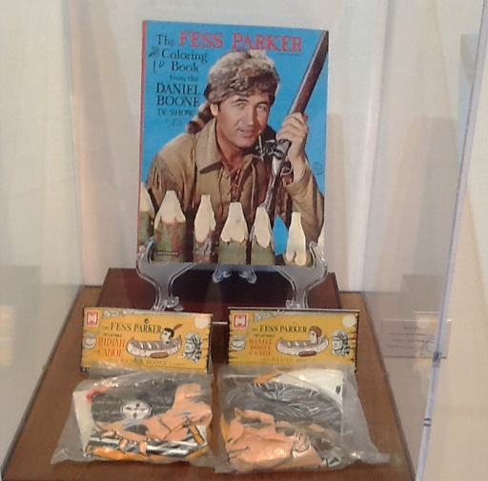
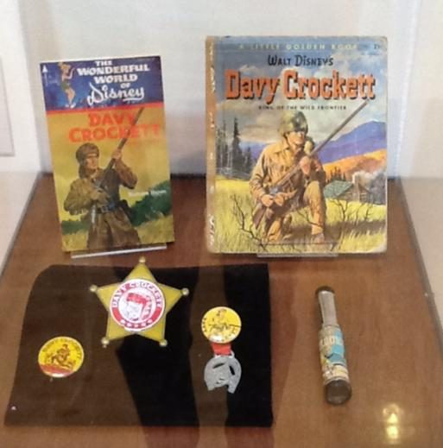
Daniel Boone (1734-1820) was a real American pioneer, explorer and frontiersman. He is famous for his exploration of what is now Kentucky. Many books have been written about Boone. TV series, 1964-1970, Daniel Boone
Arcola Pictures, Fespar Enterprises, National Broadcasting Company (NBC), 20th Century Fox Television
Actor Fess Parker played Daniel Boone.
Davy Crockett (1786-1836) was a real American frontiersman, soldier and politician. He was a member of the U.S. Congress, served in the Texas Revolution and died at the Battle of the Alamo. Many books have been written about Crockett.
TV Series, 1954-55. Davy Crockett, King of the Wild Frontier, Walt Disney Productions Actor Fess Parker played Davy Crockett.

Slide 10
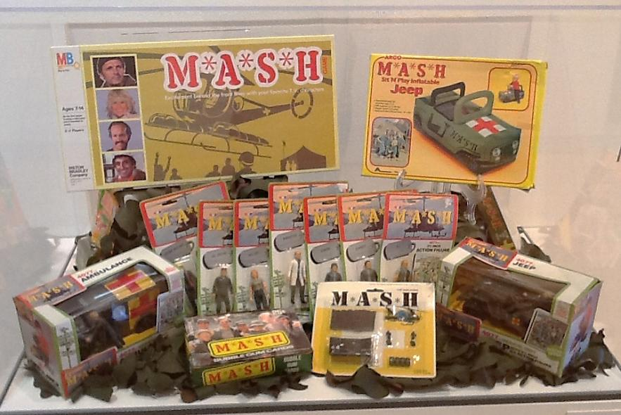
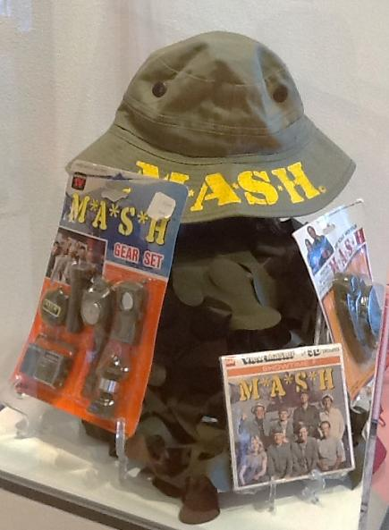
The book: MASH: A Novel About Three Army Doctors, 1968
By H. Richard Hornberger (pen name: Richard Hooker). A comedy/drama about the staff of an army hospital during the Korean War. Feature film, 1970, Director: Robert Altman
Aspen Productions, Ingo Preminger Productions, Twentieth Century Fox
Television series, 1972-1983, 20th Century Fox Television

Slide 11
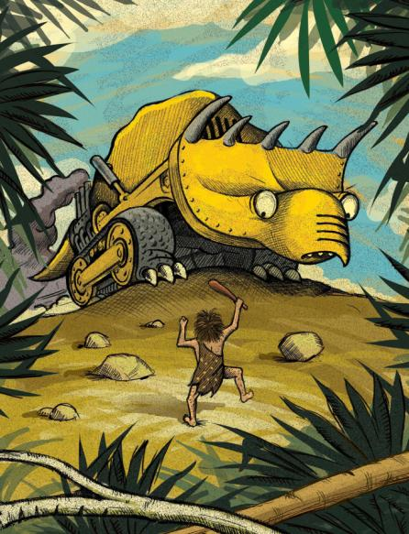
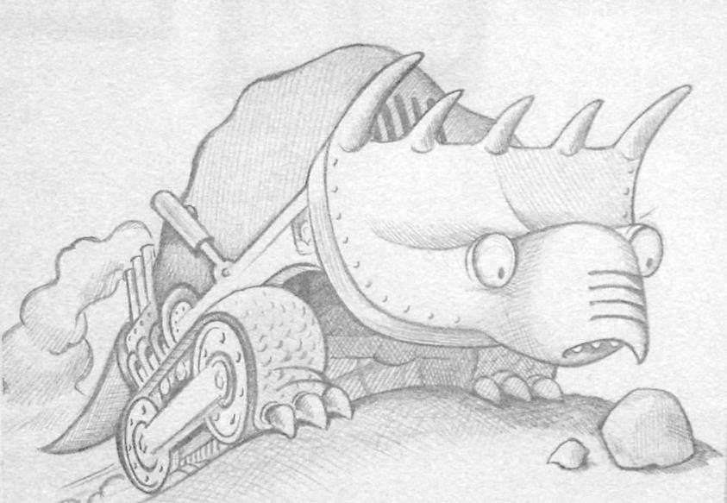
Dinotrux Book by Chris Gall Little, Brown Books 2009 DreamWorks Animation releasing a TV series through Netflix in 2015.

Slide 12
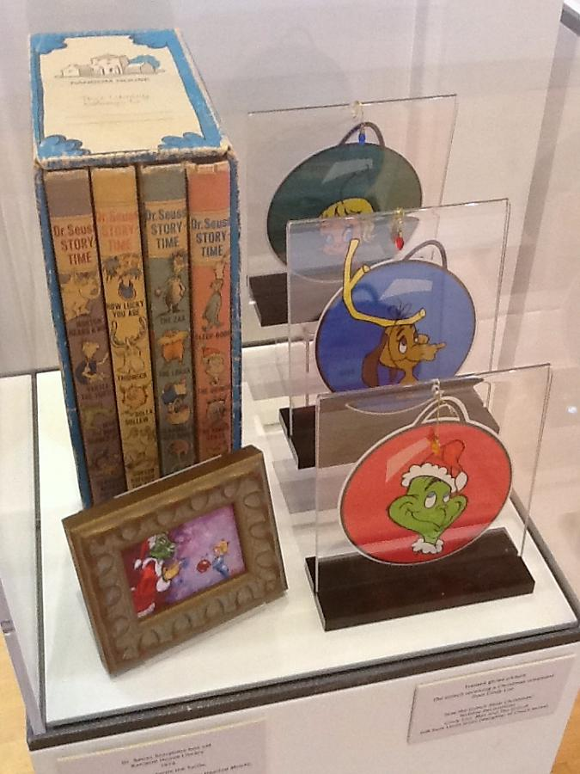
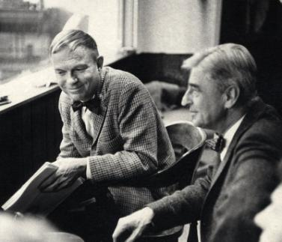
Chuck Jones and Dr. Seuss
How the Grinch Stole Christmas!
Book: Random House Books, 1957
By Dr. Seuss
Animated film,1966
Directors: Chuck Jones & Ben Washam
The Cat in the Hat Productions & MGM Television
Cast: Boris Karloff as the voice of the Grinch & Narrator
Awards: Won a Grammy for Best Recording for Children.

Slide 13
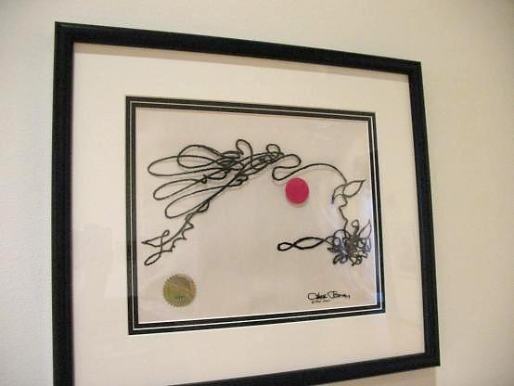
The Dot and the Line: A Romance in Lower Mathematics
Book
Chronicle Books, 1963
By Norton Juster
Animated film, 1965
Directors: Chuck Jones & Maurice Noble
MGM
Robert Morley, narrator
Won an Oscar for Best Short Subject, Cartoons.
Photo: production cel from the film.

Slide 14
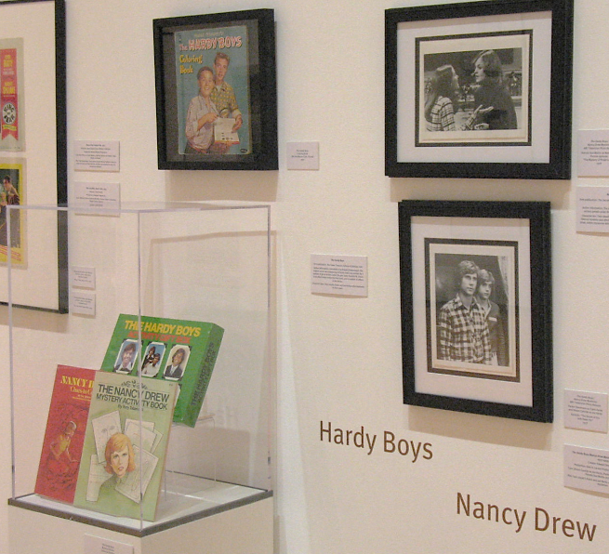
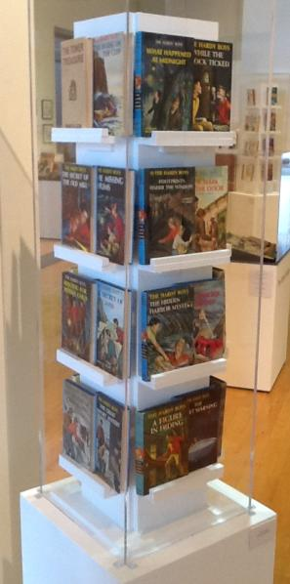
Collectibles from TV series: The Hardy Boys/Nancy Drew Mysteries, 1977-1979
Cast: Shaun Cassidy as Joe Hardy, Parker Stevenson as Frank Hardy & Pamela Sue Martin as Nancy Drew.
The Hardy Boys
First publication: The Tower Treasure, Grosset & Dunlap, 1927
66 books in series, written by a number of ghost writers under the pen name Franklin W. Dixon. Teen sleuths Frank and Joe Hardy solve mysteries.
Nancy Drew
First publication: The Secret of the Old Clock, Grosset & Dunlap, 1930. 56 stories were written by various people under the pseudonym of Carolyn Keene. Teen sleuth Nancy Drew solves mysteries with various friends.

Slide 15
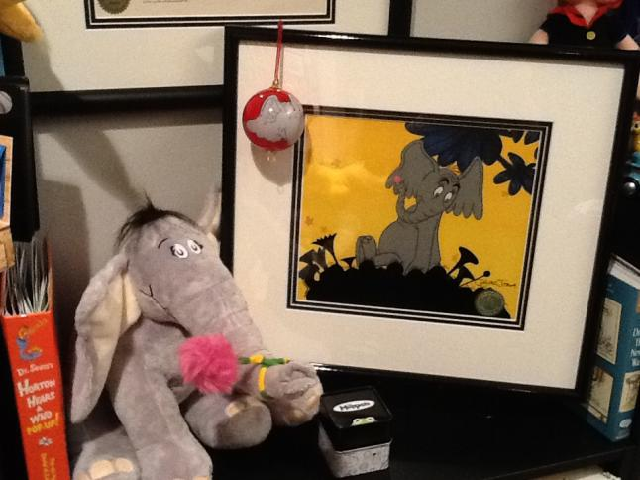
Horton Hears a Who!
Book: Random House Books, 1954
By Dr. Seuss
Animated film,1970
Directors: Chuck Jones and Ben Washam
The Cat in the Hat Productions and MGM Television
Animated film, 2008
Directors: Jimmy Hayward and Steve Martino
Blue Sky Studios, Twentieth Century Fox Animation, Twentieth Century Fox

Slide 16
Thank you! Dr. Lawrence and Holley Thompson, APS, Tempe Center for the Arts Foundation, Tempe Public Library, Chuck Jones Center for Creativity, Arizona Museum of Natural History in Mesa, Arizona Historical Society/Southern Division in Tucson, Old Tucson, The Library of Congress in Washington, DC, Rolf Brown, artist Chris Gall and DreamWorks Animation.

