Slide 1
COPPER
A Marvelous Metal
by Mary Erickson, Ph.D. and Ellen Meissinger

Slide 2
Commonly know as The Copper State, Arizona is the largest copper producing state in the United States. The copper-colored star in the center of its flag symbolizes the metal’s importance to the state.

Slide 3
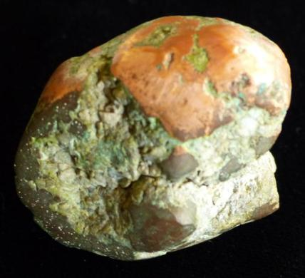
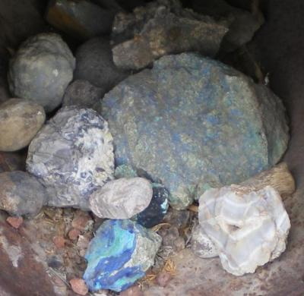
Sometimes copper is found surrounded by rock or in nuggets. Copper is also found combined with other elements in copper ore. Heat and acids are used to separate the copper from the ore.
Copper in rock Copper Ore

Slide 4
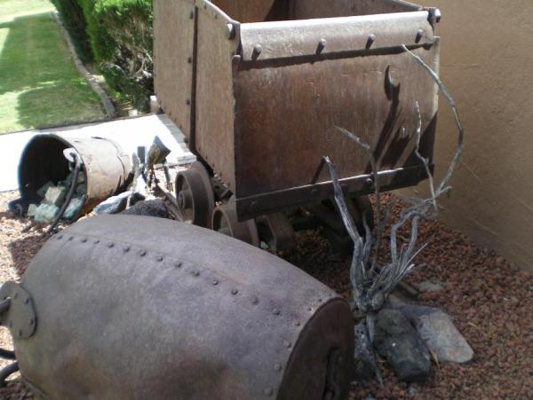
In Arizona’s historic copper towns, like Bagdad, Jerome and Bisbee, miners labored underground in mines to bring ore to the surface in cars and buckets like these.

Slide 5
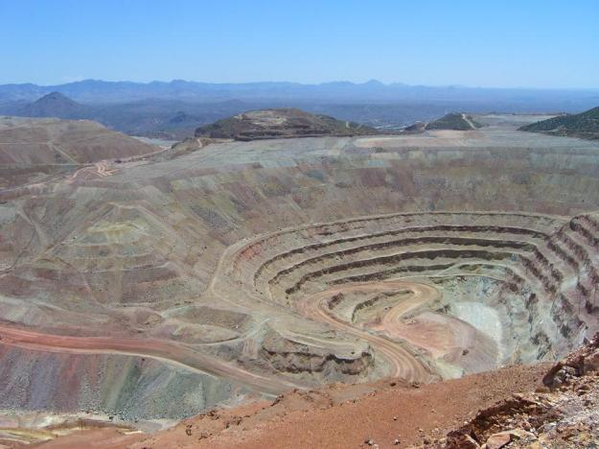
Today, copper ore comes from huge open-pit mines.
The Morenci mine, in southeastern Arizona, is expected to produce approximately 225 million pounds of copper in 2014.

Slide 6
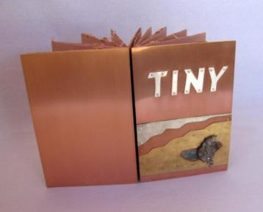
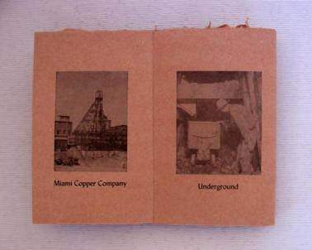
The history of copper inspired artist Karla Elling to make this book with its shiny copper covers.

Slide 7
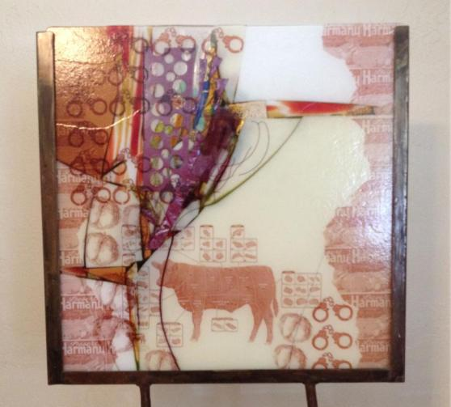
Troy Moody incorporated copper, cattle and citrus, three of Arizona’s three “Cs” in this work.
He used glass, iron, and copper to make Desert Harmonies #1.

Slide 8
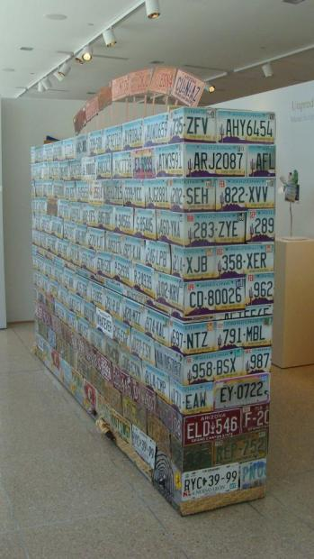
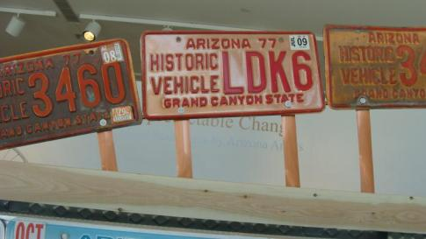
Jose A. Benavides built his artwork from Arizona license plates crowned with copper antique car plates.

Slide 9
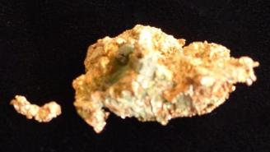
Metal working changed human
history, and it all began with copper.
During the Stone Age, people made tools from stones.
Later, people made rather soft metal tools of copper.
In the Bronze Age, they learned to smelt (heat) copper and tin together to make bronze, which is harder than copper.
Much later, in the Iron Age, people invented a way to raise temperatures even higher to extract iron from iron ore, which is even harder than bronze.
Today steel is made by combining carbon with iron.

Slide 10
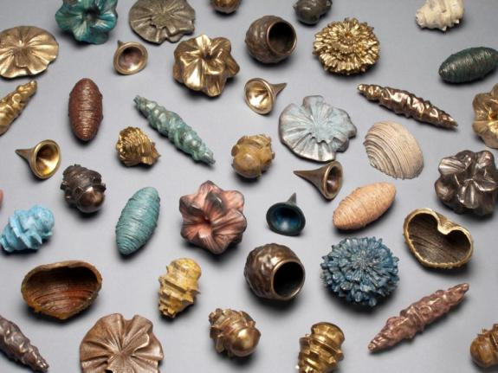
Mary Bates Neubauer’s work bridges the millennia.
She uses a computer to generate forms based on data from the environment.
She casts her pieces in copper, bronze and iron.

Slide 11
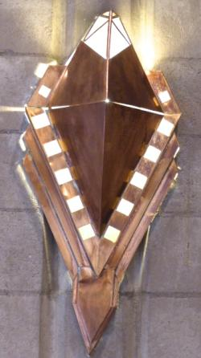
Copper has been important to people for thousands of years, and still is today. It is valuable not only for its practical uses but also for artistic qualities.
Copper is malleable.
Copper is ductile
Copper is a good conductor.
Copper produces rich colors.
Wall-mounted light fixture

Slide 12
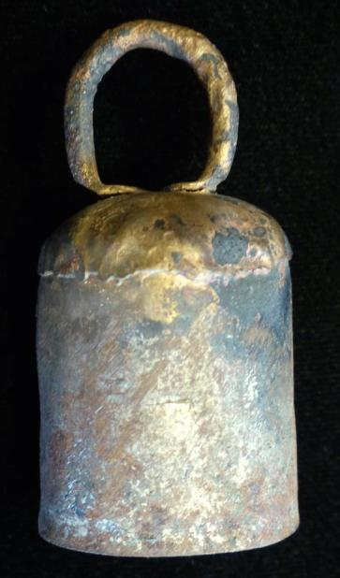
Most metals are malleable, which means you can hammer or press them to change their shape without breaking or cracking them.
Because copper is relatively soft, it is easier to shape than harder metals.

Slide 13
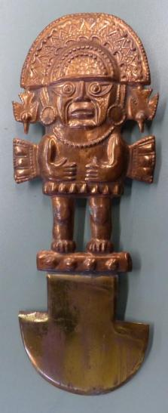
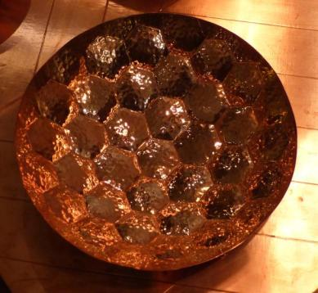
Both these objects were shaped from copper.
Which shows hammer marks?
Which was pressed into a mold?

Slide 14
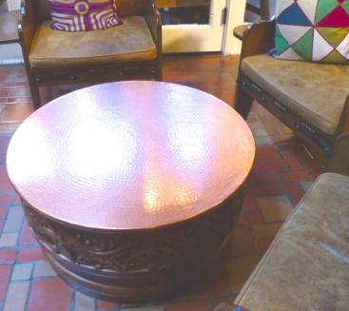
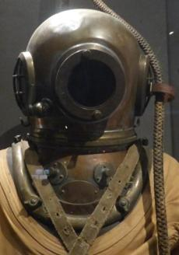
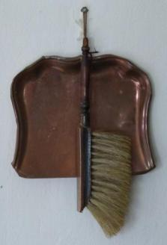
All sorts of things have been formed from copper such as the examples below: coffee table, diving helmet and dust pans.

Slide 15
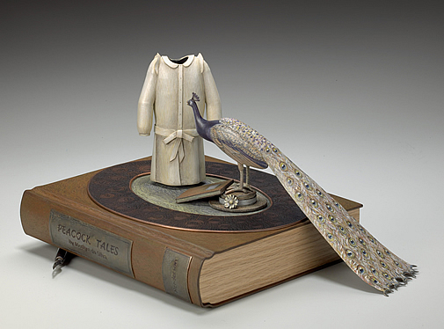
Marilyn Da Silva hammered petal-like copper shapes to make this piece, which she then coated and added detail with colored pencils.

Slide 16
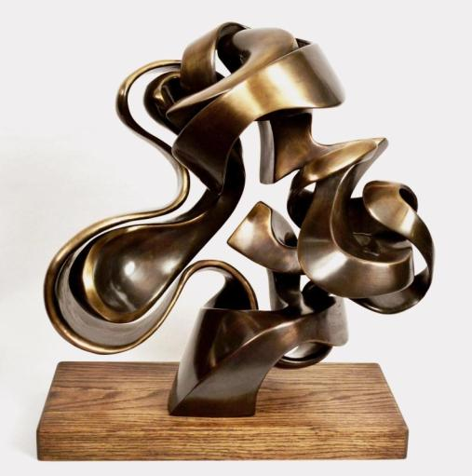
Perrin Gilbert’s Inside and Out is made of bronze, an alloy (mixture) of copper
and tin.
Because bronze is harder than copper and not as malleable, his sculpture will hold its shape over time.

Slide 17
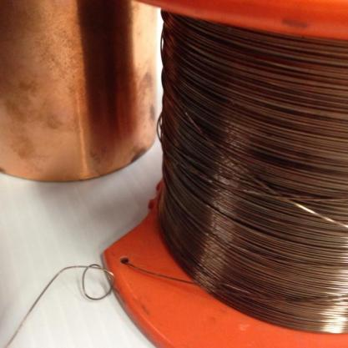
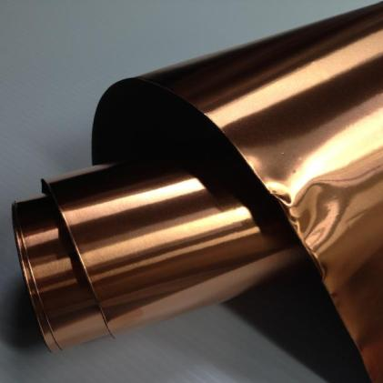
Copper is ductile, which means it can be rolled into sheets or drawn (or extruded) into wires of various widths or thicknesses.

Slide 18
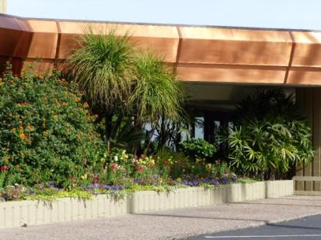
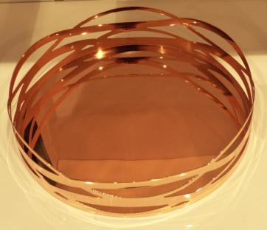
This roof edging and tray began as copper sheets.
Which had holes cut through the sheet?
Which sheet was bent at angles?

Slide 19
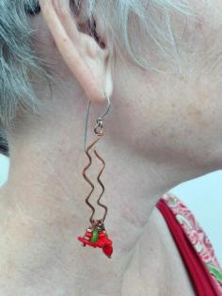
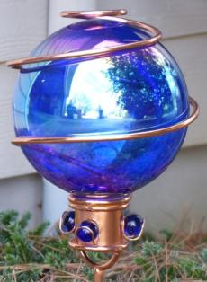
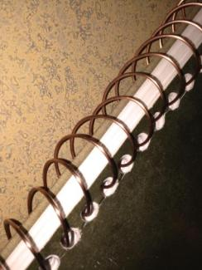
Copper wire was used to make all of these objects.
Which were meant to be practical?
Which were meant to be visually interesting?

Slide 20
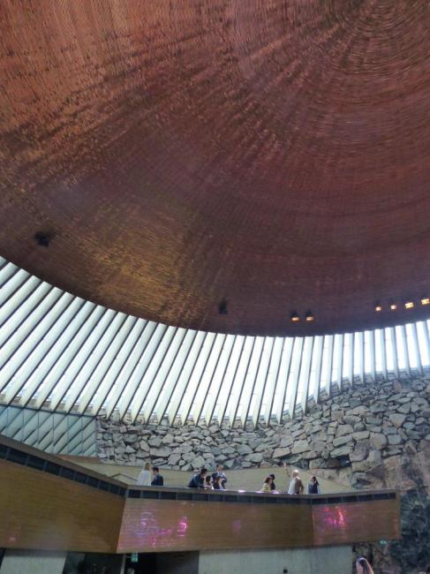
The roof of this church was made of 14 miles of copper wire!
By Timo and Tuomo Suomalainen, 1969
Temppeliaukio Church, Helsinki, Finland

Slide 21
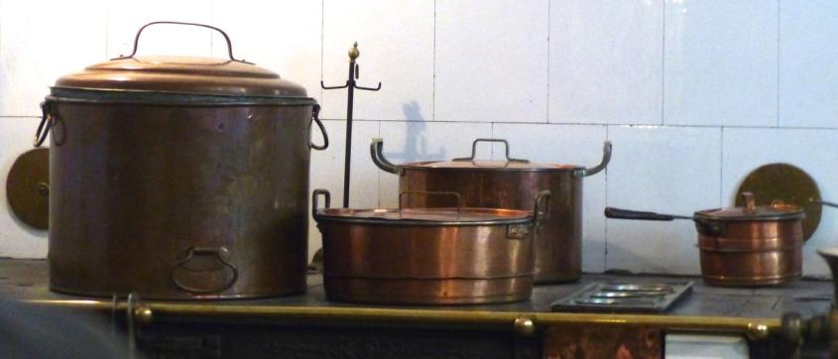
Besides being malleable and ductile, copper is a great conductor.
A material that is a good heat conductor allows heat to transfer easily through it. That’s why many cooks like copper pots.

Slide 22
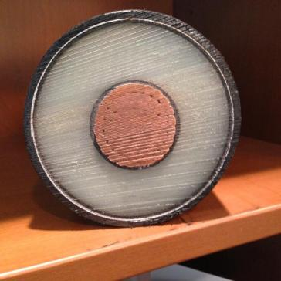
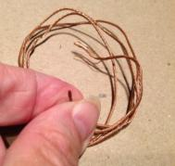
Copper is also a very good conductor of electricity. Electrical cords are made of twisted copper strands covered with insulation to keep the electricity from flowing into us we touch them.
Large gauge insulated copper cable with 230,000 volt capacity. A single strand in the cable is much larger than all seven strands in the household wire.
Small gauge household
electrical wire.

Slide 23
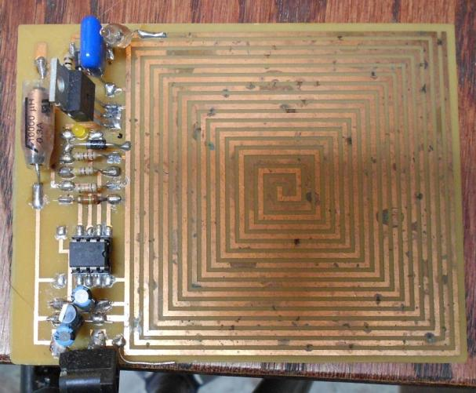
Computer circuits direct electrical energy, so they are sometimes made of copper.

Slide 24
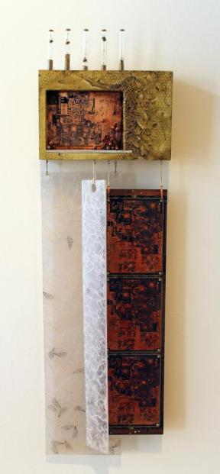
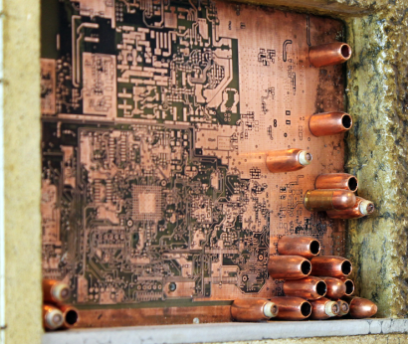
Artist Christine Cassano incorporated a printed copper circuit board in “Drone,” an artwork about complex natural and industrial systems.

Slide 25
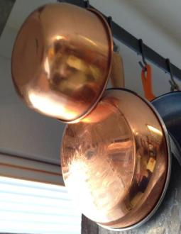
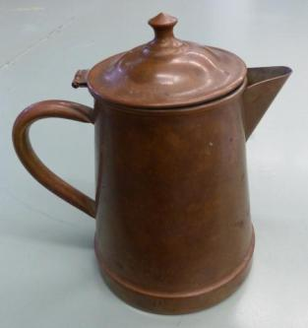
All 91 metal elements are gray or silver except copper, gold and two others (caesium and osmium).
Artists appreciate copper’s many colors. It starts out a beautiful, shiny, orange-ish color and tarnishes over time.

Slide 26
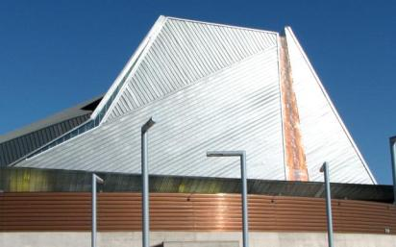
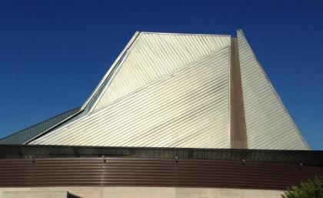
A thin, rich brown layer of tarnish forms when copper interacts with oxygen in the air. Tarnish protects the surface and can be removed by polishing.
Can you see how the copper ring around the Tempe Center for the Arts has tarnished from 2007 to 2014?

Slide 27
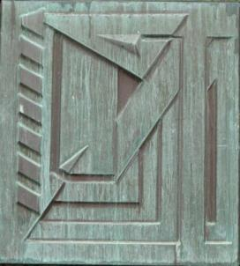
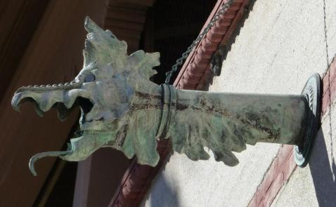
Over many years, through the slow interaction of copper with carbon dioxide and water, tarnished copper turns green. This green surface is called a patina.
Detail from the Price Tower, by Frank Lloyd Wright, Bartlesville, OK
Gargoyle from Ponce de Leon Hotel, Saint Augustine, FL

Slide 28
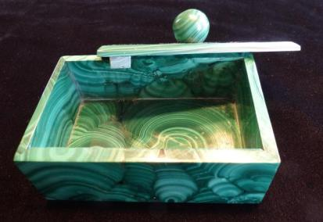
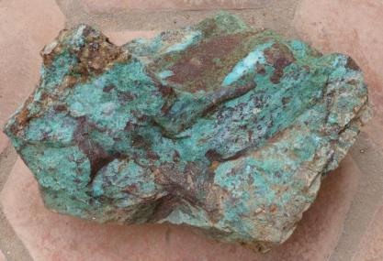
Copper within stone can make that stone greenish or bluish as it does in these. Copper is used to make some green paints.
Malachite
Chrysocolla
Turquoise

Slide 29
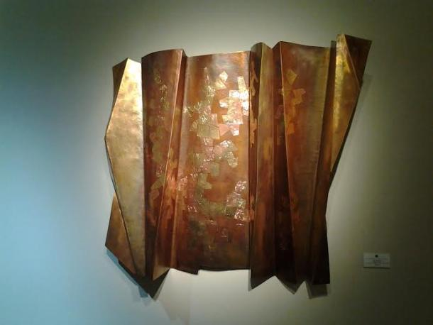
Artist Thomas Roy Markusen says that he is fascinated by copper’s “diverse palette of colors.”

Slide 30
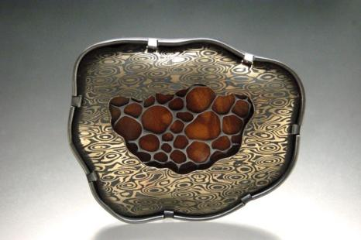
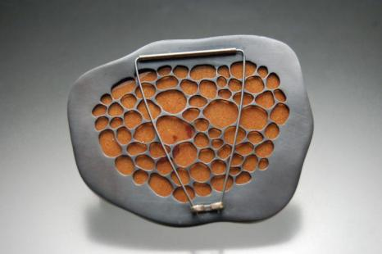
Michelle Startzman’s brooch showcases copper’s rich colors by nestling copper within other metals.
front
back

Slide 31
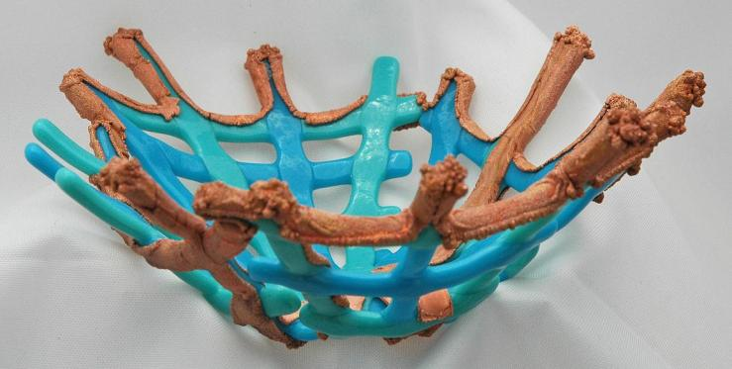
Jackie Kahn chose blue and green glass to “resemble the natural turquoise found in the copper mines of Arizona.”
Then she used acid and an electrical current to transform copper foil into a layer of tiny orange beads.

Slide 32
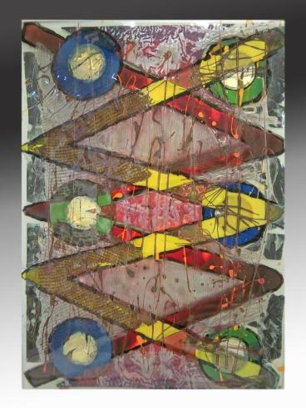
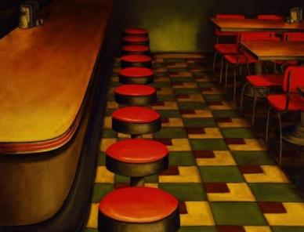
Visit the Biennial Copper exhibitions at Tempe Center for the Arts to see artworks made of, made with, or inspired by, that marvelous metal – copper.
Red Rohall Copperville Café oil on canvas
Tom Philabaum Wisconsin Sideways, glass on panel

