Slide 1
A Penny
for your thoughts
by Mary Erickson, Ph.D. and Ellen Meissinger

Slide 2
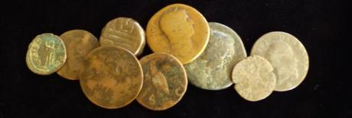
Long ago, people traded for things they wanted. For example, one person might trade animal skins for sacks of grain, or, as the story goes, beads for Manhattan Island. Metal coins were invented to be exchanged for a standard value.
Do you have any coins with you in your pocket or purse?
How many different metals are your coins made from?

Slide 3
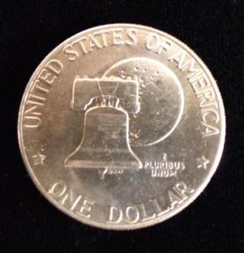
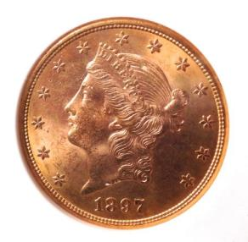
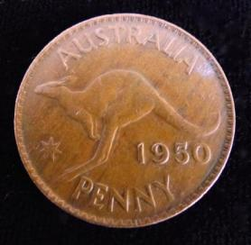
Through the years, coins have been made from precious metals like gold and silver, as well as the less precious metal, copper.
Which coin do you think is gold? silver? copper?

Slide 4
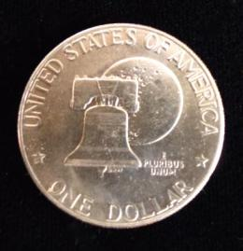
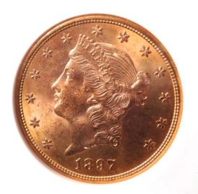
Each coin is marked with a monetary value: the silver coin stands for one US dollar, the gold coin for twenty U.S. dollars, and the copper coin for one Australian penny.
The metal in each coin also has a value. The $20 coin is worth its weight in gold (over $1000 dollars). The silver in the $1 coin is worth much less and the copper in the penny is worth just a few cents.

Slide 5
Coins have monetary value and value as metal, but also are expressions of value. That is, they show people, places, events and ideas that are valuable to the countries that mint (make) them.
What scientific event does the $1 coin commemorate?
What idea does the lady on the $20 coin honor?
What national symbol does the penny celebrate?

Slide 6
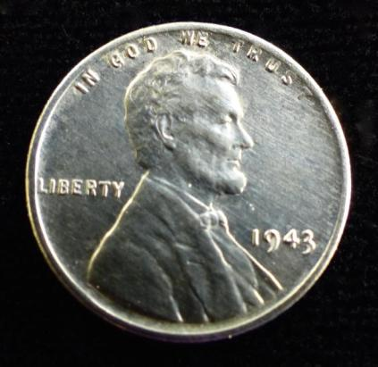
During World War II, the U.S. needed copper for lots of practical purposes, like electrical wiring in airplanes, pipes in ships and to mix with zinc to make brass shells for bullets and other ammunition.
To save copper for the war effort, in 1943, pennies were made from steel and plated with zinc.

Slide 7
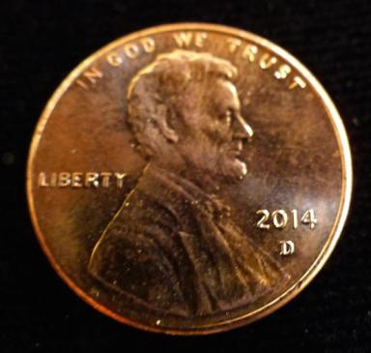
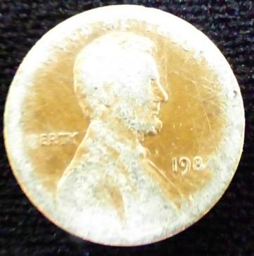
In the early 1980s, the copper needed to make a penny was worth more than a penny. Since 1982, pennies have been made of zinc and plated with copper.
copper-plated zinc penny copper worn off zinc penny

Slide 8
Between 1793 and 1982 (except 1943) all U.S. pennies have been mostly copper.
Brass is an alloy of copper and zinc. Bronze is an alloy of copper and tin.
1855 1914 1943 1945 1956 1964 2002
bronze zinc-plated brass bronze brass copper-plated
steel zinc
The 1855 penny is 100% copper. In 1855 it bought about 25 times more than a penny buys today.
So what do you think a penny is worth?

Slide 9
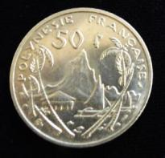
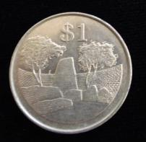
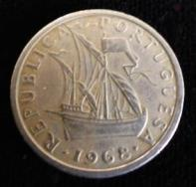
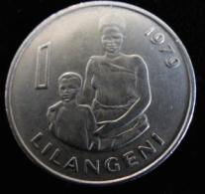
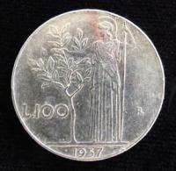
Whatever their metal, and whatever their monetary value, coins are also expressions of the values of the governments that make them.
New Zealand French Polynesia Zimbabwe
Portugal Swaziland Italy

Slide 10
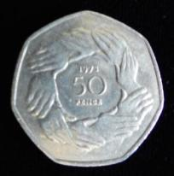
What value do you think might be represented by which coin?
Historic Voyage? Mythology? Cooperation?
Motherhood? Historic Construction? Landscape?

Slide 11
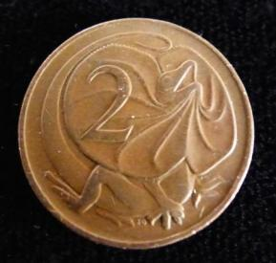
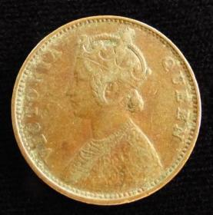
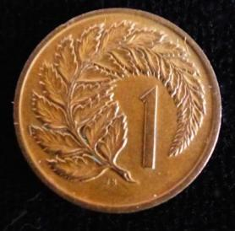
Your challenge is to design a penny that is valuable not as money or as metal, but because of what it expresses.
Design your penny to show something you think is important.

Slide 12
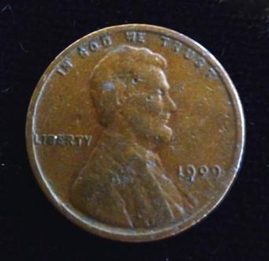
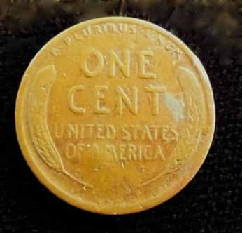
In 1909, Victor David Brenner designed the first U.S. Lincoln penny to honor the 100th anniversary of the birth of Abraham Lincoln. He also designed the wheat on the back side of that penny.
On the 1909 penny, the designer’s initials (V D B) appear in really, really tiny letters on the back, below the wheat just above the rim.

Slide 13
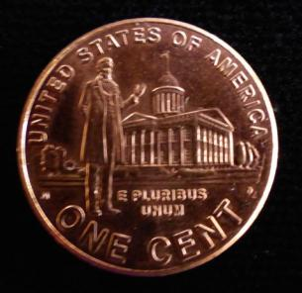
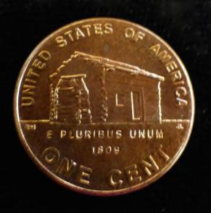
In 2009 a new series of U.S. pennies honored President Lincoln’s 200th anniversary.
What cultural, historical, natural or other value do you think is important enough to honor with your own personal penny design?

Slide 14
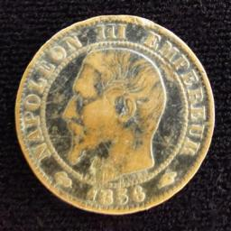
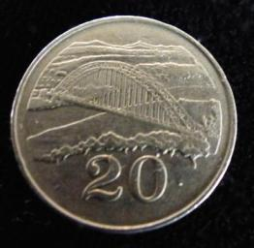
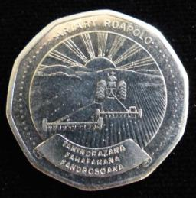
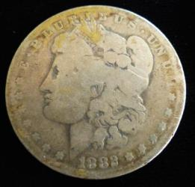
Your value might focus on a person, place, activity or idea, such as these:
Emperor Napoleon of France,
Bridge in Australia,
Agriculture in Madagascar,
Liberty in the United States.
Or will you choose a more personal value?

Slide 15
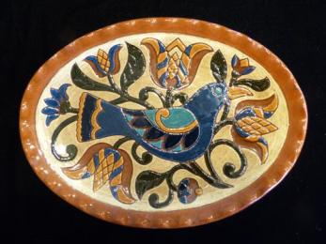
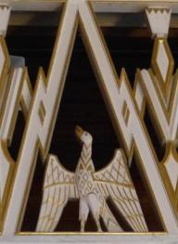
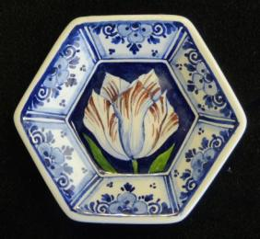
Whatever image you choose for your coin, you will need to consider how it will fit in a coin format.
The people who made these designs organized elements within an oval, a triangle and a hexagon.
Your penny should be designed within a circular format.

Slide 16
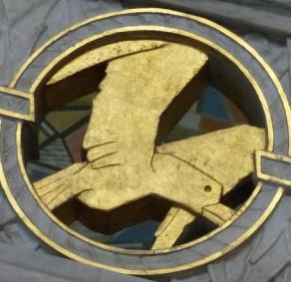
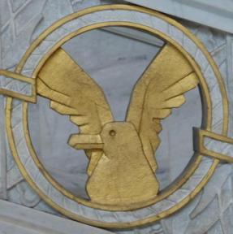
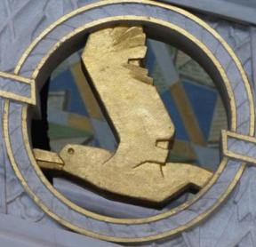
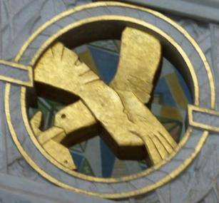
Notice the variety of ways one designer organized shapes in these circles.
Which do you think best shows off the seagull?
Why?

Slide 17
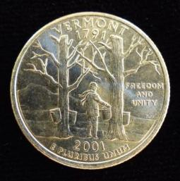
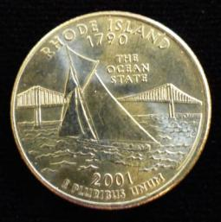
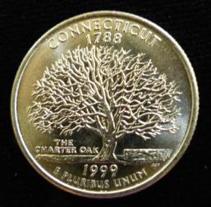
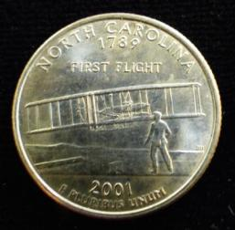
Which design is organized around one central shape?
Which has two balanced verticals?
Which balances a diagonal with a shape in the foreground?
Which has sweeping curves balanced on both sides with more curves?

Slide 18
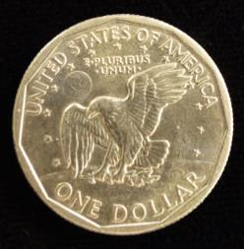
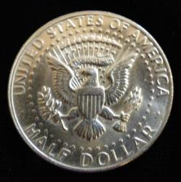
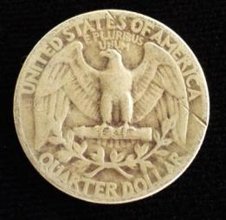
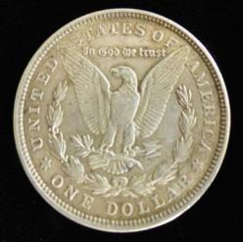
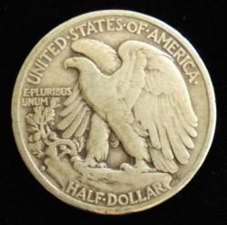
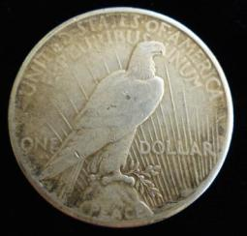
The eagle has been used as a symbol on many U.S. coins. Which design do you think is most effective in a circular format? Why?

Slide 19
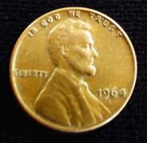
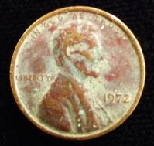
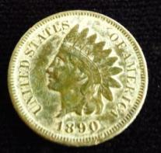
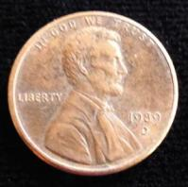
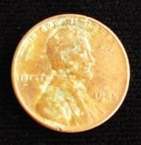
Your challenge is to design your own penny that:
expresses something you value,
is in a circular format, and
uses a range of rich copper colors.
When finished, title your penny and write an artist statement about your design.

