Slide 1
Eco Flags
by Mary Erickson, Ph.D., with Arizona art teacher Susanna Yazzie

Slide 2
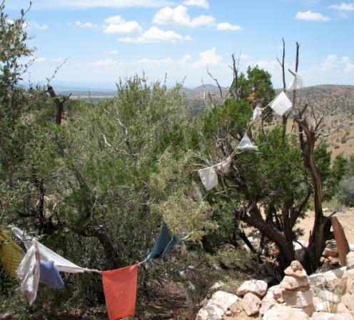
In Tibet, there is an ancient tradition of hanging prayer flags in the wind to spread good will to all.
These flags send their blessings on the winds in northern Arizona.

Slide 3
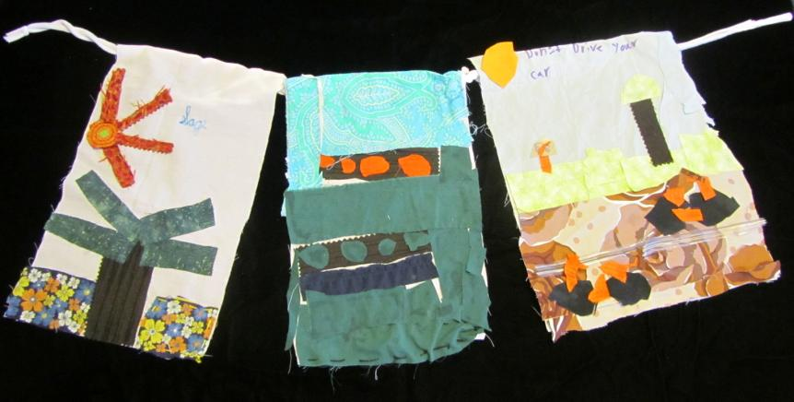
You can make your own Eco Flag that expresses your concern for the environment. Show your concern first by making your flag with recycled cotton cloth made from natural fibers.

Slide 4
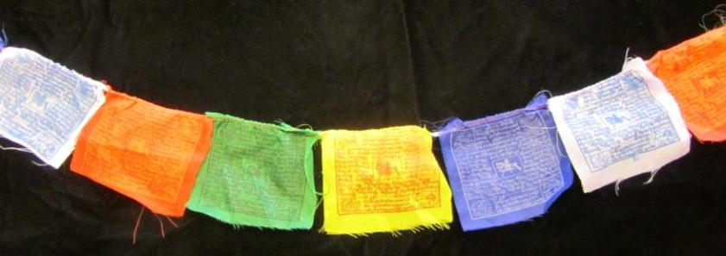
You need these materials to make your Eco Flag.
Paper, pencil & markers
Scissors
Tacky glue
Recycled cotton cloth (large pieces and 2-inch torn strips)
Fabric markers
Tapestry needles & embroidery floss (OPTIONAL)

Slide 5
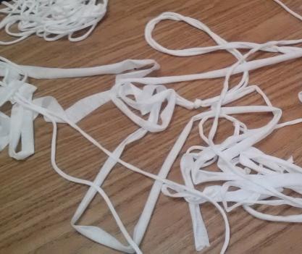
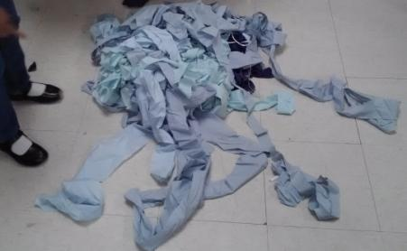
Make a cord to fly your flag using recycled cotton sheets or other fabric torn into strips. If the strip is not long enough you can tie several pieces end to end.

Slide 6
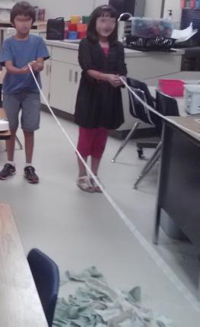
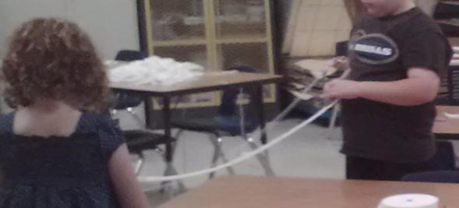
Work with a partner at each end of the strip of fabric.
Twist in opposite directions. (Both twist to the right.)
When the fabric is well twisted, get a friend to grab the middle, while you and your partner hold the fabric tightly and walk to meet up.
When the friend lets go of the middle
the two parts will twist together.

Slide 7
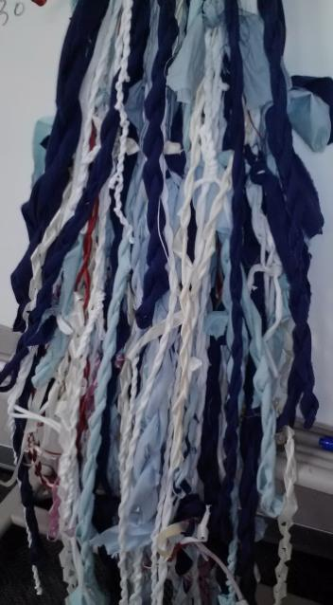
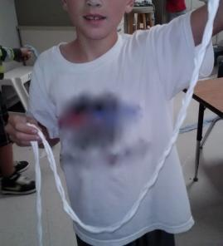
Tie the two ends together with an overhand knot.
Make a loop near the ends and slip the loose ends through the loop. Pull to tighten the knot.

Slide 8
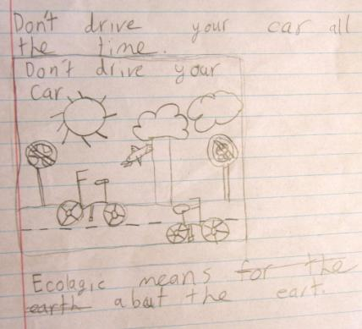
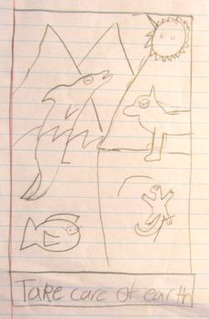
Think about what the word “ecology” means to you.
Then make a drawing that shows that idea.
Which elementary student’s drawing expresses a general idea? Which makes a specific proposal?

Slide 9
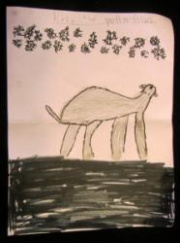
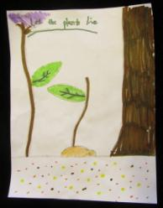
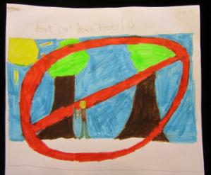
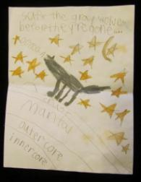
Use markers to color in the shapes in your drawing.
Can you match the idea with the drawing without reading the words?
Don’t cut down trees.
Help the polar bear.
Let the plants live.
Save the gray wolf.

Slide 10
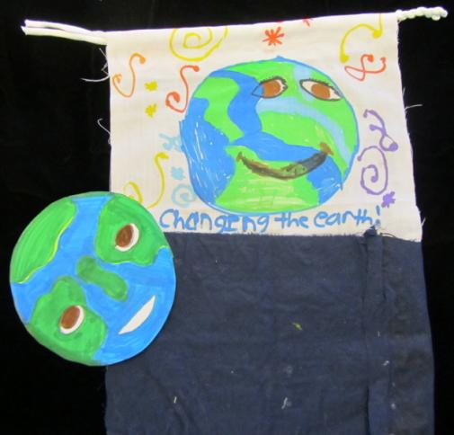
Choose colors of cloth to use in your Eco Flag. Be sure to use some cool colors (blue, green and purple) to symbolize the natural environment.
Cut out shapes from
your drawing.
Trace around the
shapes on the cloth
you have chosen.

Slide 11
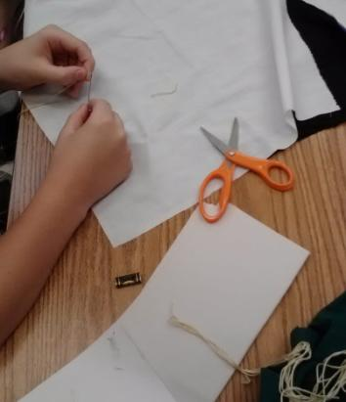
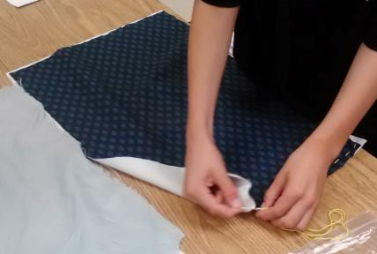
3)
If you choose to sew pieces of cloth together, you need to learn how to 1) thread a needle, 2) work the needle through the cloth smoothly while you hold the pieces in place and 3) tie a knot to secure the thread before cutting it.

Slide 12
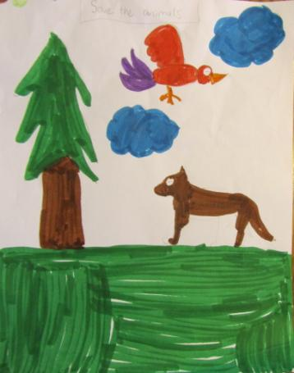
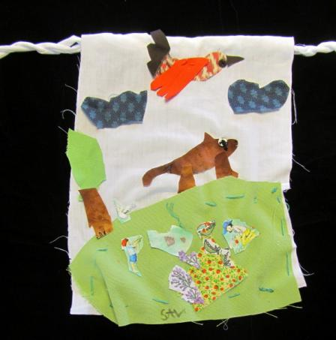
This Eco Flag urges us to “Save the Animals.”
What small details in the drawing were not included in the flag?

Slide 13
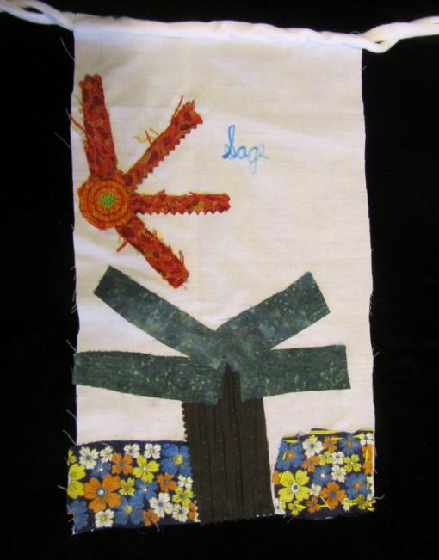
Applique shapes in place on a cloth background.
You can glue them or sew them with a needle and embroidery floss.
Can you see which flowers near the bottom were glued and which were sewn?

Slide 14
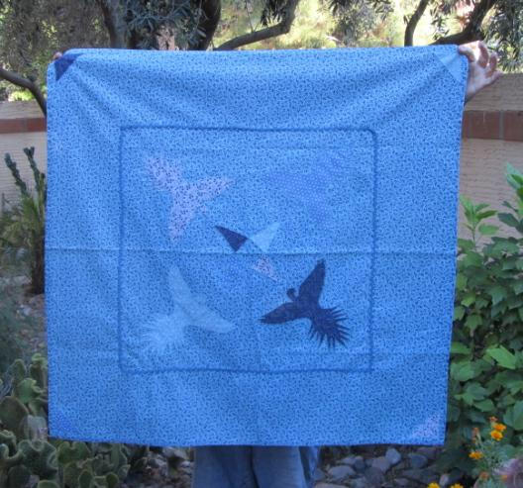
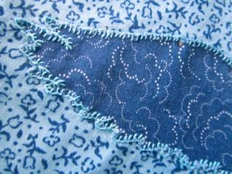
If you practice sewing, you will become more and more skilled. One day, you might be able to applique with small (blanket) stitches. This tablecloth shows birds flying high on a blue sky.
Applique by Lena Hubin

Slide 15
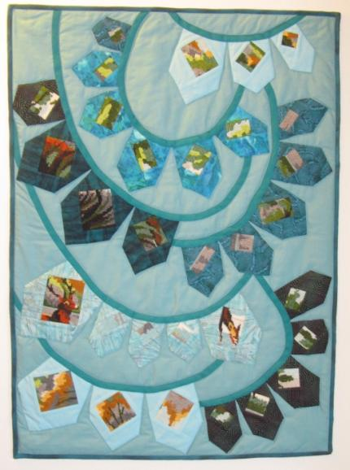
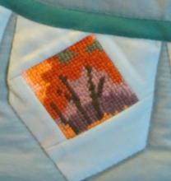
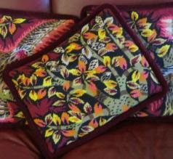
Prayer Flags for the Earth
by Rhoda Imhoff
This small quilt combines
piece work and applique.
The detailed pieces on each flag were cut (recycled) from old needlework pillows.

Slide 16
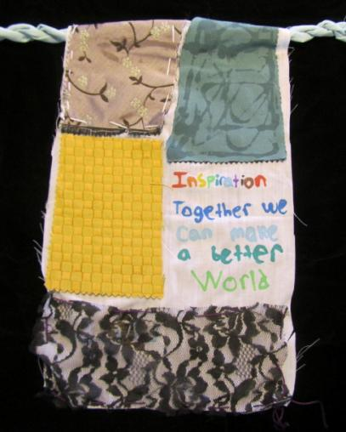
Whether you are a beginner or a skilled artist, you can express your ideas in fiber.
The words on this elementary students’ Eco Flag echo those of Chief Seattle:
“Humankind has not woven the web of life. We are but one thread within it. Whatever we do to the web, we do to ourselves. All things are bound together. All things connect.”

