Slide 1
Getting in Touch with Texture
By Mary Erickson, Ph.D. and Allison Lee, Arizona art teacher

Slide 2
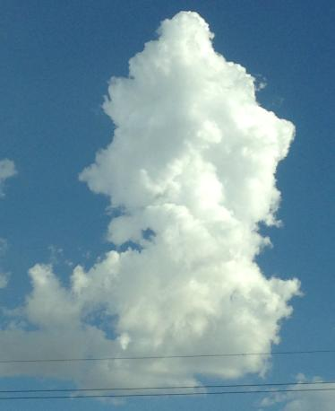
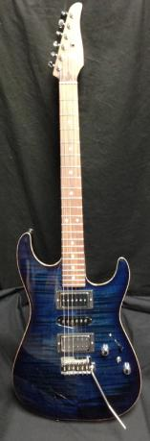
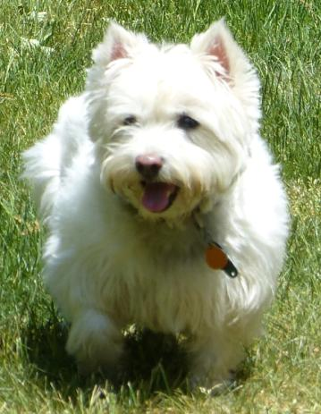
Think back to an enjoyable moment in your past. Can you connect a particular sight, sound or touch to that memory?
Fluffy clouds in a blue sky A favorite song Wet nose of a friendly dog
We experience our world with five senses: sight, hearing, touch and also smell and taste.

Slide 3
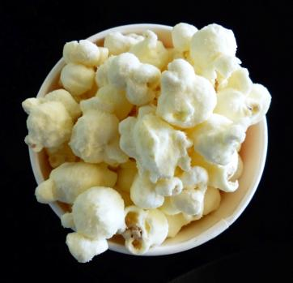
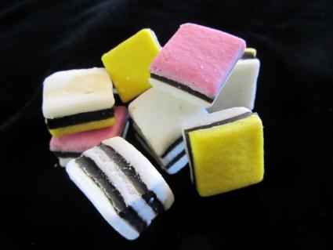
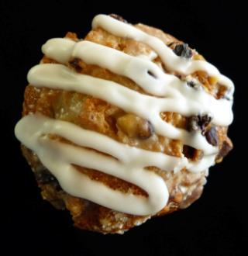
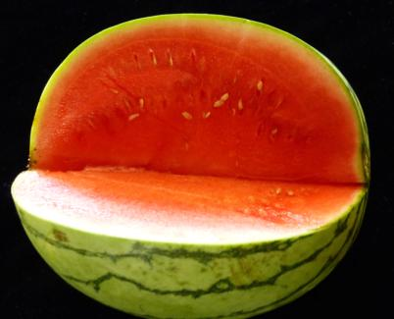
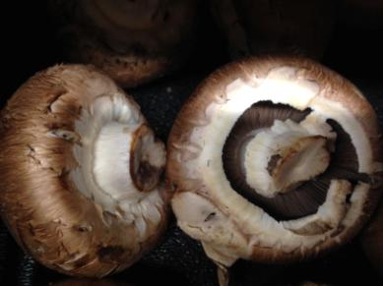
We can experience food with all five of our senses.
Sound of popping corn Taste of candy Smell of hot muffin
Touch of mushrooms Color of watermelon

Slide 4
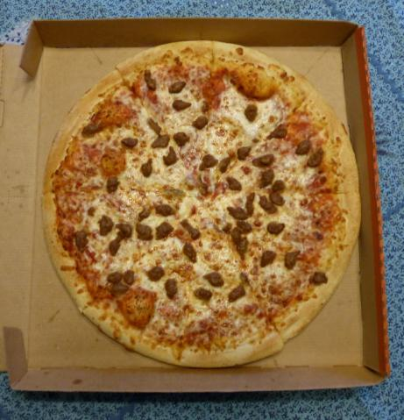
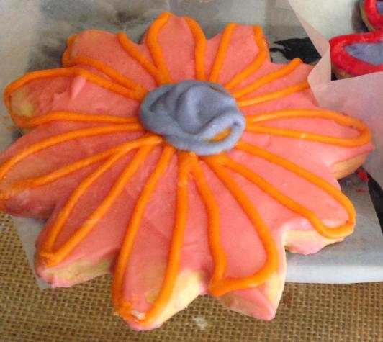
What memories come to you when you eat particular foods?
Does the smell of pizza make you want to curl up on the sofa and watch a movie?
Do frosted cookies remind you of your grandmother?

Slide 5
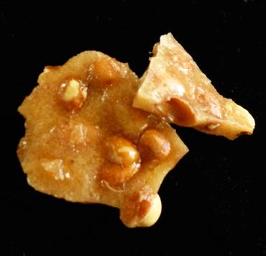
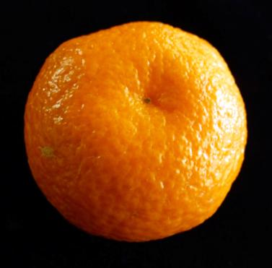
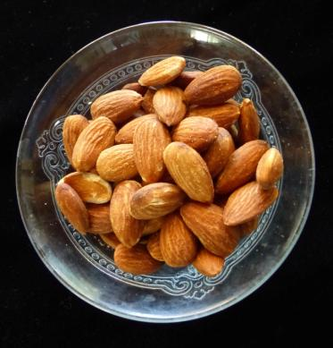
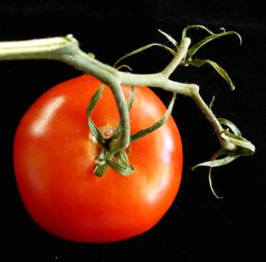
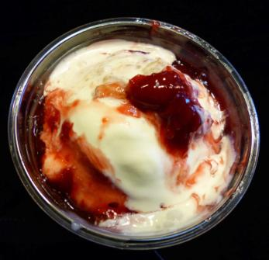
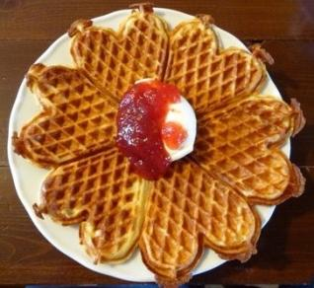
We all eat food. We eat various foods on different occasions. Some foods are personal favorites. Others are family traditions. Are any of these your favorites?

Slide 6
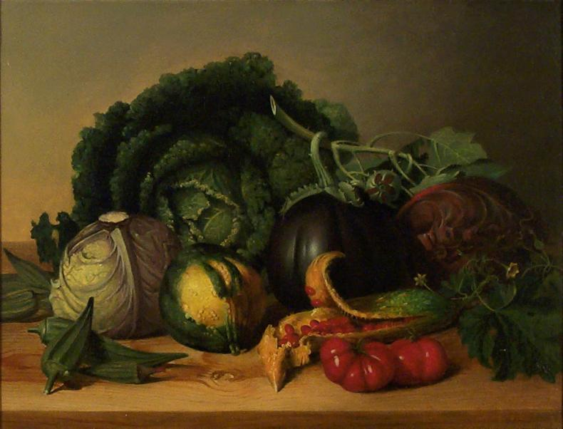
Many artists have used food as subject matter for their art. Peale painted these vegetables about 200 years ago. They are long gone, but the painting preserves their memory even today.
James Peale
Still Life, 1821
oil on canvas,
Collection of Arizona State University Art Museum
Gift of Oliver B. James

Slide 7
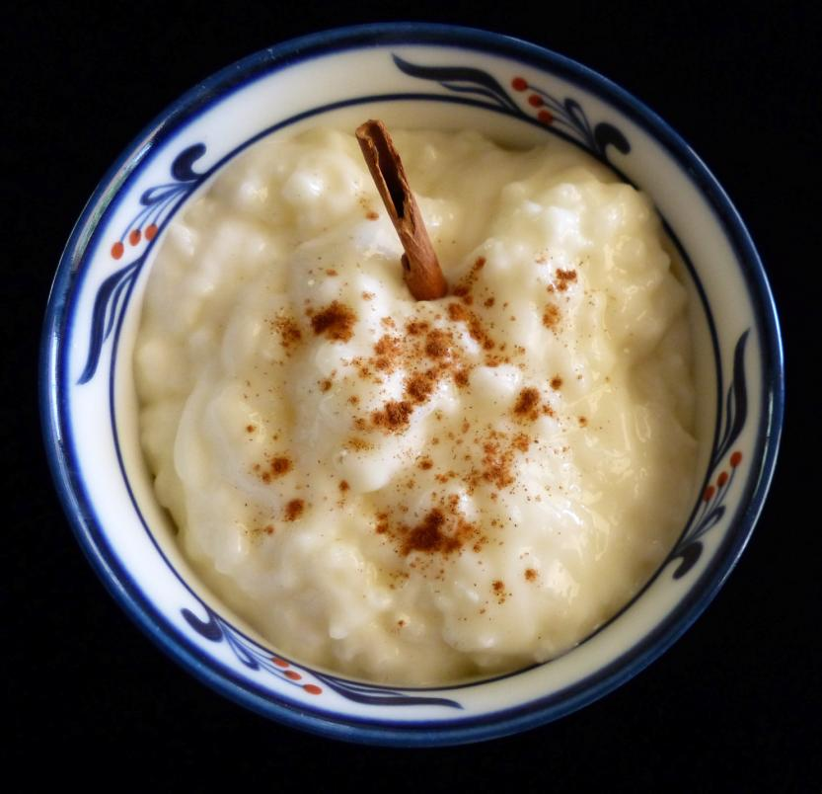
Some foods have special meaning within a culture.
On special occasions in Sweden, the cook hides a cinnamon stick in the rice pudding. Some say the person who gets the stick will marry in the next year.

Slide 8
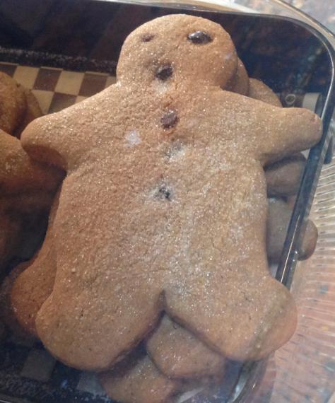
Did you know that gingerbread men have been special in Europe for hundreds of years?
Ginger is grown in southern Asia. Before planes, trains and trucks, it took months, even years, for spices, like ginger and cinnamon, to travel by sailing ships, camels and river boats to Europe.
Gingerbread men are a traditional Christmas treat in Germany.

Slide 9
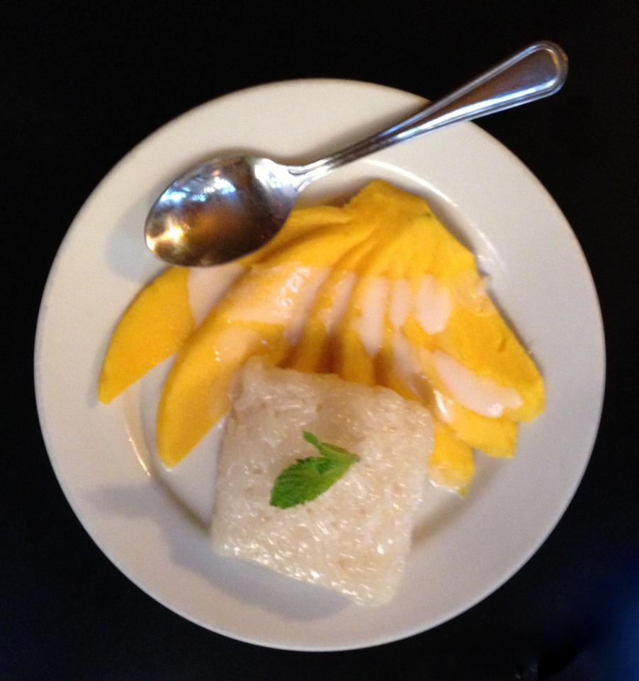
In summer the mangoes are ripe in Thailand.
Mangoes and sticky rice (made with coconut milk) is a traditional summertime treat.

Slide 10
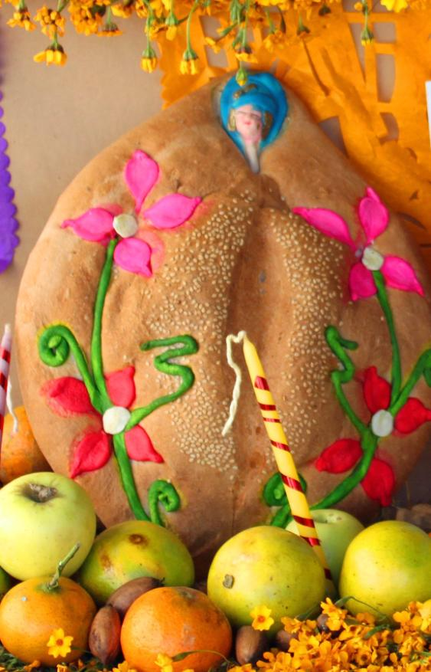
There is a tradition in Mexico around the Day of the Dead to remember people who have died. Some families eat pan de muerto (bread of the dead). Sometimes the bread is dipped in hot chocolate to remember the person who died.

Slide 11
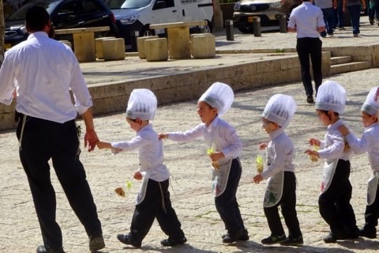
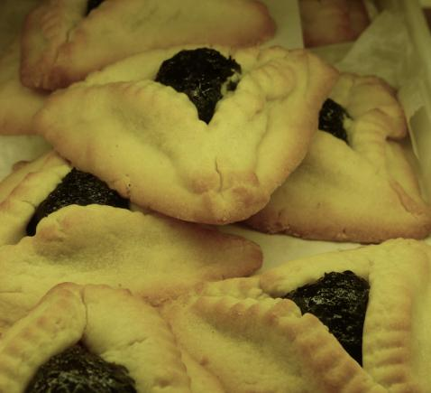
Jewish people have a holiday called Purim. These “Haman Cakes” tell the story about someone trying to unsuccessfully trying to bribe a king with bags of money. The little cakes represent the bags of money.
Israeli boys carrying the cakes (Hamantachen) they made for Purim.

Slide 12
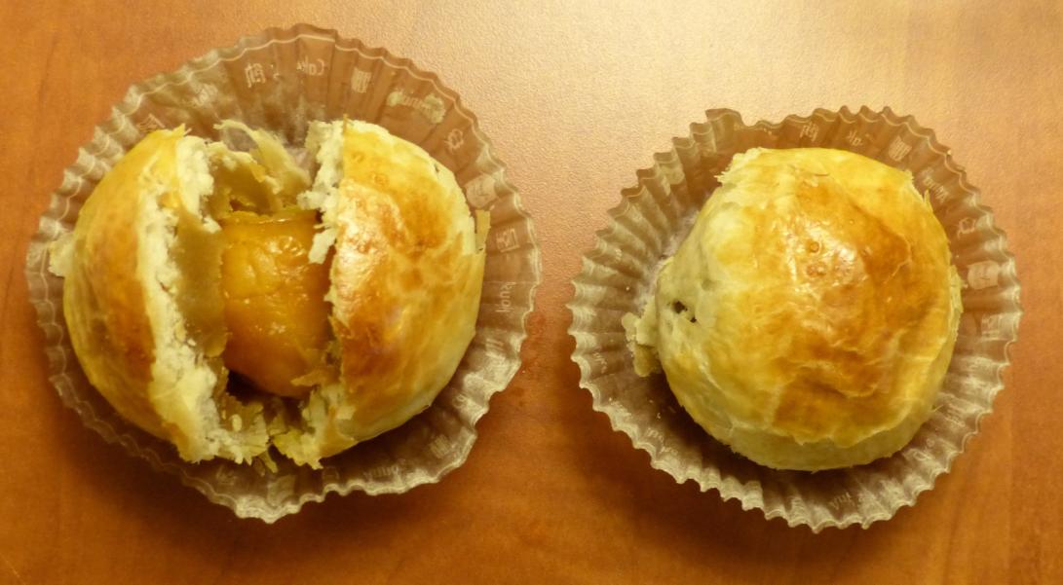
Chinese moon cakes are traditionally eaten to celebrate the Autumn Moon. They are small treats filled with lotus flower paste. In the center is a salted duck egg yolk symbolizing the moon.

Slide 13
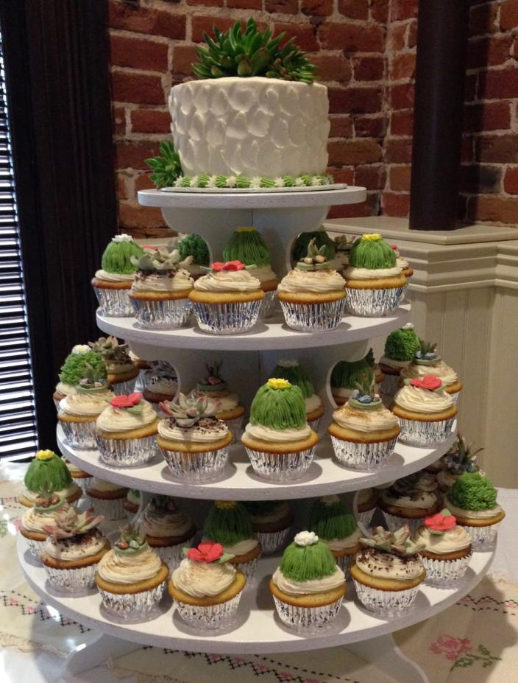
This cupcake cake was made for the wedding of an Arizona couple.
The frosting is formed to look like desert plants.
What special foods does your family and/or culture eat on special occasions?
Creative Cakes & Desserts by Dena
Prescott, Arizona

Slide 14
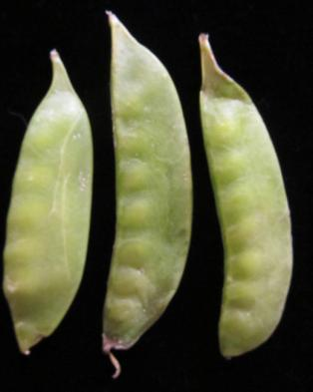
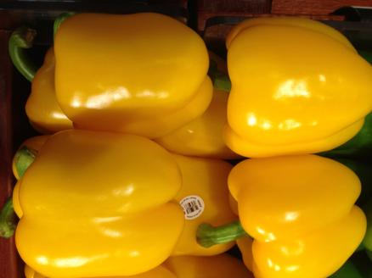
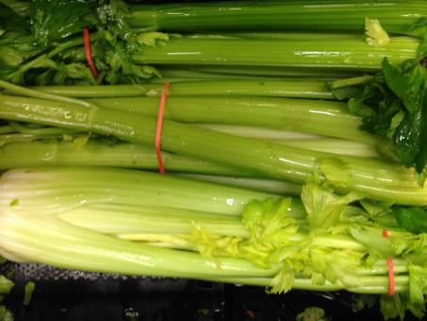
Food has texture you can see without touching.
Peppers Pea pods Celery
Which looks smoothest?
Which has ribs?
Which is the most lumpy?

Slide 15
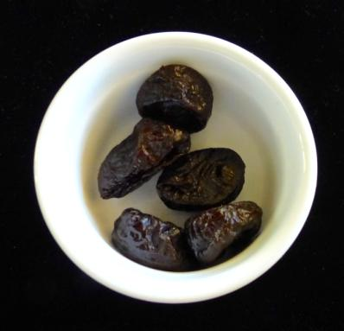
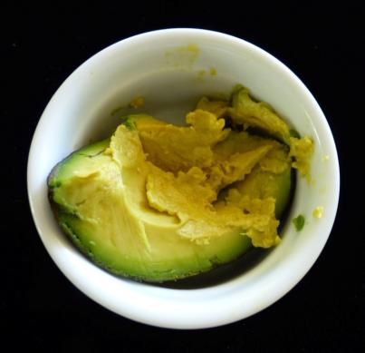
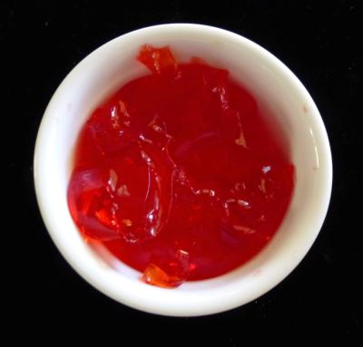
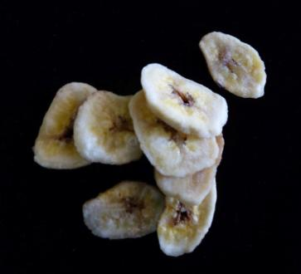
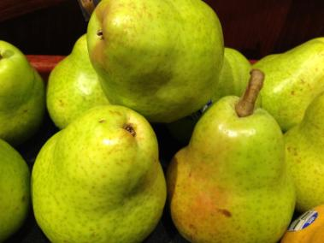
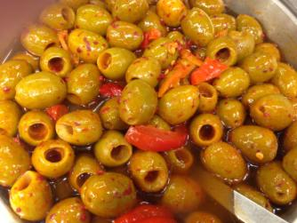
What texture do you see in these foods?
Dried prunes Mashed avocado Gelatin dessert
Pears Banana chips Olives

Slide 16
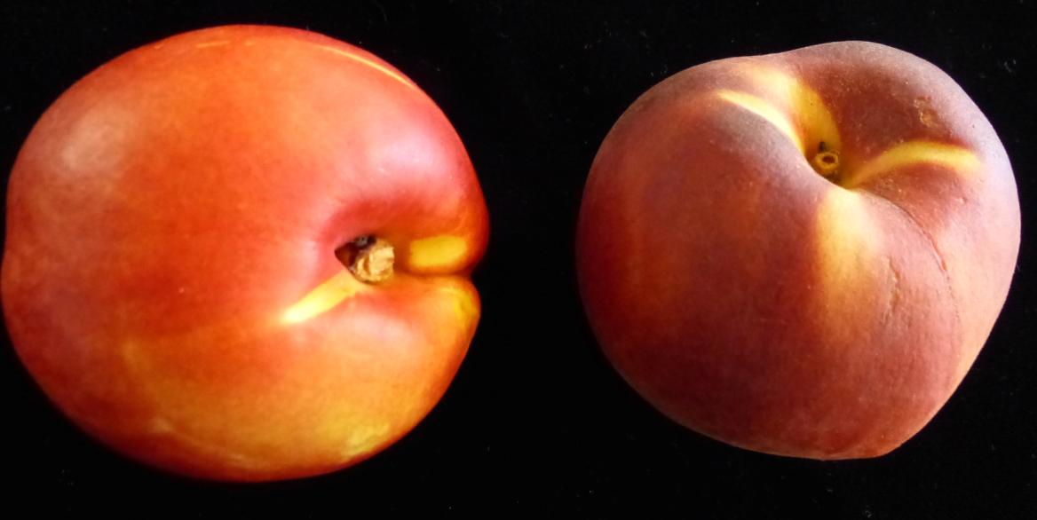
Have you ever compared the feel of the skins of a peach and a nectarine?
Can you tell from this photograph, which is the peach and which is the nectarine?

Slide 17
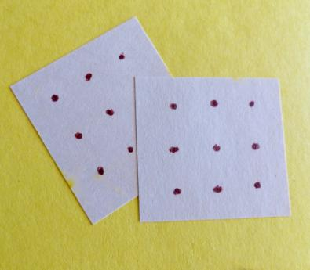
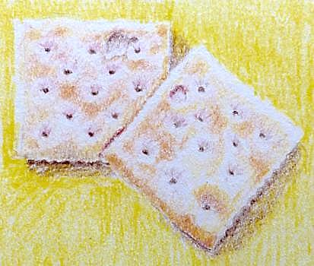
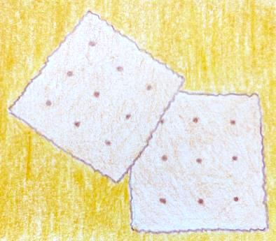
Sometimes food is the subject matter of artworks.
(These are not photographs of actual crackers.) Any texture you see is just an illusion created by the artist. Which has the best illusion of texture?
Left Center Right
Cut paper collage Colored pencil drawing Colored pencil drawing

Slide 18
Compare some of the many textures James Peale shows in his two-dimensional painting.
James
James Peale
Still Life, 1821, oil on canvas
Collection of Arizona State
University Art Museum
Gift of Oliver B. James

Slide 19
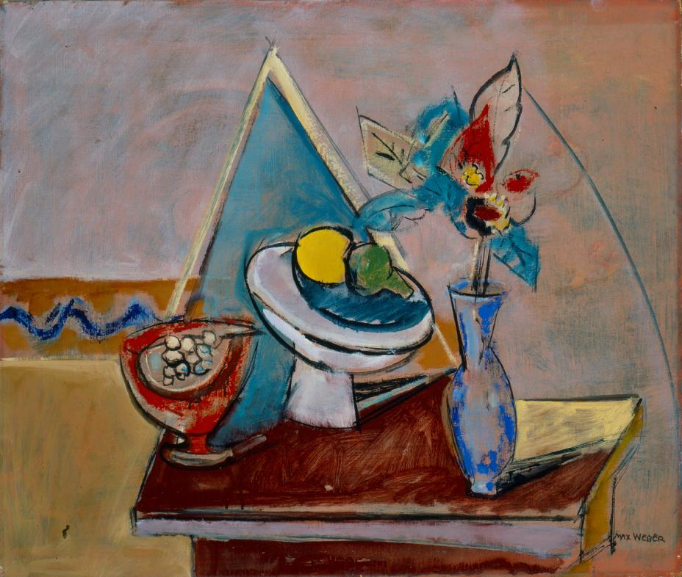
Max Weber painted this Still Life in a very different style over 120 years after James Peale.
Max Weber
Still Life, 1945
Oil on canvas, 22” x 26”
Collection of Arizona State
University Art Museum
Gift of Oliver B. James

Slide 20
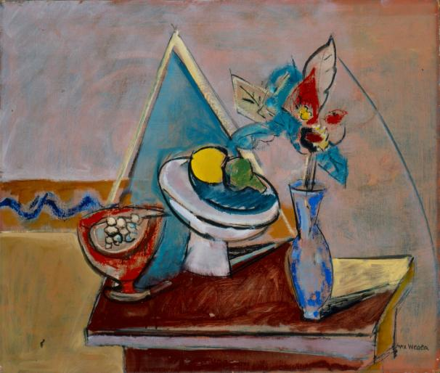
Which artist was most interested in creating an illusion of texture? How can you tell?
James Peale Max Weber
Still Life, 1821, oil on canvas Still Life, 1945, oil on canvas
Collection of Arizona State University Art Museum Collection of Arizona State University Art Museum
Gift of Oliver B. James Gift of Oliver B. James

Slide 21
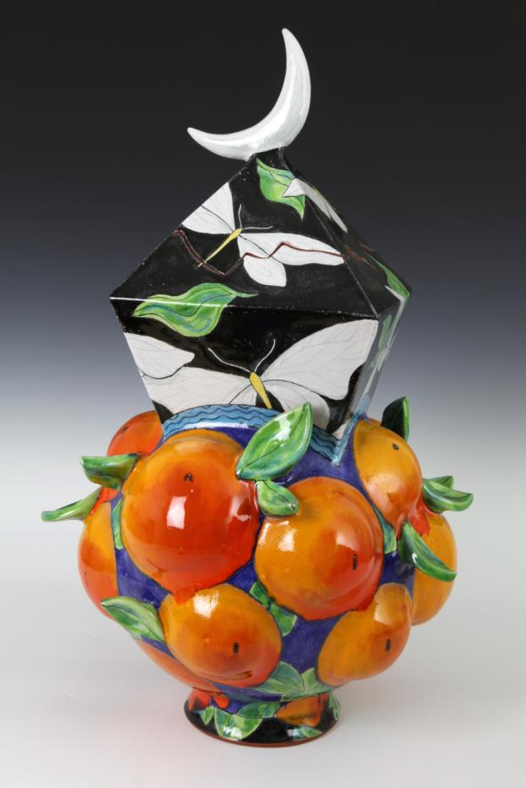
All the artworks we’ve looked at so far are flat, that is, two-dimensional. Sculptors can show food in three-dimensions.
Exhibitions usually do not allow visitors to touch the art. The leaves and oranges in this piece have an actual shiny surface texture. You can see the shiny texture even though you may not touch it with your fingers.
Farraday Newsome, Luminous Night Jar, Ceramic, 2015

Slide 22
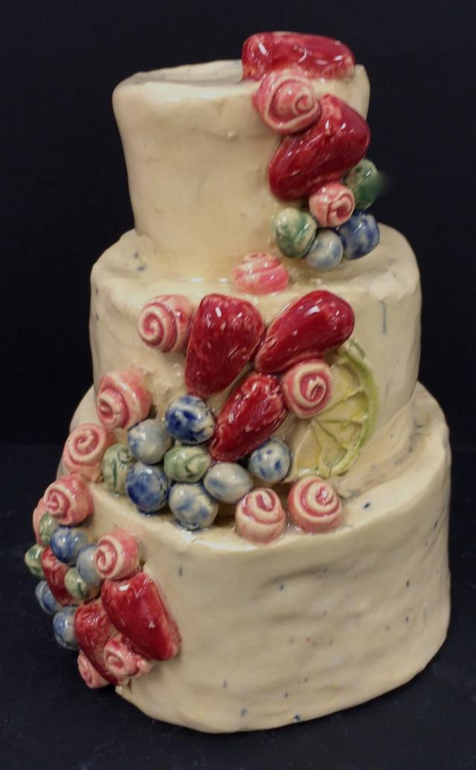
A middle school student made this cake from clay and decorated it with colorful clay fruit.
What textures did the student make to show different fruits?
Where do you think the student might have got the idea for this cake?

Slide 23
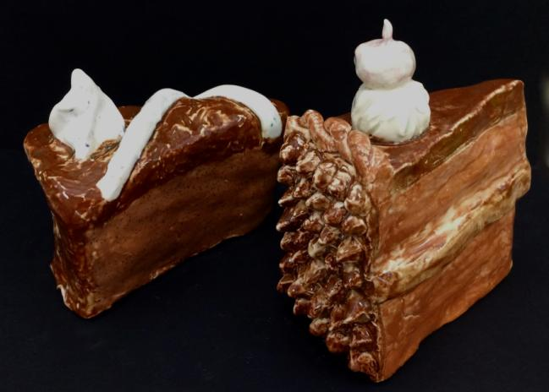
The last lesson in Sweet Memories challenges you to use a dessert as subject matter in your own ceramic artwork.
What treat do you enjoy at home, at school, or at some community or cultural event?

