Slide 1
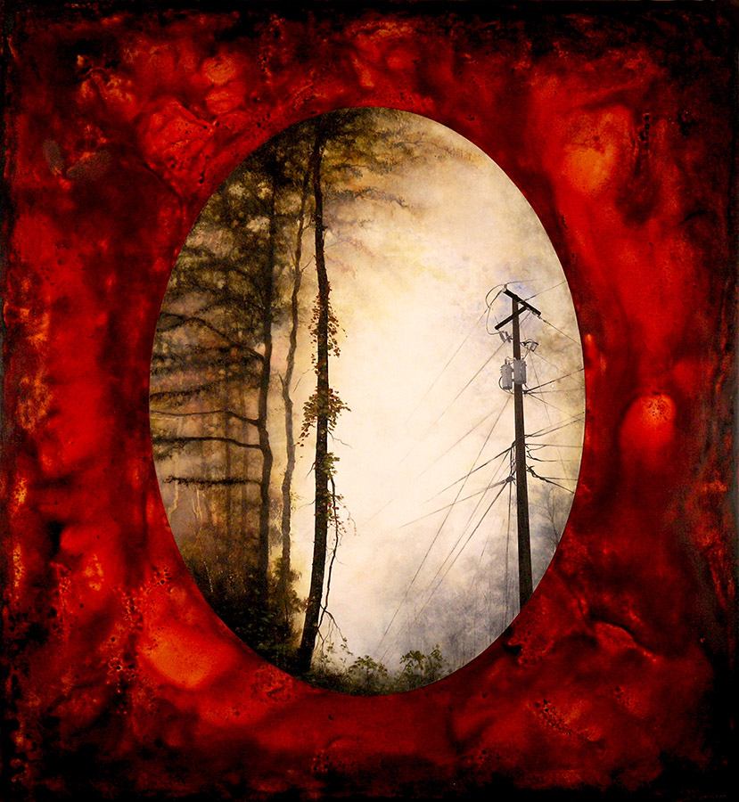
Mixed Structures
in Mixed Media
By Mary Erickson, Ph.D., and Sarah Chelton, Arizona art teacher

Slide 2
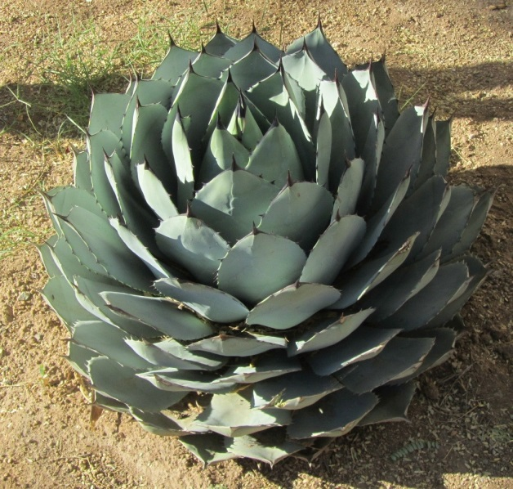
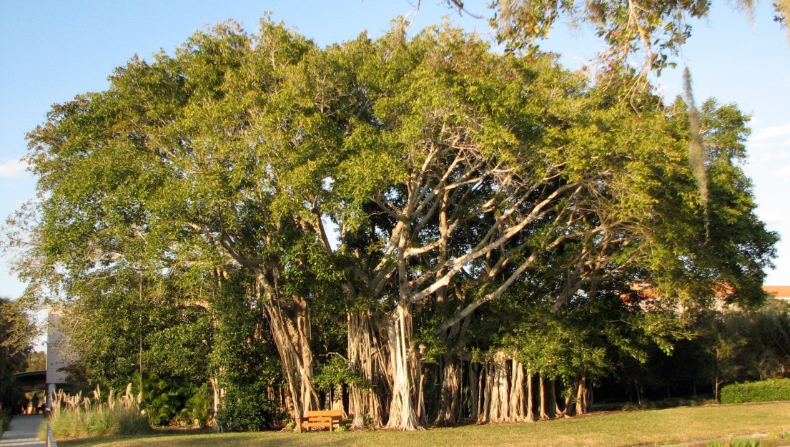
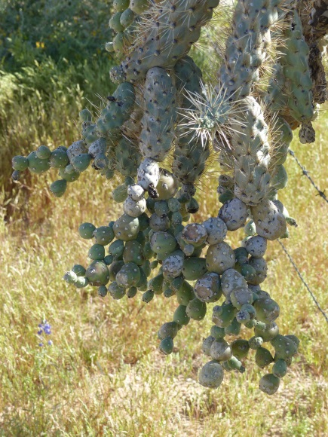
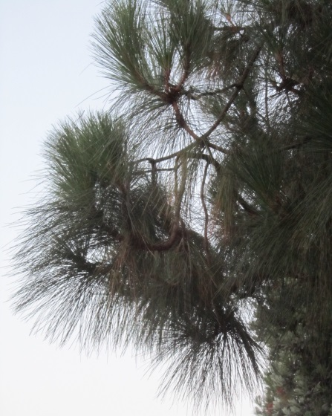
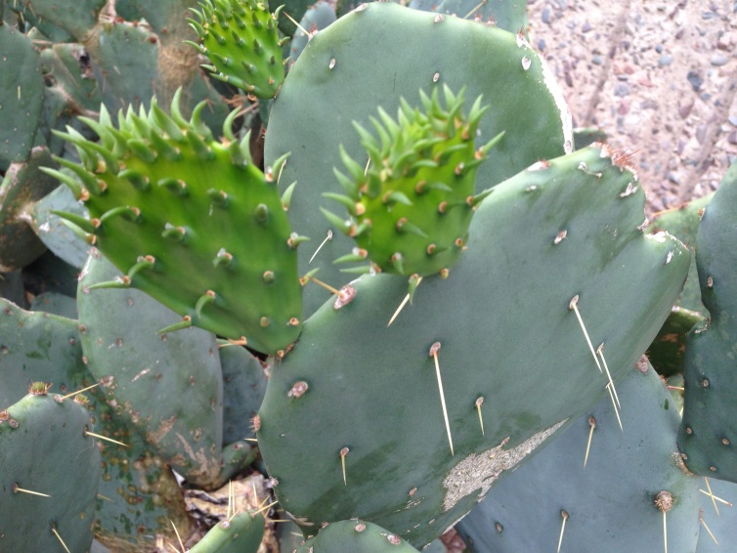
In lesson 1, you examined structures of nature that are often green, like plants, but not always green.

Slide 3
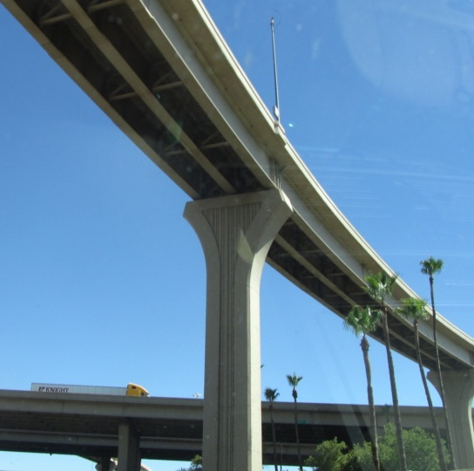
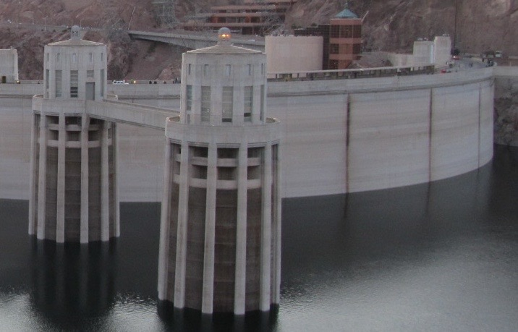
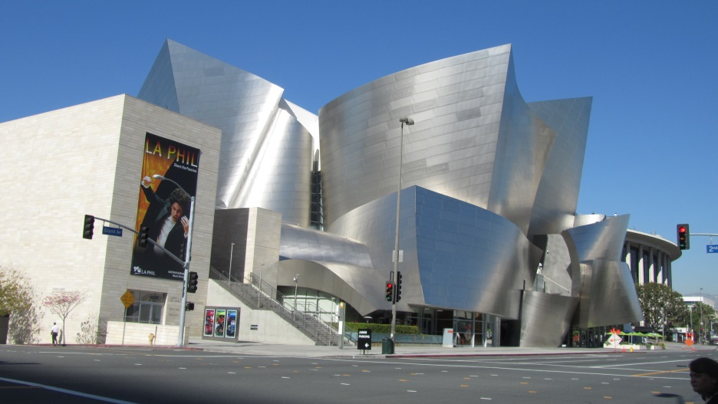
You also examined structures made by people, which are sometimes gray, like cement and steel, but not always.
Tempe Center for the Arts from pedestrian bridge
Intake towers in Lake Mead at Boulder Dam
Walt Disney Concert Hall, Los Angeles

Slide 4
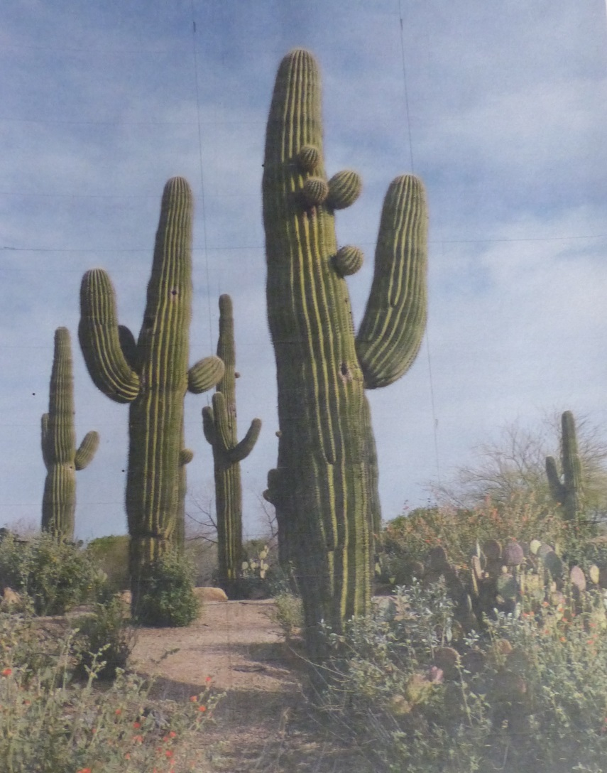
In this project, “green” refers to structures of nature and “gray” refers to structures made by people.
Your challenge is to create a photographic mixed media artwork that shows a real and/or imagined relationship between green and gray.
Unify the “green” and “gray” parts by using similar or contrasting sizes, shapes, or colors.

Slide 5
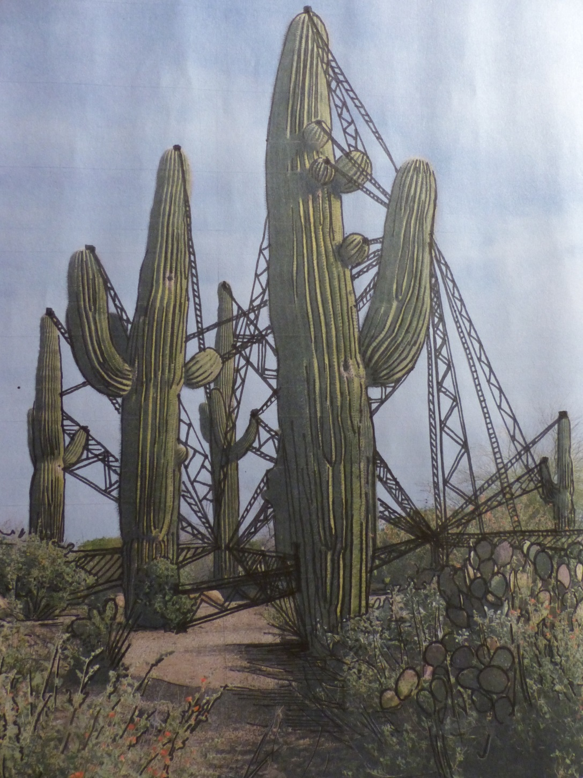
This work began with a “green” photograph to which “gray” elements were added with a black marker.
The shape, size and color of the marker lines contrast with the lines in the cacti.

Slide 6
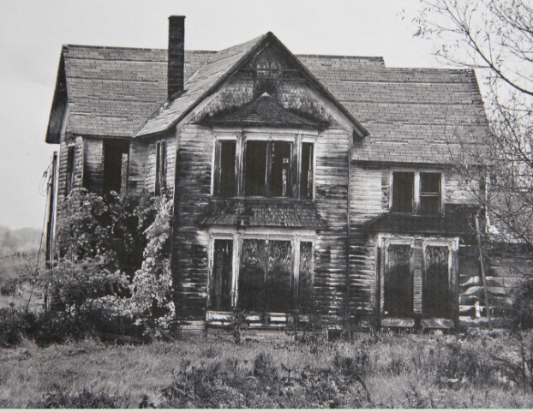
This sample began with a photograph found in a magazine.

Slide 7
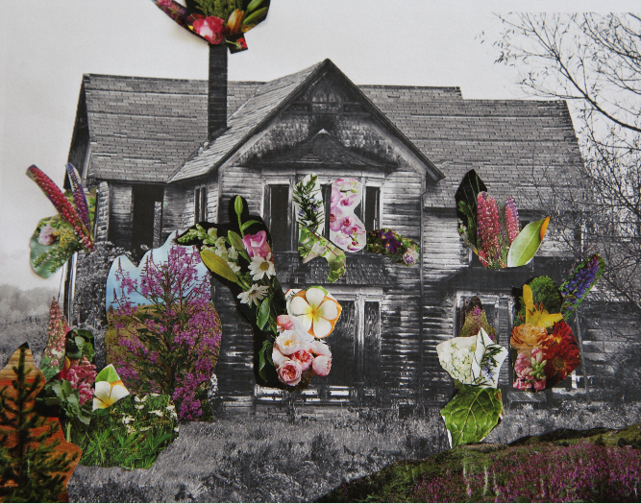
The artist cut magazine images and glued them to the photo in this mixed media work.

Slide 8
On the bottom 2/3 of the photo, the artist selected “green” images that are similar in size to parts of the “gray” image. She also added a “green” image at the top, which contrasts with the plain, empty sky.

Slide 9
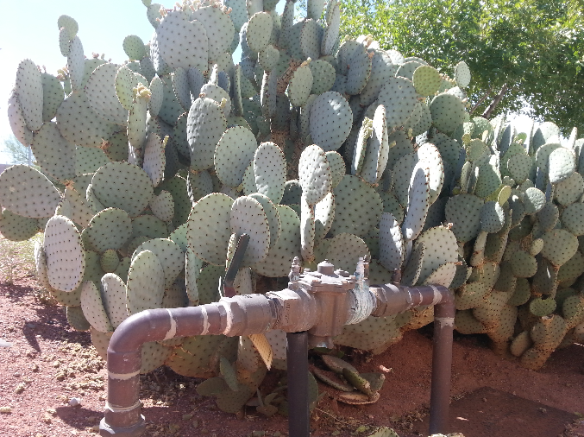
A high school student photographed a prickly pear cactus growing near a water pipe.
He chose to paint with acrylic paint on his photograph.

Slide 10
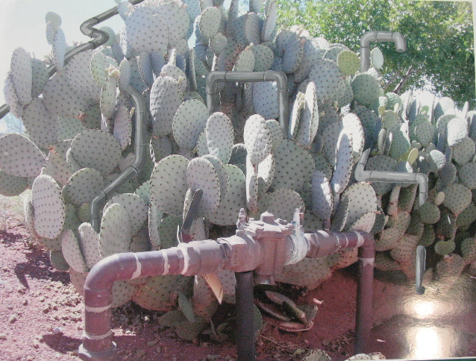
He wrote “I loved the Green and Gray project because I consider myself environmentally conscious.” He titled his work Pipes.

Slide 11
The artist integrated subtle pipe forms among the cactus pads. Notice that the color of the pipes is similar to the colors of the cactus.

Slide 12
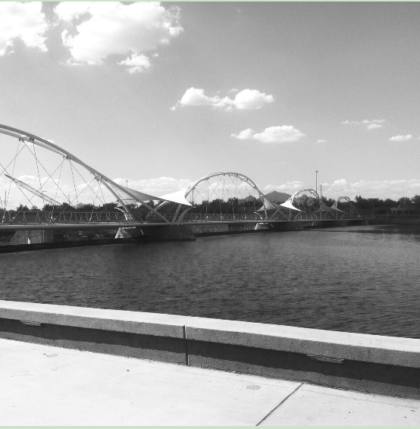
Another high school student started her mixed Green and Gray piece with her own black and white photo of a pedestrian bridge.

Slide 13
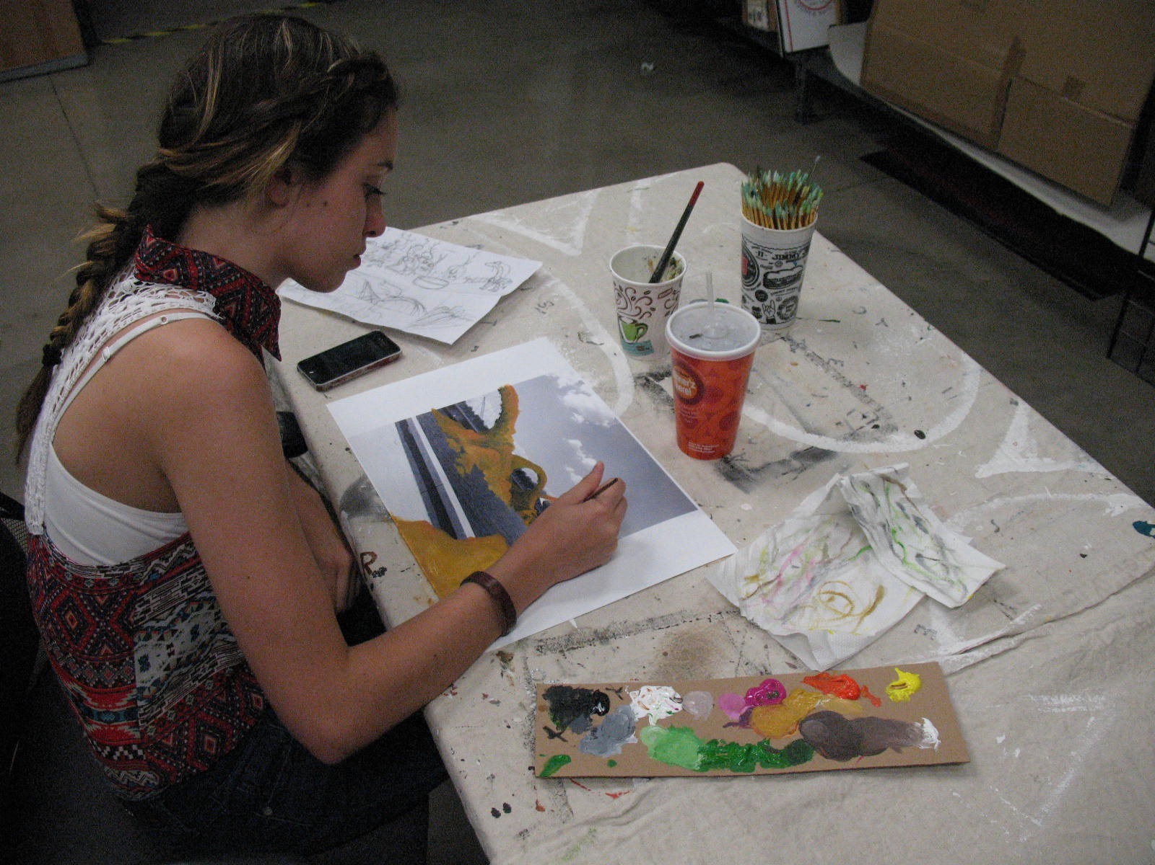
She mixed acrylic paints with her photography. She combined the human-made bridge arches with natural arches inspired by those in Utah.

Slide 14
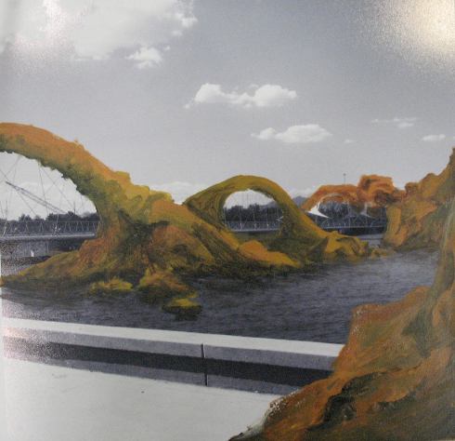
She titled her final mixed media piece, The Arch of a New World.
Notice how she created stone arches that repeat the arches of the bridge.

Slide 15
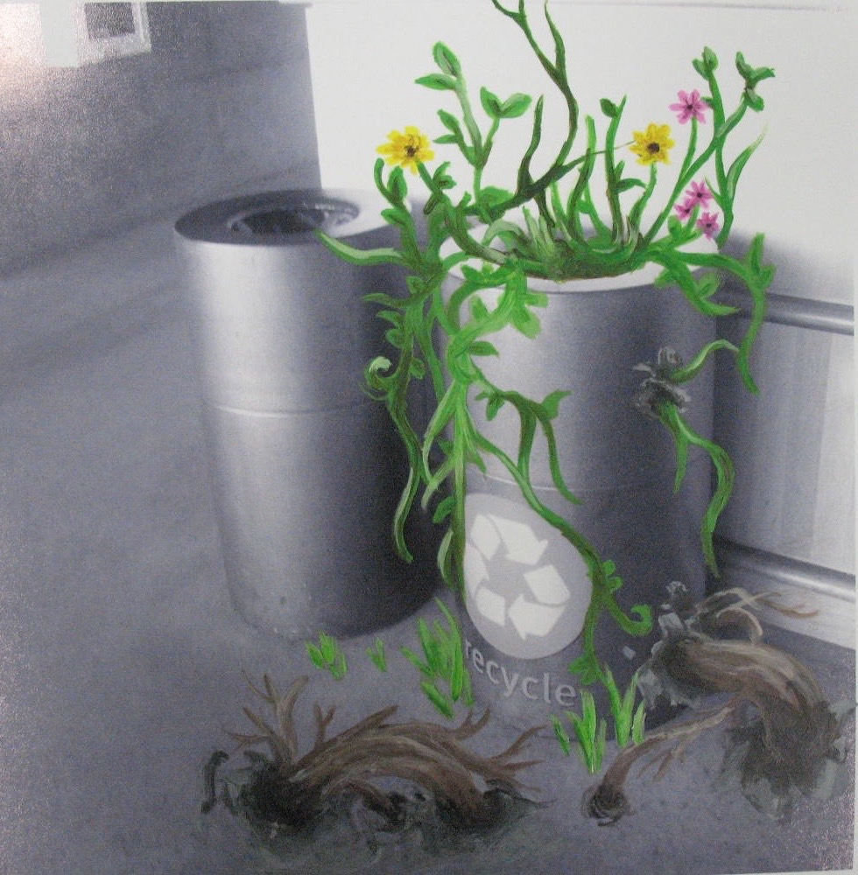
How will you mix “green” and “gray” parts in your mixed media artwork?
How will you unify the parts of your final work using similar and/or contrasting sizes, colors or shapes?
This student chose “green” parts that contrast in shape, size and colors with the “gray” parts.

Slide 16
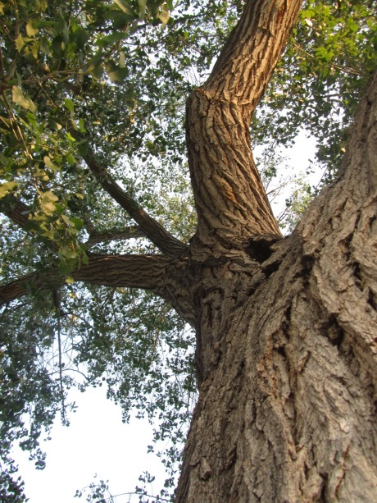
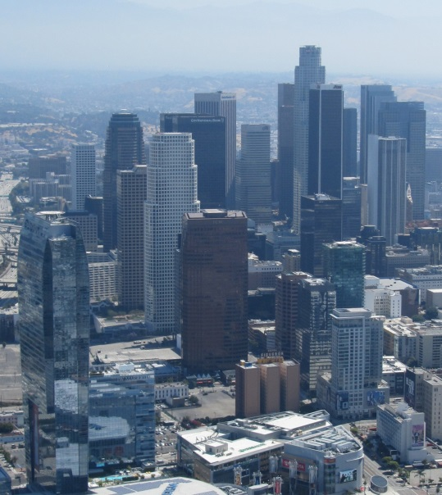
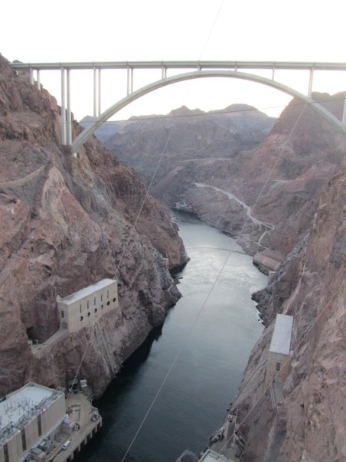
For a more challenging piece, your teacher may ask you to create a photographic mixed media series using The Rule of Thirds.
Will you primarily address the green aspects in your initial photograph -- or the gray aspects? Or will you incorporate both green and gray in your initial photograph?

Slide 17
Using the “Rule of Thirds” can help you unify your photographs.
The Rule of Thirds is a guideline that proposes that an image should be imagined as divided into nine equal parts by two equally spaced horizontal lines and two equally spaced vertical lines.

Slide 18
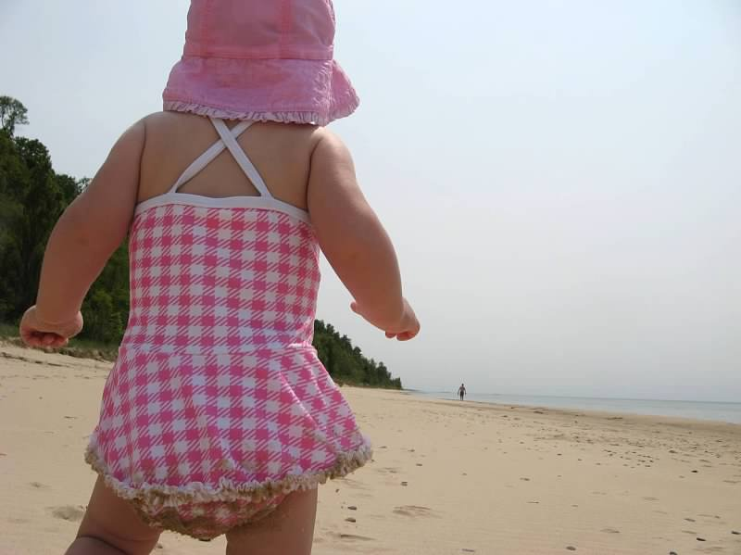
When you use the Rule of Thirds you place important compositional elements along these lines or their intersections.

Slide 19
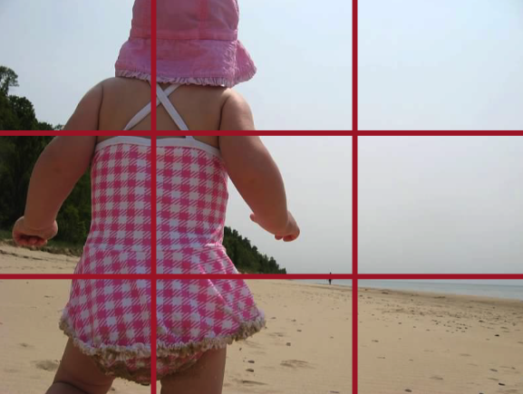
Notice that the main subject (little girl) is placed on the left third and the horizon line is placed on the bottom third. The intersection of objects creates visual interest.

Slide 20
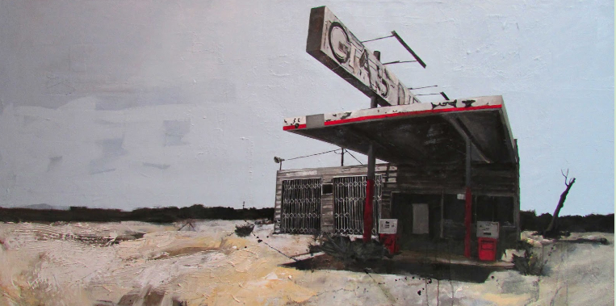
This mixed media painting by Jonathan Howard is called Worn Out Life.

Slide 21
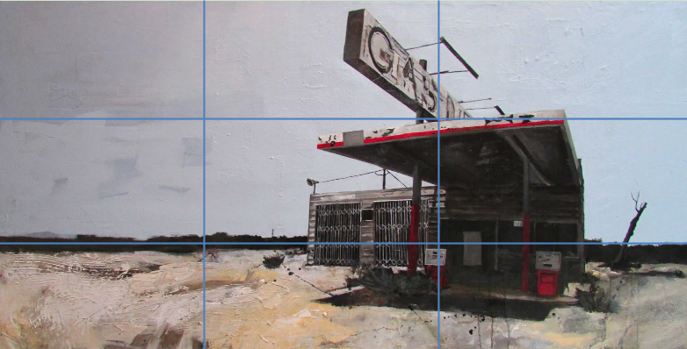
Notice how the horizon line falls on the bottom third and the building falls on the right vertical third of the image.

Slide 22
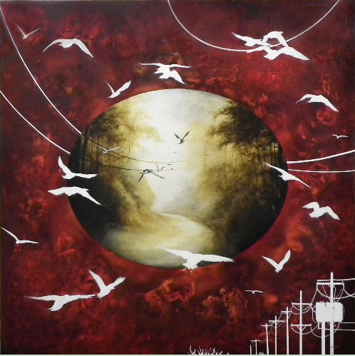
This acrylic painting by Candace Eisenfeld is titled Modern Romanticism.

Slide 23
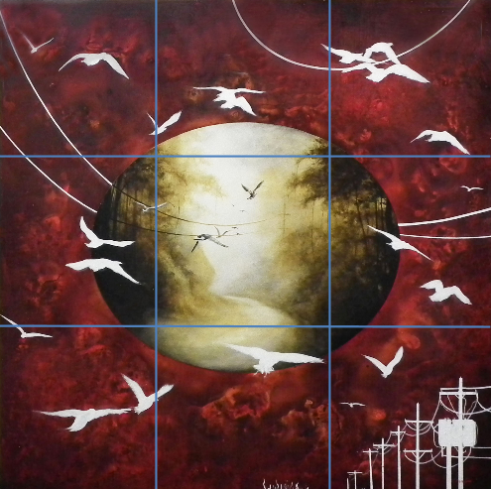
Notice that the focal point, the circle in the middle, touches all the center intersections of the rule of thirds. This is another way to use the rule of thirds.

Slide 24
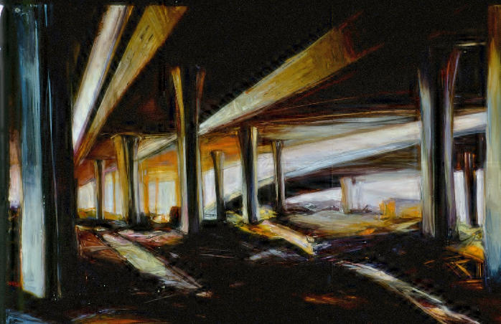
Apply the Rule of Thirds to this painting.
Where is the horizon line in this oil painting titled Eclipse by Karen Jilly?

Slide 25
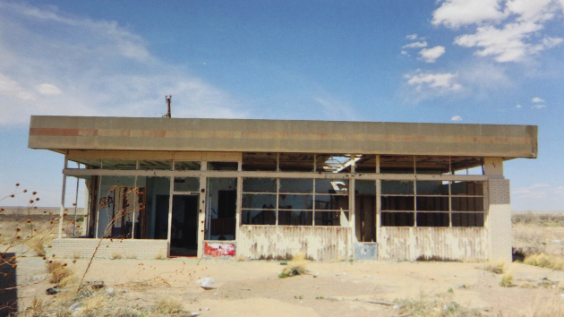
Using either your phone or a digital camera, take a photograph that shows an object that could be related to the “green and gray” theme.
This image focuses on abandoned buildings in a desert landscape. The buildings represent the “gray” aspect and the landscape of the desert represents the “green”.

Slide 26
The horizon line is on the lower third of the image and the door is located at the intersection of the lower third and the left third.

Slide 27
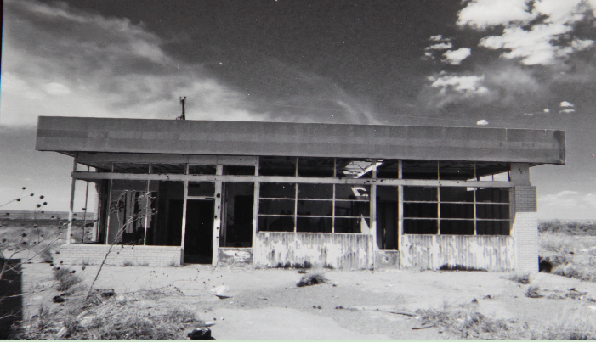
You may want to edit your image. The initial photograph was edited to black and white to emphasize the gray aspect of the theme.

Slide 28
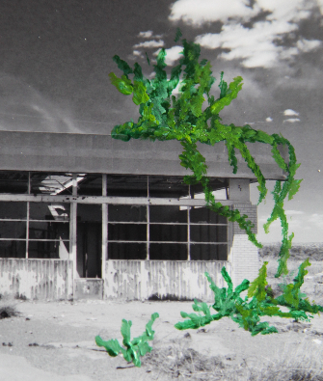
In this sample, the next step in the artist’s process was to start addressing the “green” idea of the image.
The artist used acrylic paints to paint greenery into the image. She added the greenery to balance the “green” and “gray” and to create a sense of tension between “green” and “gray”.

Slide 29
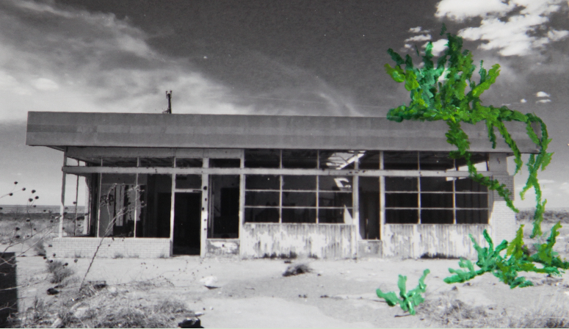
The painted “green” elements contrast dramatically with the initial photo both in shape and color.

Slide 30
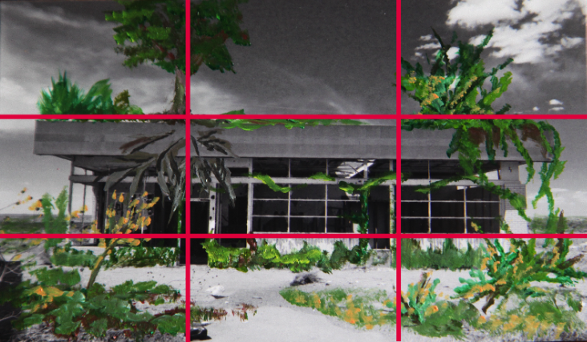
When completed, the artist’s image shows the relationship between “green” and “gray” and used the Rule of Thirds.

Slide 31
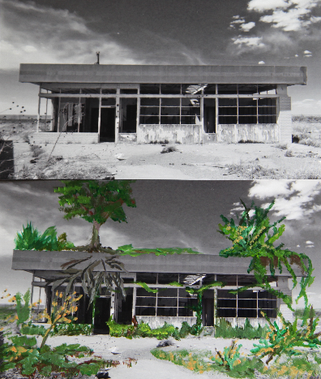
Your final series might be a diptych.
Placing two related images together creates a diptych.

Slide 32
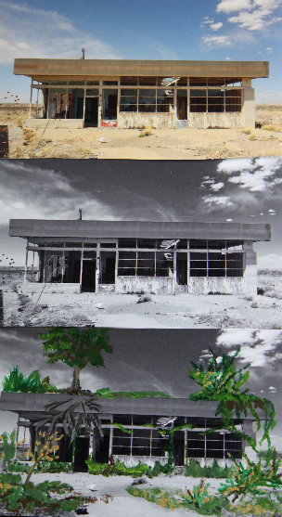
Or you could make a triptych by placing three related images together.

Slide 33
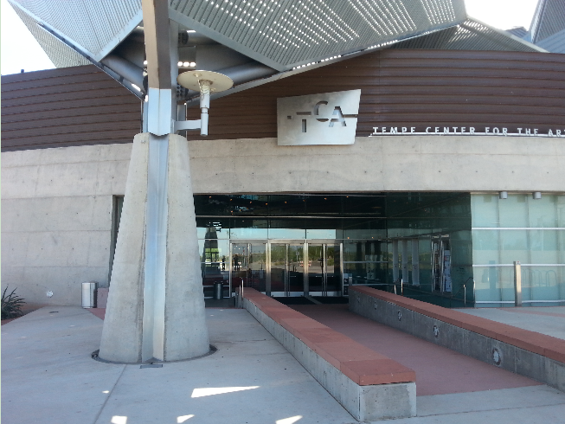
This is a high school student’s photograph of the entrance to the Tempe Center for the Arts. Notice that the post on the left is located at the vertical third of the image.

Slide 34
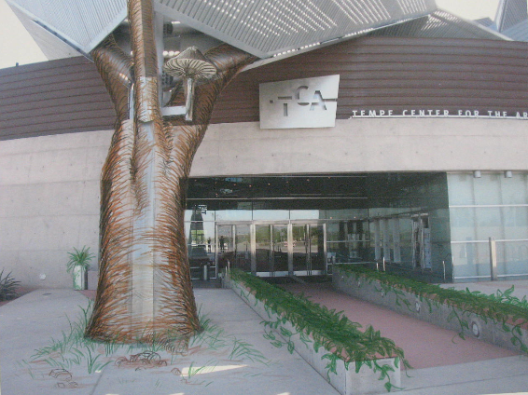
This is the student’s completed Green and Gary mixed media artwork. He added “green” to the “gray” with colored pencils. He titled his work Entry.

Slide 35
What would you like to say about relationships between natural and human-made structures in the world around you or in your imagination?
Start with a photograph.

