Slide 1
Sweet Treats (Secondary Version)
By Mary Erickson, Ph.D. and Allison Lee, Arizona art teacher

Slide 2
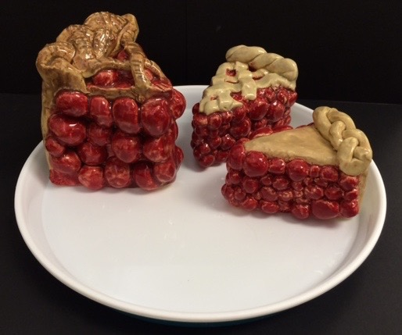
Do these slices remind you of a time you enjoyed a treat? Your challenge is to make an artwork to remind you of an event or group that is important to you.
Then, working with others, your next challenge is to present several, so they look good together.

Slide 3
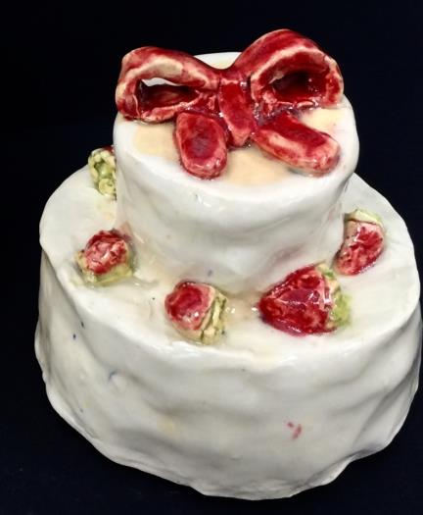
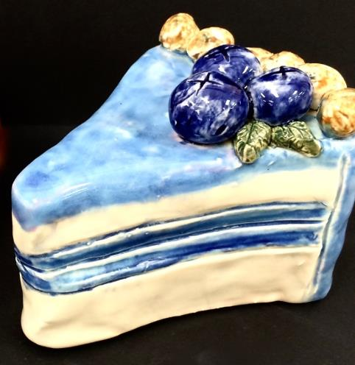
You will be making a ceramic sculpture that includes at least two textures.
You will also add decorative details and apply several colors of glaze.

Slide 4
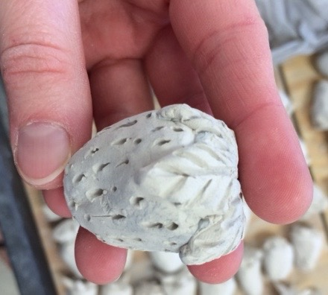
Practice construction skills by making a strawberry.
Make a cone from clay.
Use a loop tool to hollow out the berry.
Bring the berry together at the top.
Make a leafy stem.
Score both surfaces and use slip to attach the stem.
Poke a pin through the berry to let out air when it is fired and to make a seed texture.

Slide 5
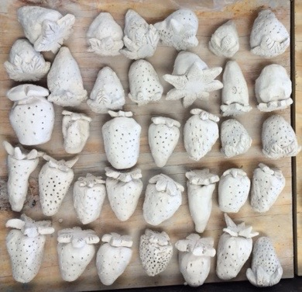
How many ways are leaves attached?
Describe several different types or patterns of texture.

Slide 6
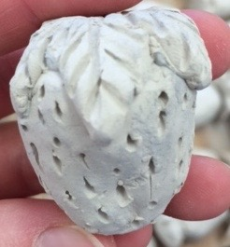
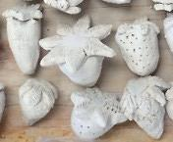
Compare the berries on the right with the excellent berry on the left?
Identify specific differences in craftsmanship between the left berry and berries on the right?

Slide 7
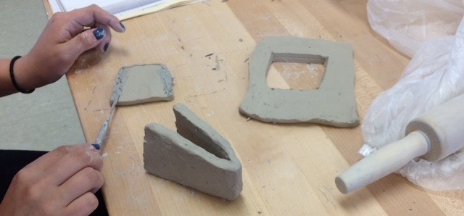
Plan and cut the pieces you need for your sweet treat from slabs of clay.
Score edges and apply slip before attaching pieces to make a joint that will not separate when fired.

Slide 8
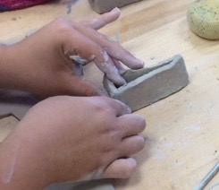
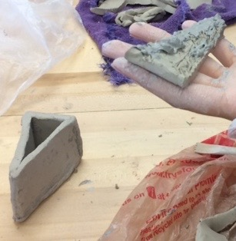
This student presses in the back of her piece. After scoring the edges and adding slip, she will press the triangular piece on top. Her dessert will have no bottom, so air can escape when it is fired.

Slide 9
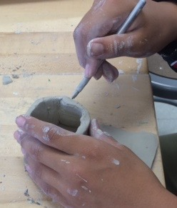
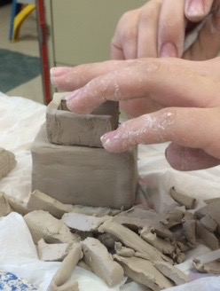
You may decide to make a triangular slice of pie, a square cake, a round cup cake, or a sweet treat in some other form.

Slide 10
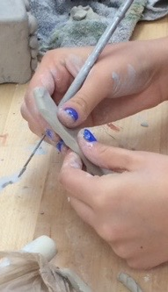
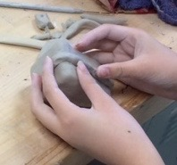
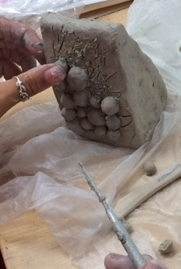
Next, you will make pieces to add texture or decorative details to your sweet treat. Remember how to attach pieces of clay. Even small pieces must be scored and slip must be used or they will fall off in the kiln.

Slide 11
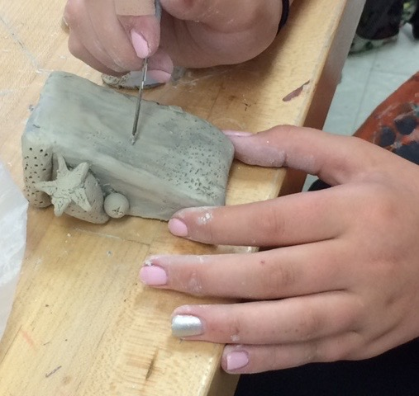
Use a pin tool to add smaller textural details.

Slide 12
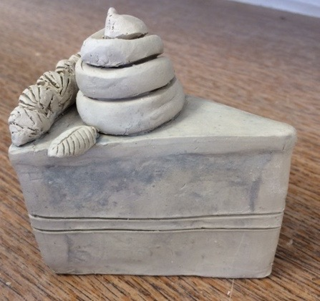
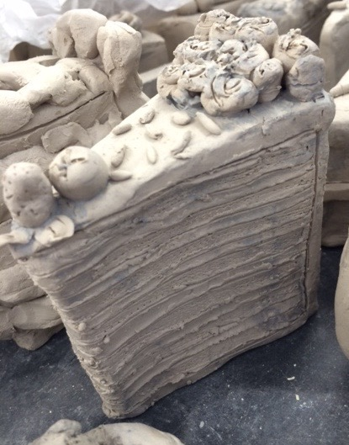
Which textures were made by joining pieces?
Which textures were made with a pin tool?

Slide 13
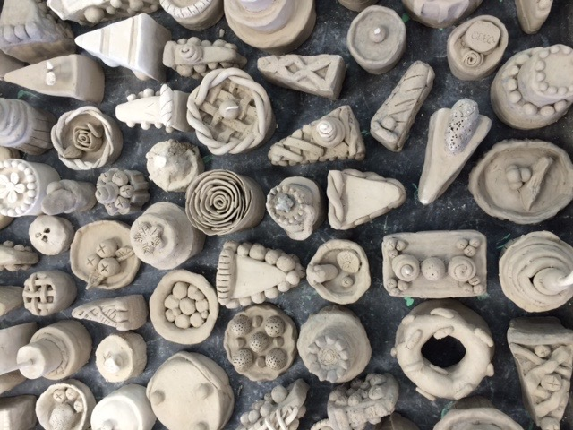
What kinds of textures and decorative details will be the best choices for your memorable sweet treat?
How can you make them in clay?

Slide 14
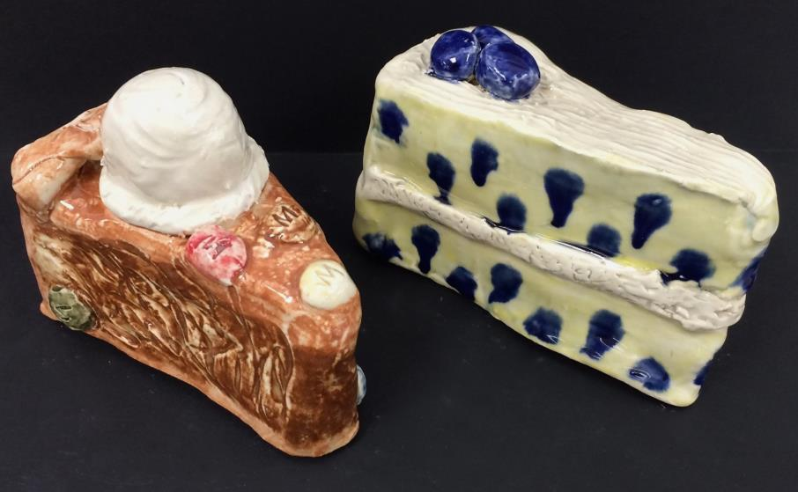
Sometimes we say that flavors go together or complement each other. When cold ice cream melts on hot pie, both the flavors and temperatures complement each other. Maybe you think that frosting or fruit complements the flavor of cake.

Slide 15
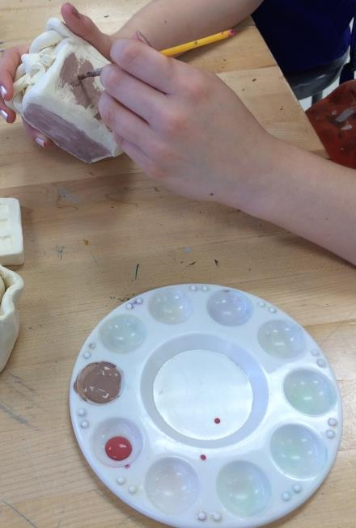
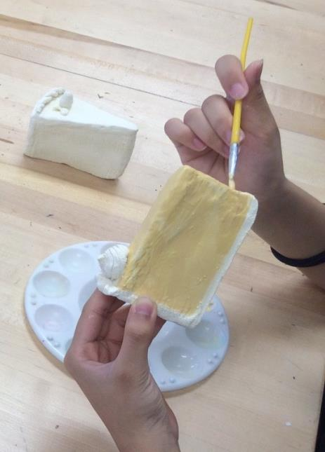
After your piece is fired, select, mix and brush glazes carefully on your piece. Then brush on a clear glaze.

Slide 16
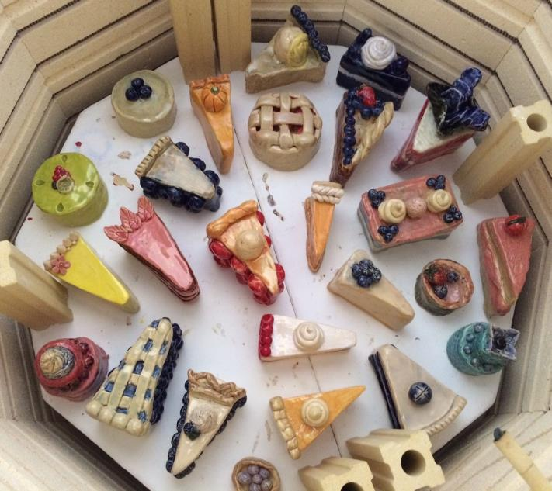
These are students’ sweet treats in the kiln after glaze firing. Each one is special in its own way.
They all compete for our attention.

Slide 17
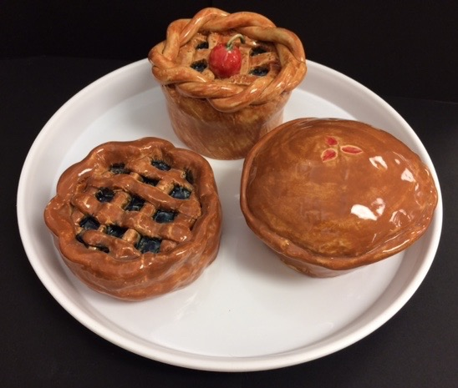
The visual characteristics of artworks can also be complementary. The similar colors and round shapes of these pieces, as well as the round plate complement each other.

Slide 18
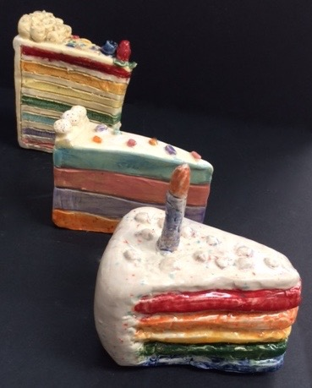
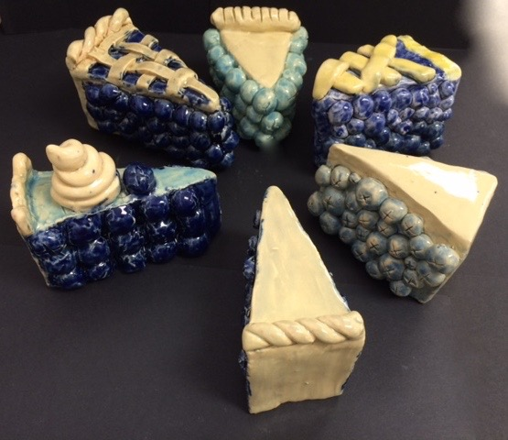
What shapes, colors and textures complement and help unify each presentation?
How were the pieces organized in different was in these two presentations?

Slide 19
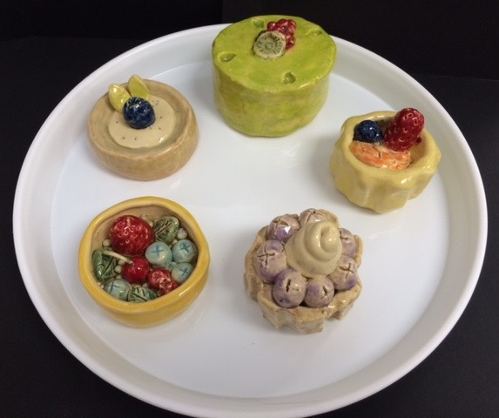
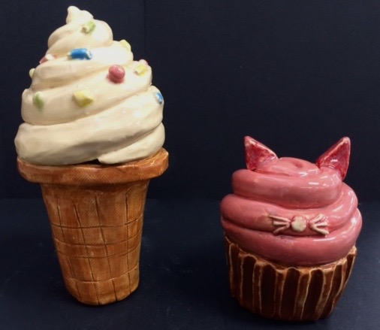
Even pieces that are quite different can be presented in a unified way.
How do the pieces within each of these two presentations complement each other?

Slide 20
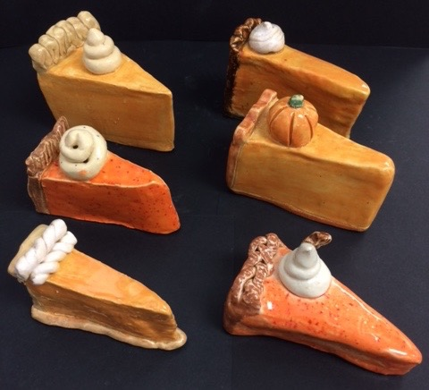
If Thanksgiving is an important event in your culture, you may have made a pumpkin pie. Maybe you could give your presentation a title that relates to being thankful?

Slide 21
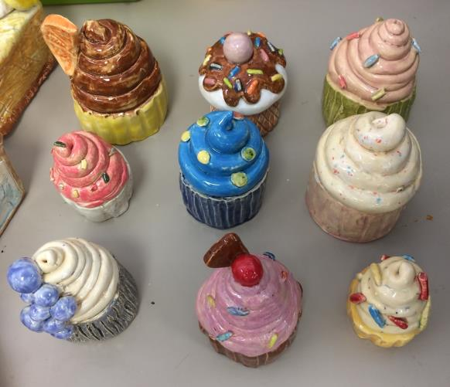
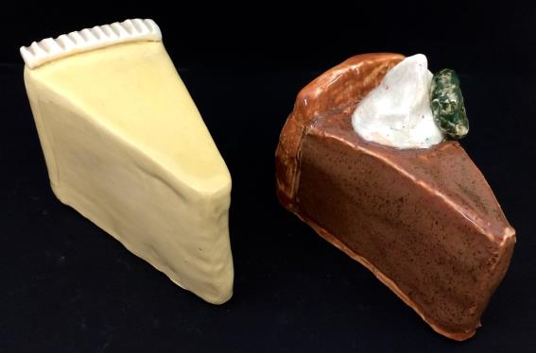
Maybe cupcakes or cheesecake is more your group’s thing - or some very different treat. What makes your group proud enough to celebrate with a treat?

Slide 22
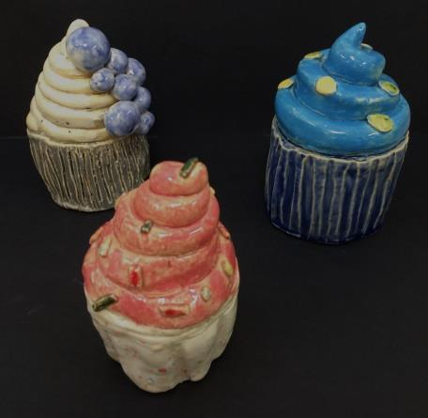
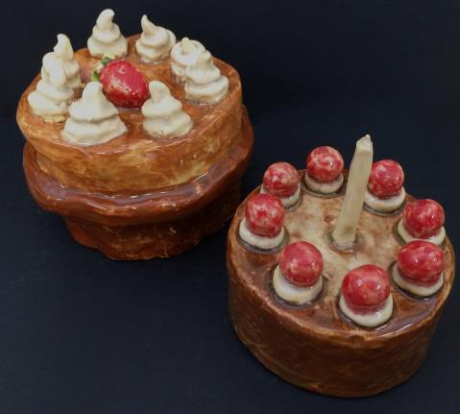
Discuss with others a sweet treat you eat when you celebrate with a group you care about.
What sort of treat would you like to build, enhance with textures, details and glazes?

