Slide 1
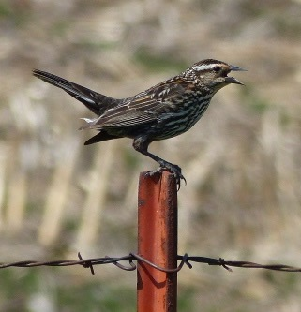
Bio-Music With Birds
By Mary Erickson, Ph.D. and Rebekah Osborne, Arizona music teacher
With 3rd grade students at Kyrene de la Paloma Elementary

Slide 2
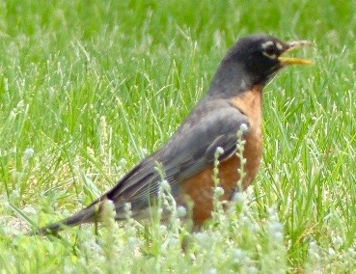
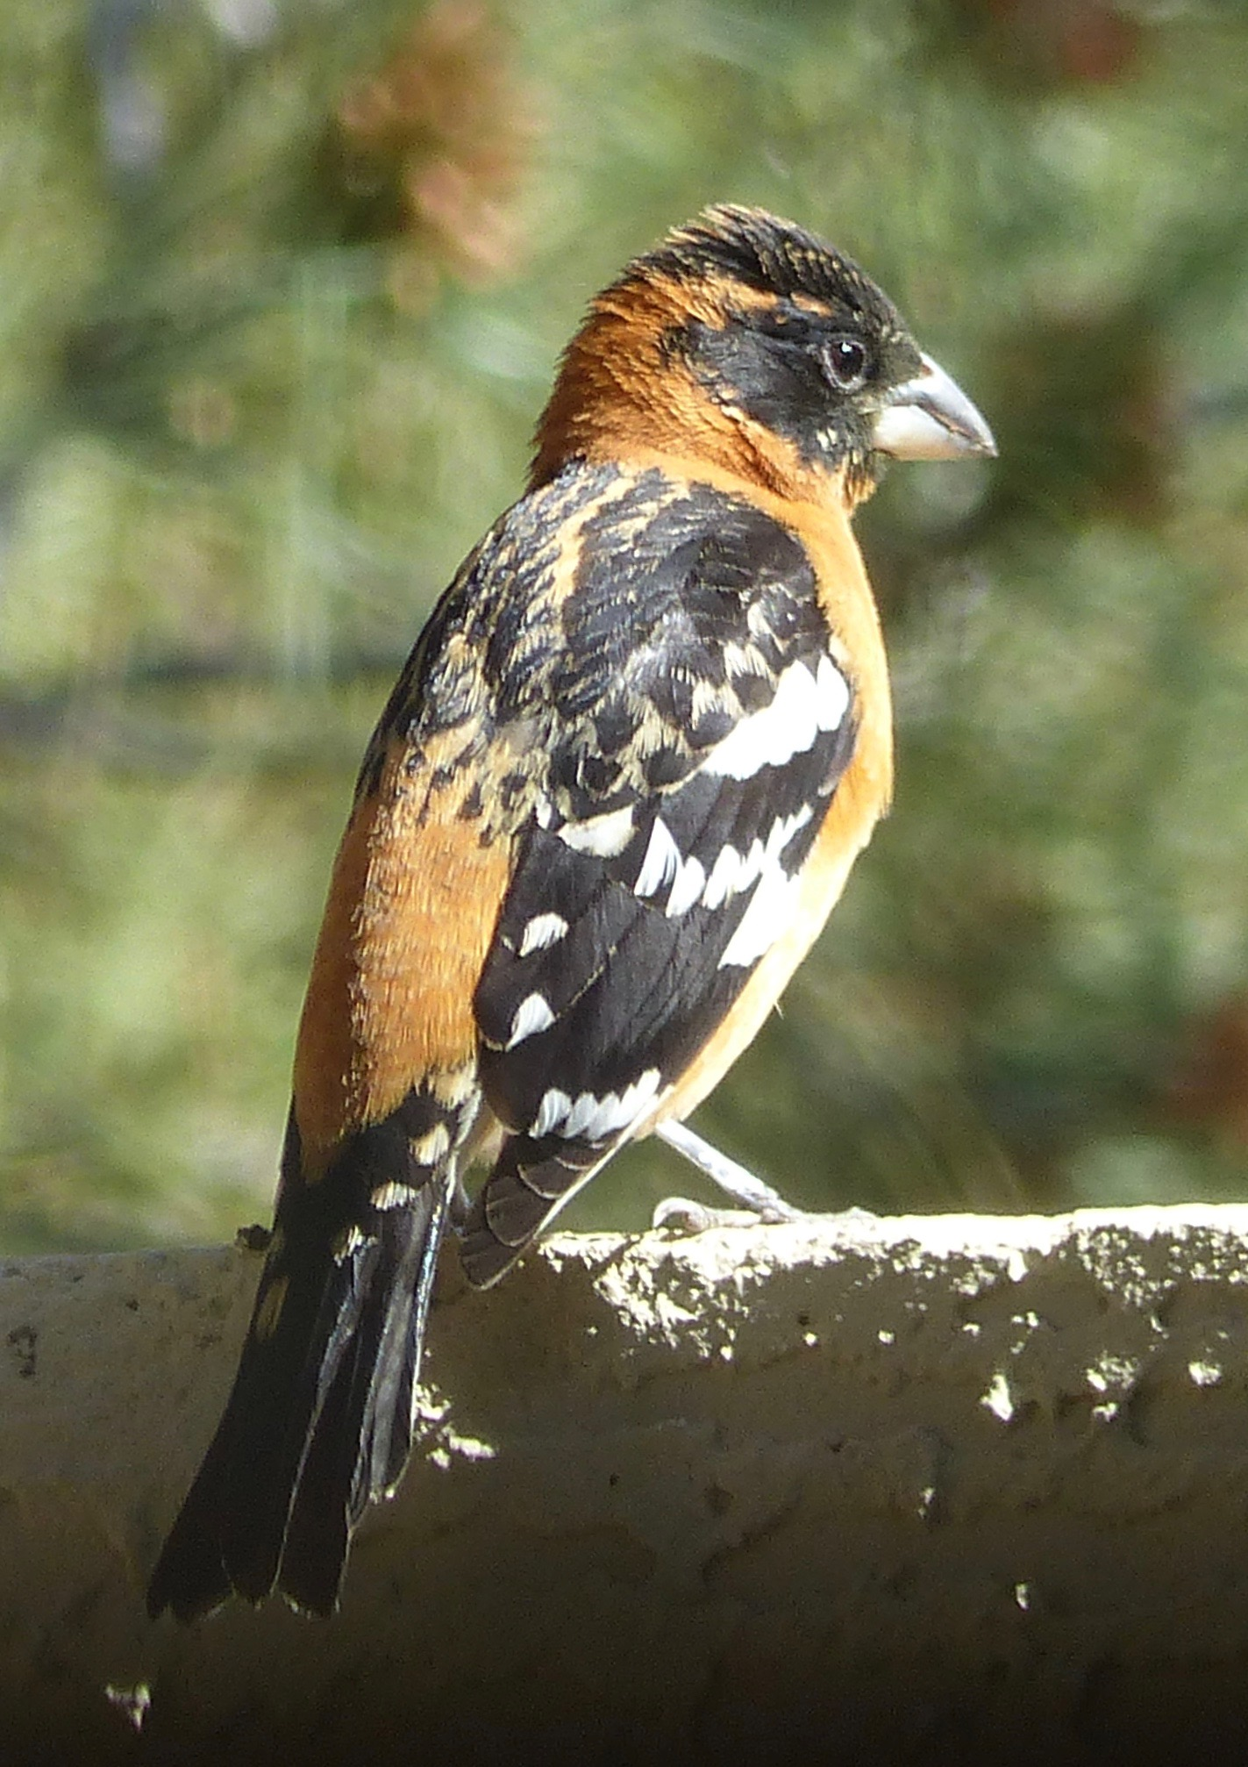
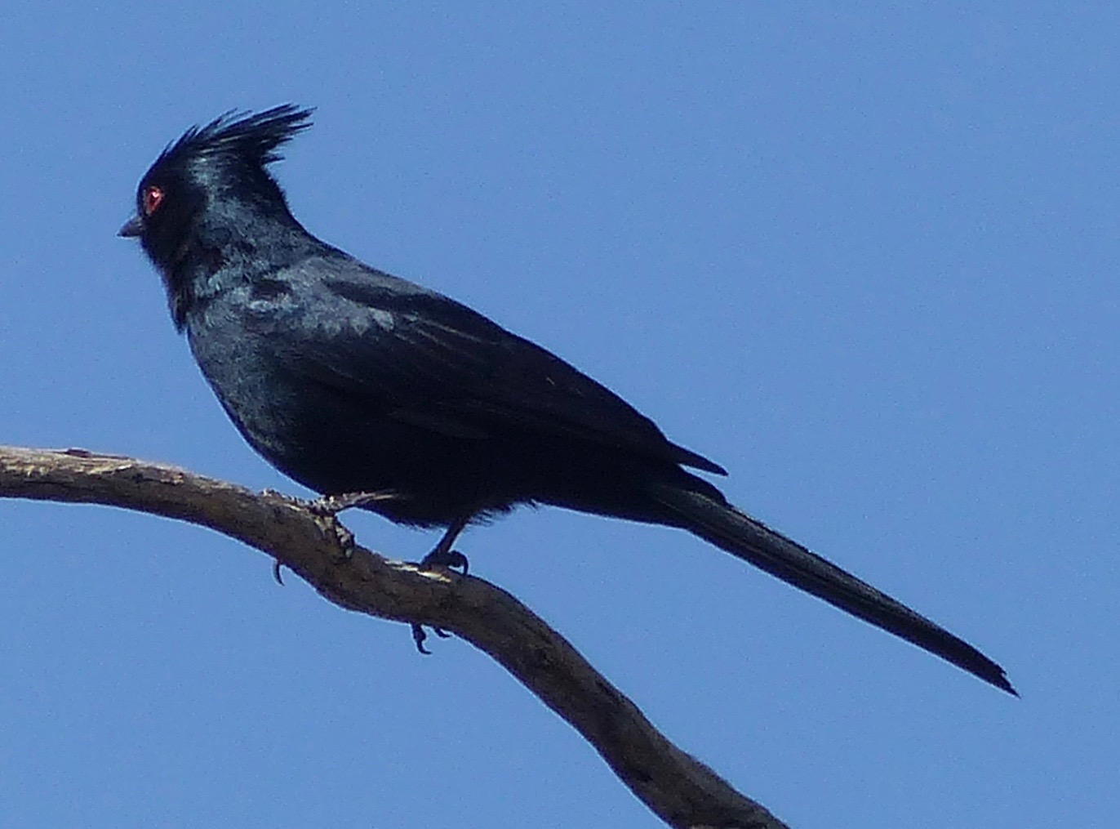
People enjoy listening to birds.
Scientists study how birds communicate with their calls.
Musicians can get inspiration for their music from birds.

Slide 3
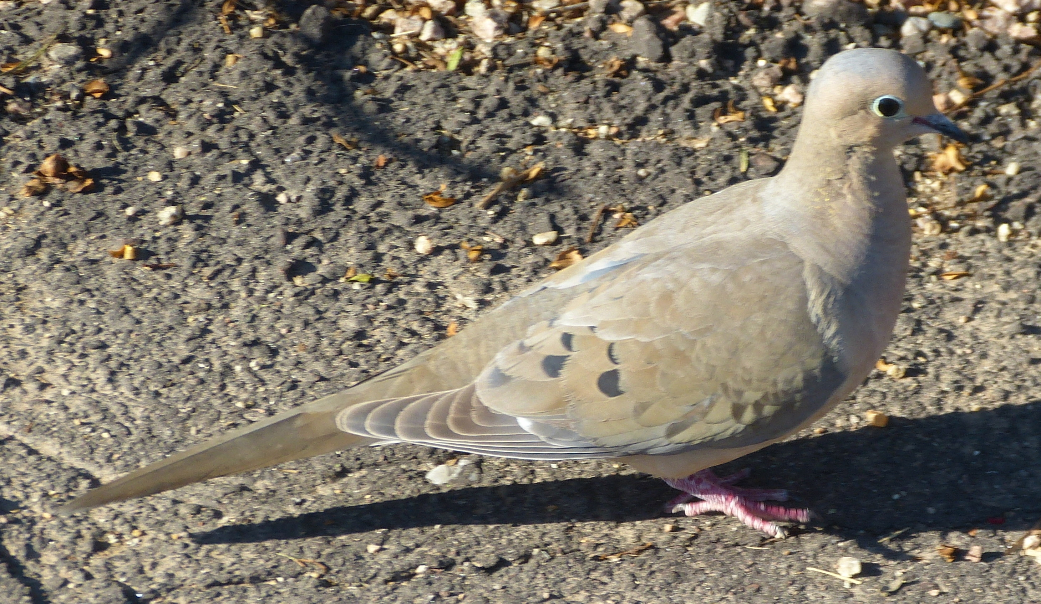
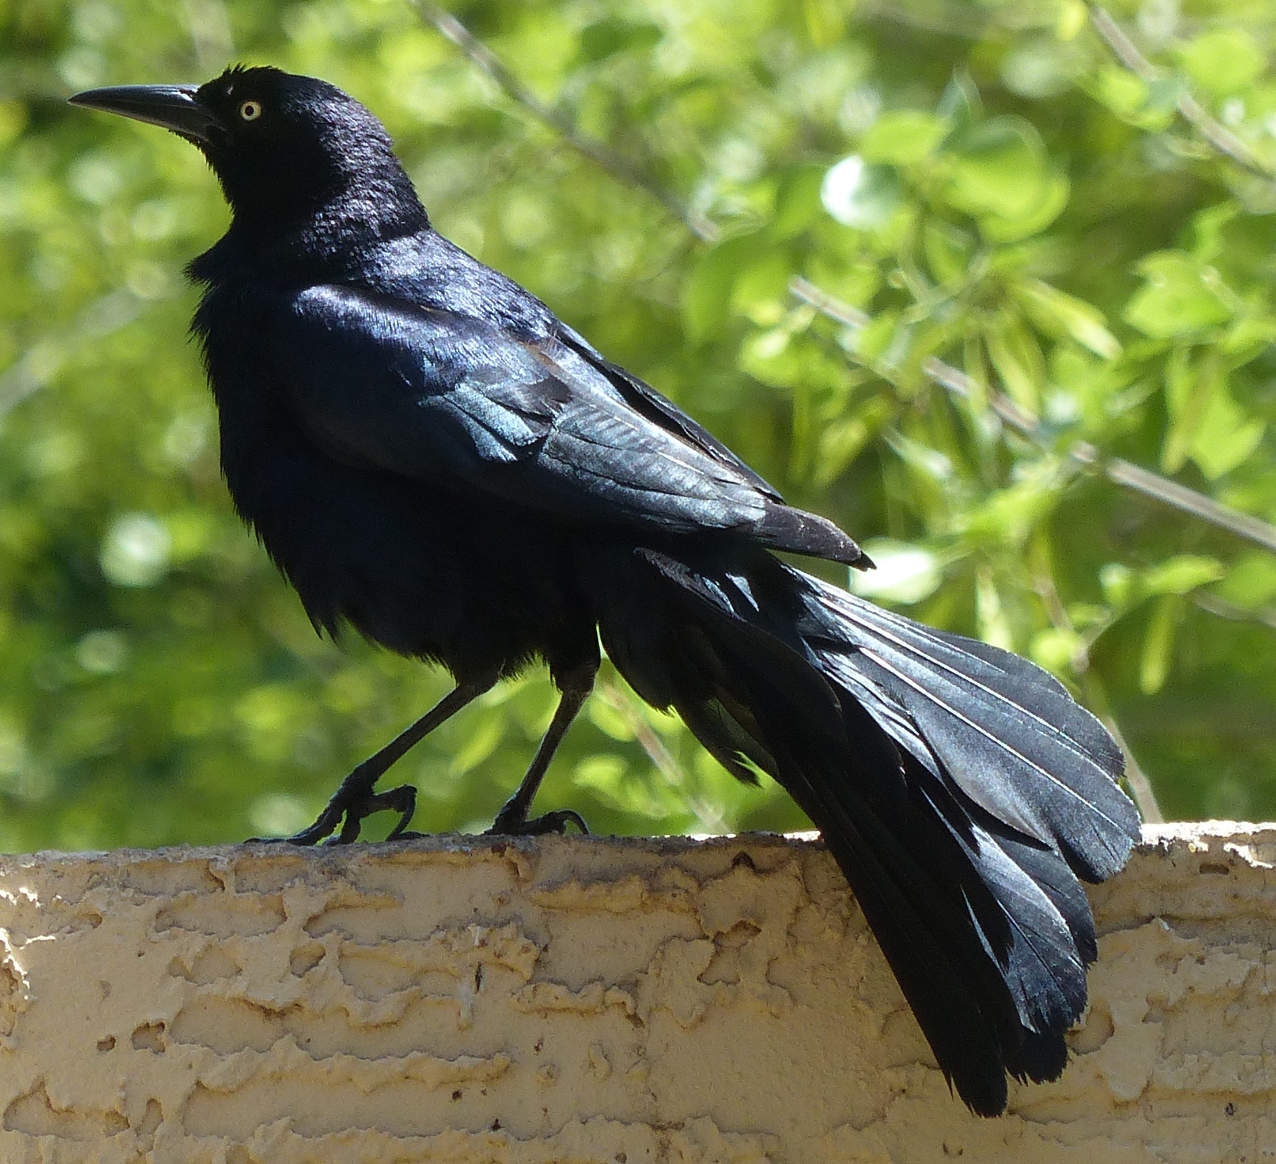
Where do you see birds?
Have you ever enjoyed listening to the different sounds birds make?

Slide 4
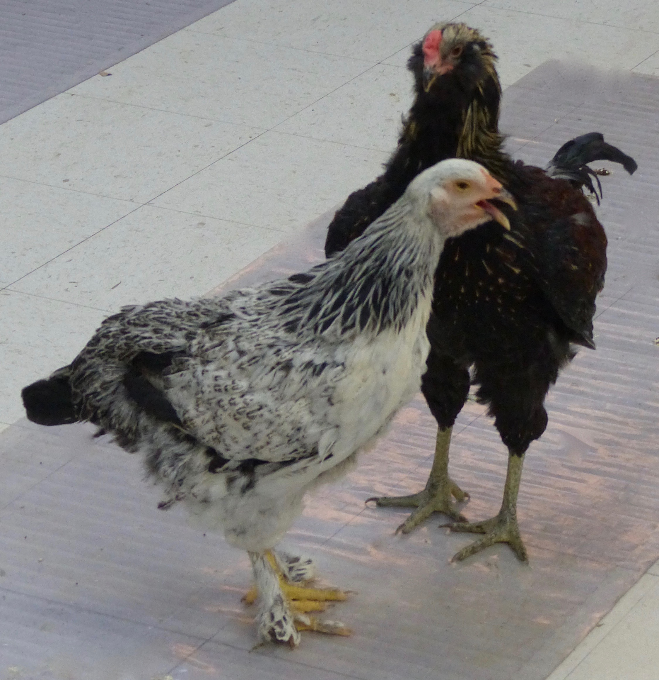
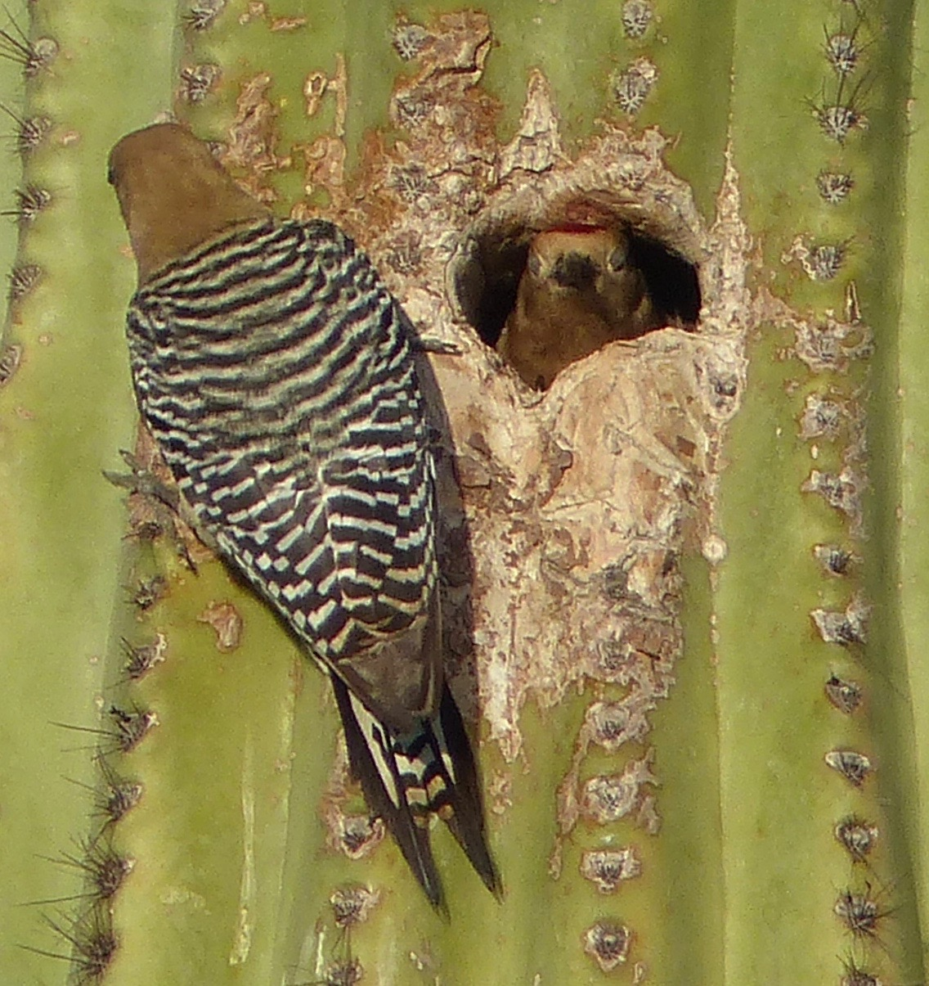
What do you imagine these birds might like to say to each other?

Slide 5
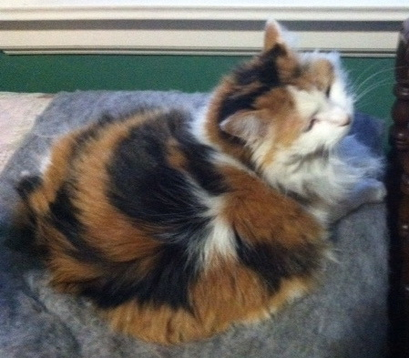
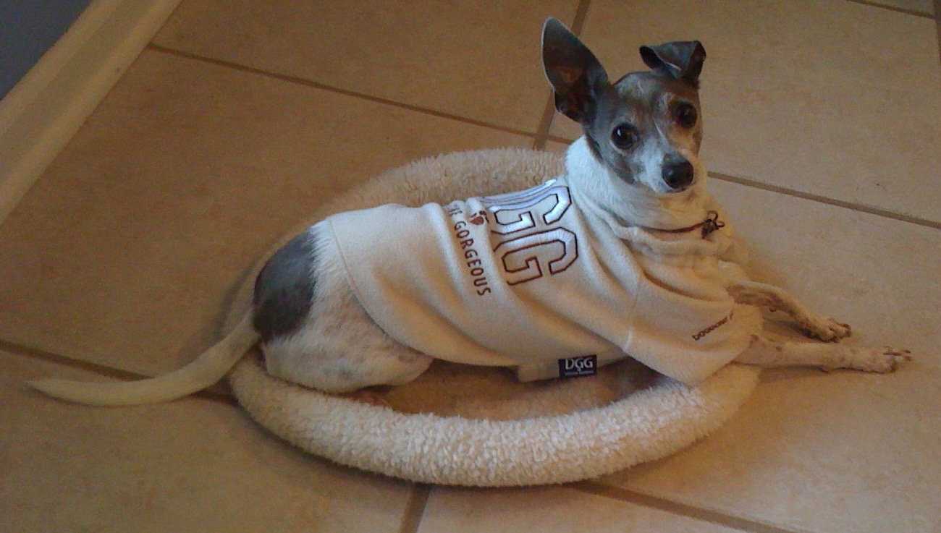
Communicating with a cat or dog is challenging because humans, cats and dogs are different species. That is, we are different kinds of animals. Have you ever said “Here, kitty kitty” to try to get a cat to come to you? Would you say “stay” to a dog who wants to jump up and come with you?

Slide 6
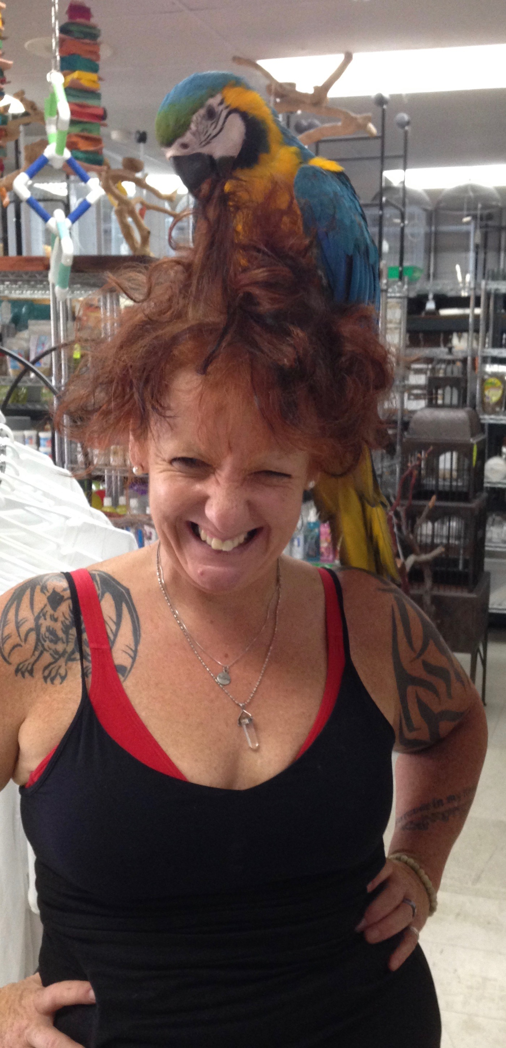
.
Humans and macaws are different species.
This human and her bird have a relationship that they both seem to enjoy, but are they communicating?

Slide 7
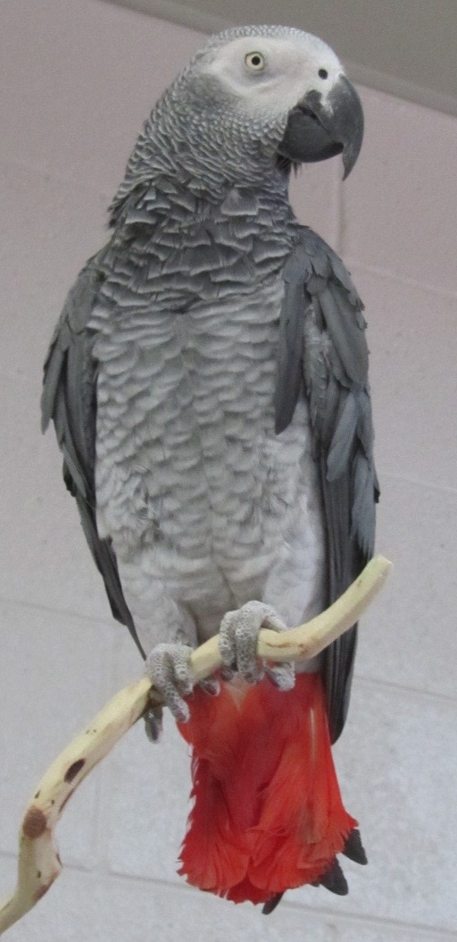
Scientists study inter-species communication.
For example, scientists have talked with chimpanzees, who answer humans’ questions by pointing to visual symbols.
One scientist taught her African Gray parrot to identify objects and name colors.
.

Slide 8
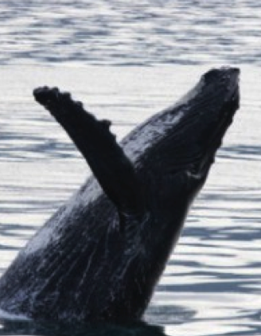
Do animals make music?
A musician and a whale have made inter-species music together. The human plays a clarinet and the whale interacts by making sounds (“singing”) underwater.

Slide 9
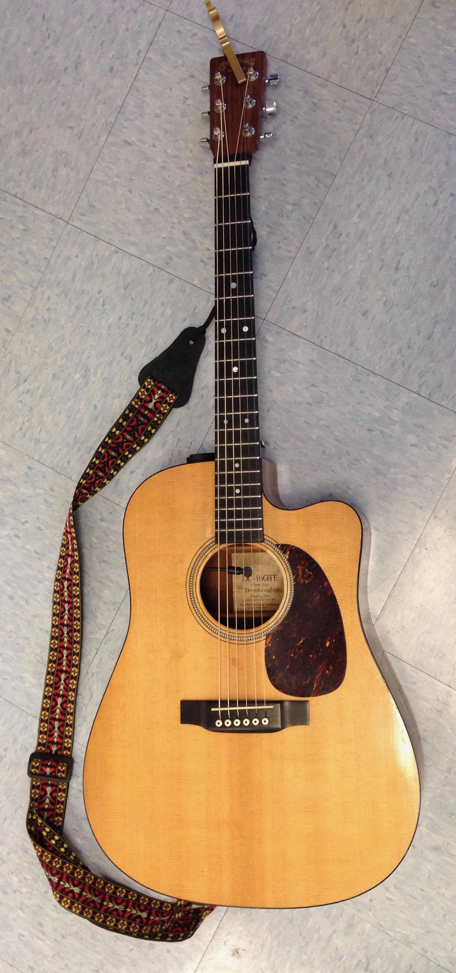
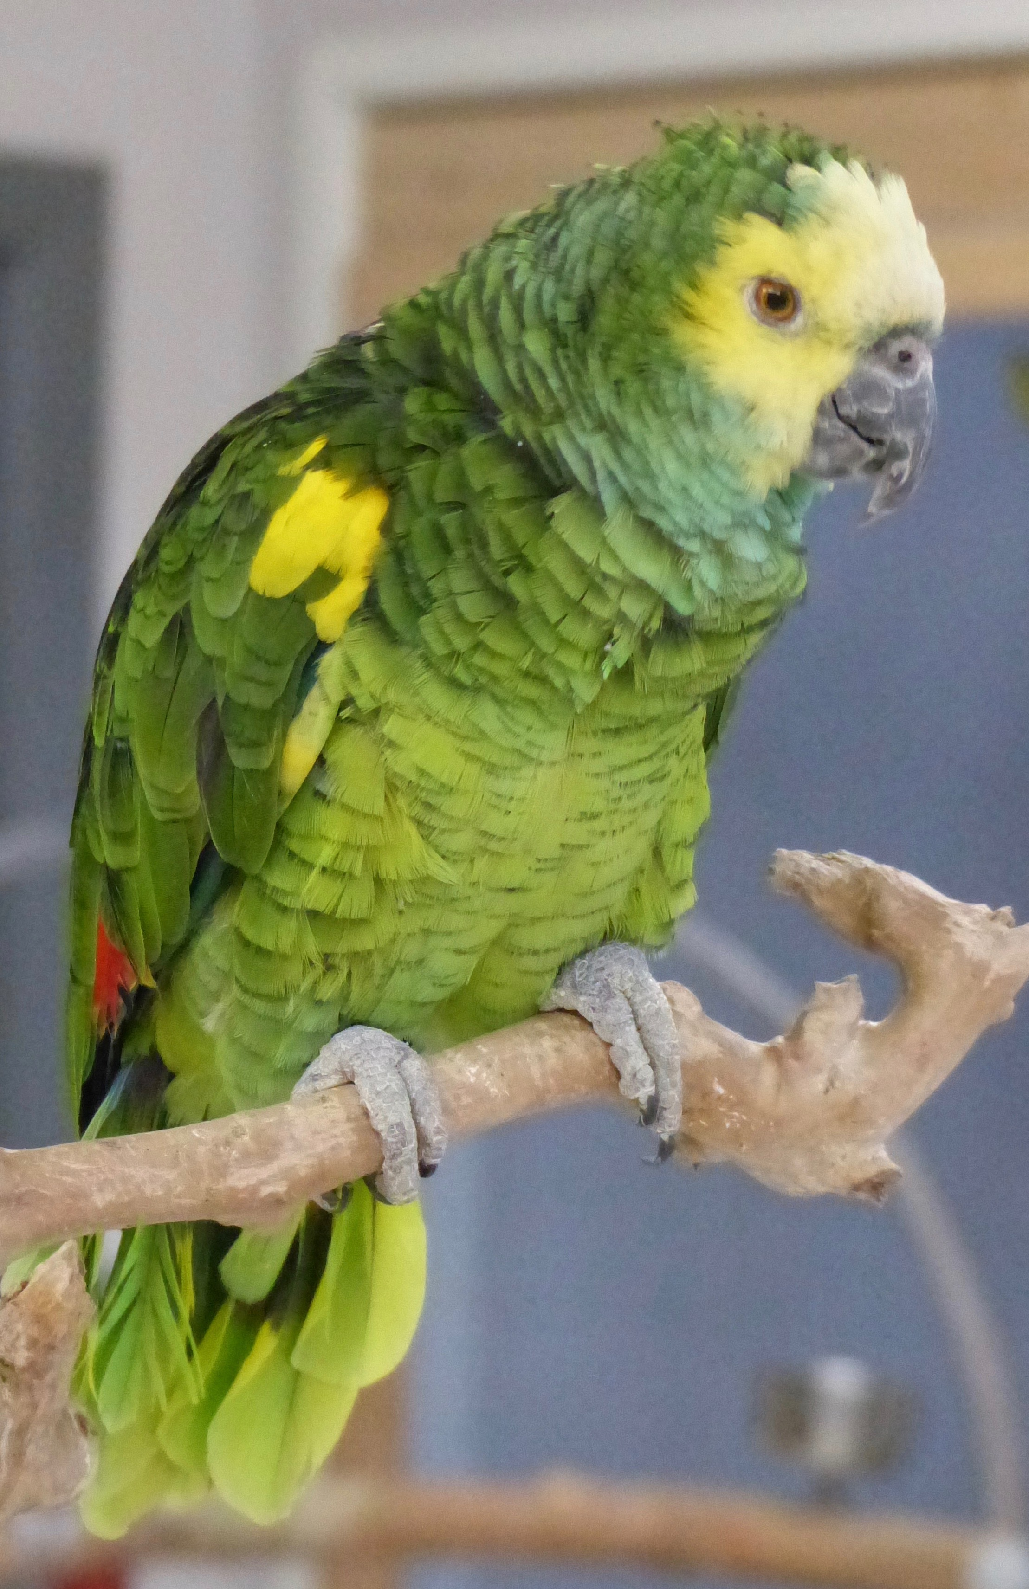
Parrots and humans can also make inter-species music together. A human musician may sing or play guitar while a parrot interacts by whistling and singing.
You will be creating a short melody to play as a duet with a bird.

Slide 10
Listen for Elements of Music in recordings of bird calls before choosing a bird to make music with.
Dynamics – Loud and soft sounds
Rhythm – long and short sounds
Tempo – fast and slow sounds
Pitches – high and low sounds
Tessitura – areas of high sounds, middle sounds and low sounds
Tone – whistle, harsh, rough, scratchy
Form – repeated patterns, constantly changing patterns, mixture or both
Mnemonic – pitch patterns that sound like something

Slide 11
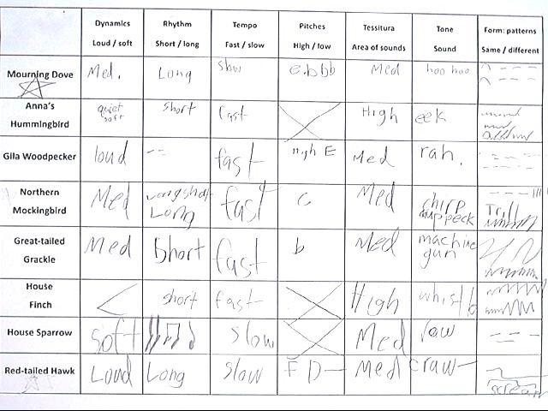
Listen several times to Arizona bird calls.
Write your descriptions on your bird call grid.
Draw lines in the last box to describe each bird call.

Slide 12
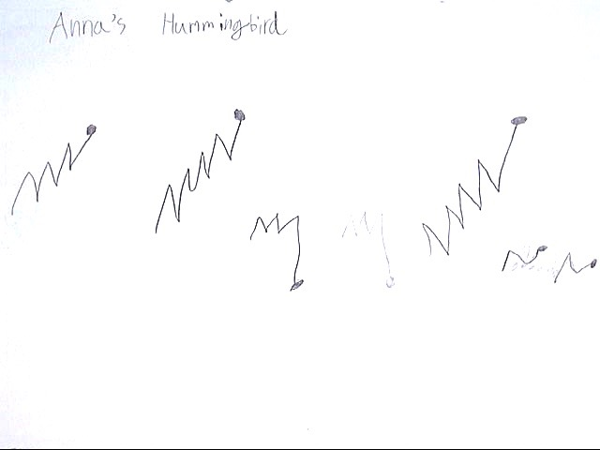
A spectrogram is a series of lines that describe sounds.
Later, you will review your Bird Call Grid and choose one bird to study more. Then you will draw a spectrogram-like line that describes that bird’s call.

Slide 13
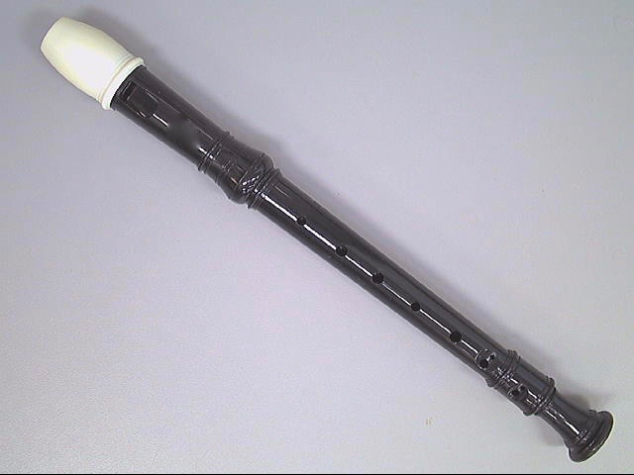
Now that you have analyzed your bird call, your challenge is to create a short melody for a duet with your bird.
Review finger positions to play a B and an A. Remember, cover more holes to go up and fewer to go down.

Slide 14
Your inter-species musical challenge is to create a melody to play as a duet with a bird. A melody is a pattern you can remember and play or hum.
Your job is to:
Create a short melody to complement a bird call,
Record your melody,
Explain your creative choices in writing
Share your thinking and recording with the class.
You have many creative choices to make as you create your short melody. When you are finished, remember to record you choices on your Music Reflection worksheet.

Slide 15
What sort of musical phrase will you choose?
A phrase is a sentence in music.
You may make your phrase any length.
You may use just one phrase.
You may use more than one phrase.

Slide 16
What pitches will you choose?
If you play up, where will you start?
If you play down, where will your start?
Will you play up and down?
Will you mix it up?
Will you trill between two notes? (alternate quickly between two notes)

Slide 17
What rhythm will you choose?
Will you make short sounds?
Will you make long sounds?
Will you mix up rhythms?

Slide 18
What choices will you make about expression?
Will you play notes quickly?
Will you play notes slowly?
Will you play notes smoothly (legato)?
Will you play notes separately (staccato)?

Slide 19
What form will you choose?
Will you play one phrase?
Will you use more than one phrase?
Will you use repetition?
Will you use contrast?

Slide 20
What choices will you make to relate to your bird call?
Look at your Bird Call Grid and Spectrogram-Like Drawing to help you remember your bird’s call.
Think about what the bird did:
Do you want to sound similar?
Do you want to be an exact echo?
Do you want to play something very different?

Slide 21
When will you make your entrance?
Do you want to play as your bird sings?
Do you want to play after your bird sings?
Do you want to play continuously underneath?

Slide 22
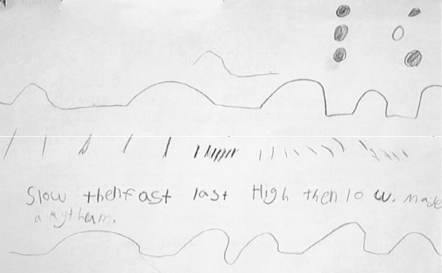
Finally, do you think you can remember your ideas or should you write them down?

Slide 23
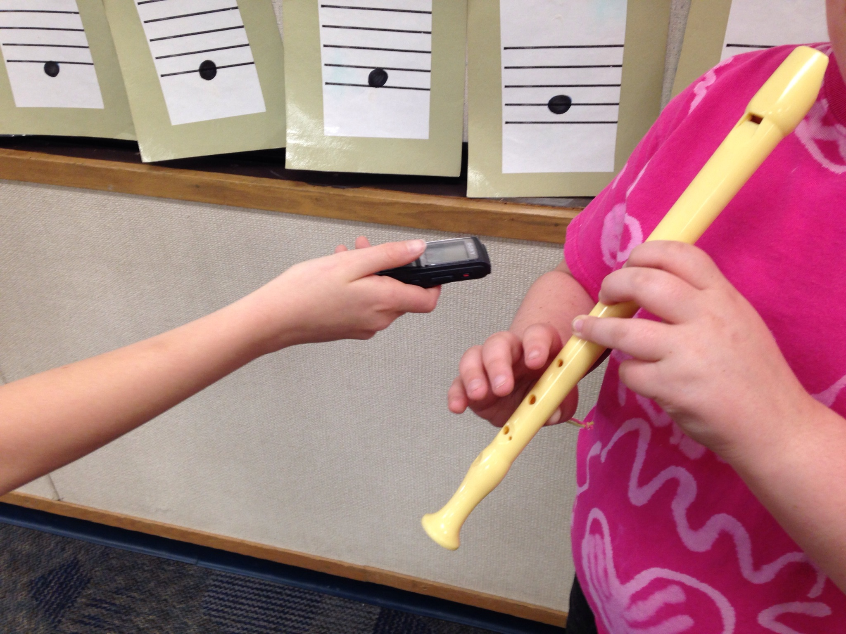
Record your melody. When everyone is finished recording, enjoy your classmates’ inter-species bird duets.

