Slide 1
2014 Biennial:
COPPER
Exhibition Preview

Slide 2
This exhibition features works on copper, art made of copper and artists inspired by copper, a tradition for seventh anniversaries. The event falls on the seven-year anniversary of the opening of the TCA and features 22 Arizona artists. The exhibition also pays tribute to the special historical and economical impacts of the metal on Arizona, known as the “copper state.”
The Gallery at TCA thanks the prestigious jury panel that selected the exhibiting artists: Tom Bollinger, Christine Cirillo-Ching, Ed Copley, Patty Haberman and Marilyn da Silva.

Slide 3
Juried Arizona Artists by city: Ajo: Pilar Hanson Cave Creek: Thomas Roy Markusen Chandler: Jose A. Benavides, Jacque L. Keller (with John L. Gleason) and Mary Bates Neubauer Cornville: Daniel C. Pierre Gilbert: Ingrid I. Shults Mesa: Jackie Kahn Paradise Valley: Karla Elling Phoenix: Christine Cassano, Red Rohall, Michelle Startzman and John Tuomisto-Bell
Scottsdale: Cecelia H. Calderon and Perrin Gilbert Tempe: Mary Hood and Troy Moody Tucson: Judith Arnaud Gary, Cynthia Miller, Tom Philabaum and Janet Windsor.

Slide 4
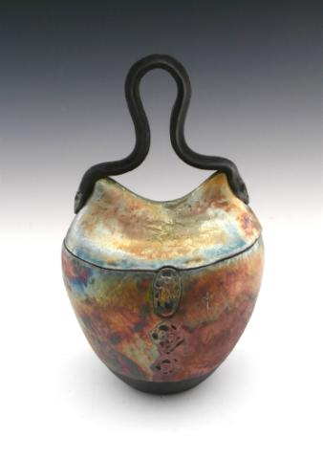
Judith Arnaud Gary, Tucson
Gary is a native Arizonan and has been drawing and painting since childhood. While attending the University of Arizona, she took a clay class and found an immediate connection with the material. She later received a Bachelor of Fine Arts degree from the U of A and today continues to work with pencils, paint and clay. Gary says “I often use copper in my clay work in the form of copper carbonate, which is important for achieving the results I’m looking for in my raku pieces…. I have always loved the look of copper.” ww.judithgary.artspan.com

Slide 5
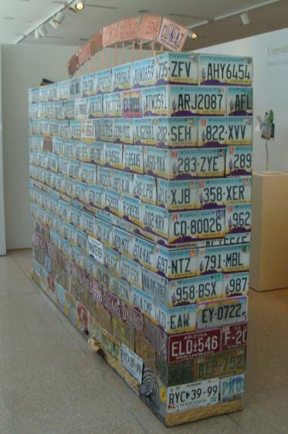
Jose A. Benavides, Chandler
Before he was even a teenager, Benavides was drawing cartoons for the local paper in Edinburg, TX. While attending high school in CA, a well-meaning math teacher advised him that he was too smart to be an artist and encouraged him to get an engineering degree. Years later, the realization that he could do both engineering and art became a turning point in his life. He says “The piece ‘Copper Crown’ is made of more than 300 automotive license plates that are arranged to indicate a sense of history and culture.
www.joseart.com

Slide 6
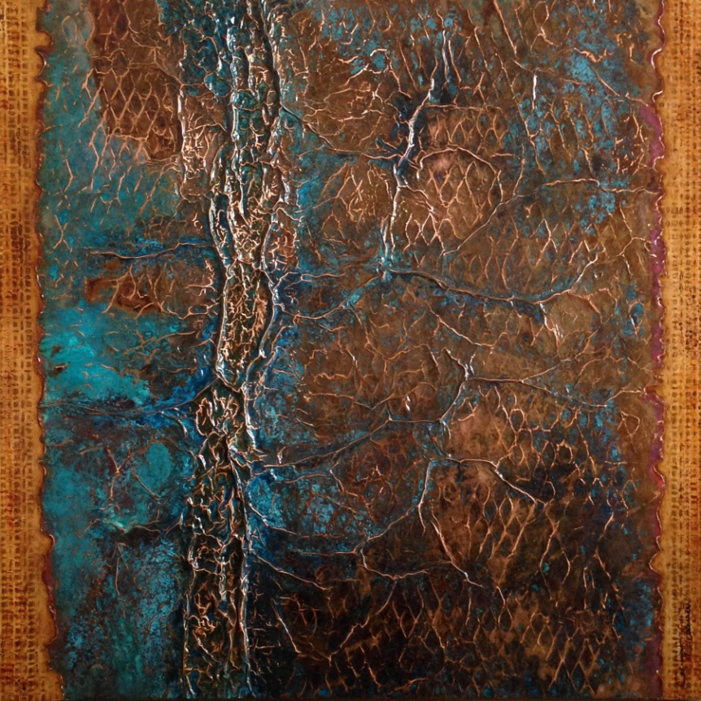
Cecilia H. Calderon, Scottsdale
Calderon was born and raised in Mexico City but has lived in the United States for many years. She likes to work with copper because she can change its surface with media such as acid patinas, oils, acrylics and plasters and techniques such as repoussé (hammered relief) and metal etching. She says “Copper is a noble and fascinating material and in it I have found the perfect ally to express my connection to nature, the ultimate artist.” www.ceciliahcalderon.com

Slide 7
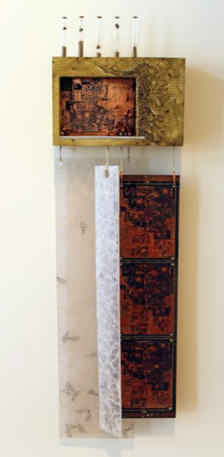
Christine Cassano, Phoenix
Cassano is a mixed media artist and was originally born and raised in Virginia and later relocated to Phoenix. She approaches and analyzes her artwork much like a scientist approaches a problem. She says “The body is a system…. At the heart of my work is a need to harmonize the organic self with an industrial civilization. These themes are inherent in my cabinet of materials – clay, wood, stones, concrete, circuitry, metals, and a wide range of found objects.
www.christinecassano.com

Slide 8
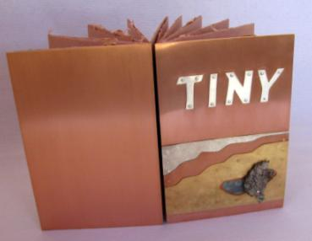
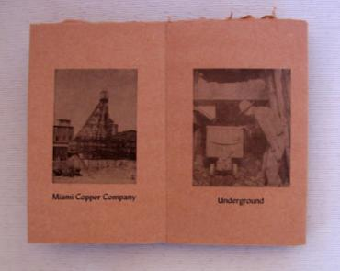
Karla Elling, Paradise Valley
Elling is a letterpress printer and papermaker, specializing in desert fibers. For thirty years she has printed the work of contemporary poets and writers, including several Poet Laureates of the United States. Elling says “My limited-edition artist book traces the immigration and American dreams of my family, the Rydens, [who were copper miners]. The stories were told to me again and again by my mother (nicknamed Tiny).” The paper in this handmade book was made with remnants of clothing worn by her family.

Slide 9
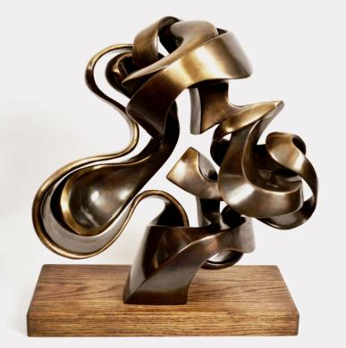
Perrin Gilbert, Scottsdale
Gilbert was born in Minnesota. In his teen years he was floundering in school until an art class became a distinct turning point and an outlet for his energy and creativity. Gilbert went on to earn a Bachelor of Fine Arts degree in sculpture from Arizona State University and currently works at Bollinger Atelier in Tempe, where he helps in the metal casting process for artists from around the nation.
Gilbert says “The reason I make art has exactly as much to do with the ideas I want to express as the process I go through to express them.”

Slide 10
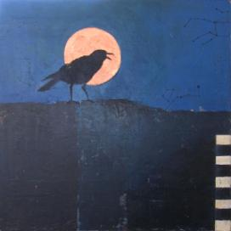
Pilar Hanson, Ajo
Hanson is a mixed media artist. She received a Bachelor of Science degree and a Master of Fine Arts degree in painting from Portland State University in OR. She says “This piece is an acrylic painting, including the metallic copper on panel, with some application of transfer material. The raven is a symbol of communication between worlds. The constellations refer to the stories we tell to give order to the universe. The black and white stripes suggest both native textiles and the coon tail rattlesnake…. and copper is the metal symbolic of this place, Arizona.”
www.phanson.net

Slide 11
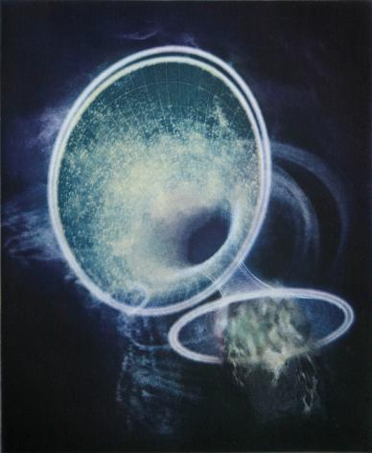
Mary Hood, Tempe
Hood, originally from Milwaukee, WI, is an associate professor of art in printmaking at Arizona State University. She has exhibited throughout the United States and abroad in places such as Denmark, Bulgaria, France, and Egypt.
She says “I use a traditional 19th century photogravure dust grain printing method [which uses a copper plate].” Photogravure is a method of printing images using photographic and etching techniques.
www.hoodmary.com

Slide 12
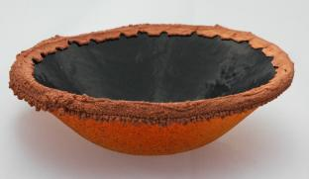
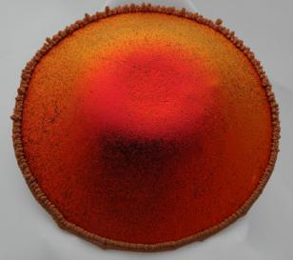
Jackie Kahn, Mesa
Kahn says she “has been attracted to copper since childhood. I began collecting scrap pieces from my father's work and held onto them as if they were treasure.” Kahn, a glass artist, became drawn to the process of fusing glass with copper called electroform. “Electroforming involves applying copper foil to fused glass vessels and placing them in an electrolyte solution- an acid solution with copper anodes that are attached to a low voltage electrical current. The electrical current controls the amount of anodes that form and create a skin-like layer of tiny copper crystal beads. www.dragonflyglassart.com

Slide 13
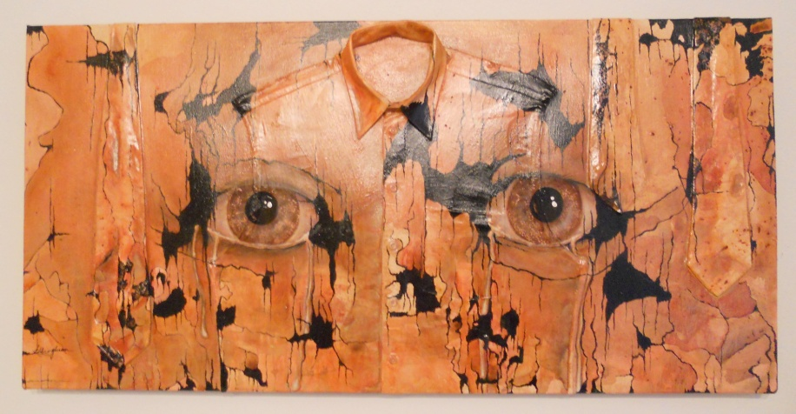
Jacque L. Keller (with John L. Gleason), Chandler
Keller studied at the Toledo Museum of Art’s Youth Studies Program as a child and began painting professionally in the early 1980’s. This piece is a collaborative work with her friend and sculptor John L. Gleason. The two artists are artistic collaborators as well as business partners. Keller says “The work is fabric, copper and acrylic on wood. This is about men who cry and love and worry and commit themselves to their families. The intense nature of this artwork comes from my perspective of strong passionate good men in my life, including John, Glen, my son Andy, my husband Tom, my departed Dad Papa Jack and more.”
www.quantumartinc.com

Slide 14
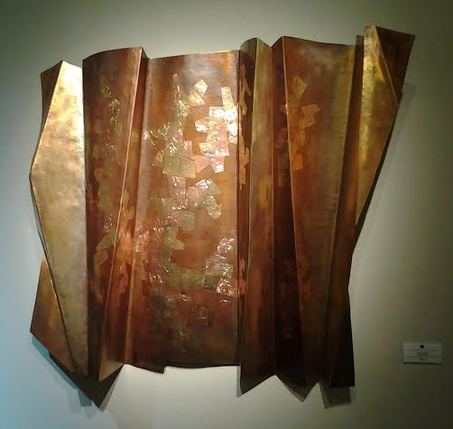
Thomas R. Markusen, Cave Creek
Markusen was born in Chicago and has been a leader as a metal smith, designer and educator for more than 40 years. Markusen’s work is found in many collections including the White House Collection of American Crafts, the Vatican Museum in Rome and the American Craft Museum in New York City. He says “Because copper is such a reactive metal, I am able to attain an unlimited color palette. Its malleability allows me to achieve my aesthetic forms. I continue to be fascinated by the versatility of copper.”
www.markusenmetal.com

Slide 15
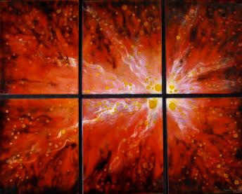
Cynthia Miller, Tucson
Miller is originally from Chicago but currently lives in Tucson. Her art is primarily focused on working with vitreous enamel glass that can be kiln-fused onto burnished copper panels. She says that “copper enameling captures and celebrates both light and color like no other medium…. Enamel is permanent, brilliant color. It is glass, not paint. There can be as many as ten layers of color and multiple firings of each panel. This creates depth and texture and a sense of adventure at seeing something new at each viewing.”
www.finefusions.com

Slide 16
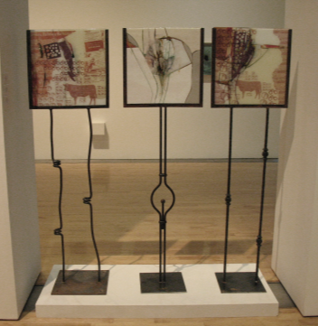
Troy Moody, Tempe
Moody is an independent artist and designer and has spent more than 15 years creating unique art glass installations for religious, commercial and private spaces nation-wide. He says “This work is from a recent series of art glass assemblage exploring the use of nostalgic imagery with scraps of copper sheeting, mesh and wire as inclusions within kiln-formed glass. Copper, along with cotton, cattle and citrus are heralded as cornerstones of the Arizona economy. www.troymoody.com

Slide 17
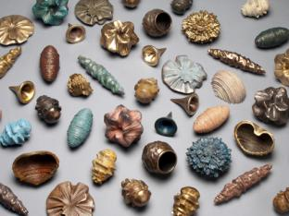
Mary Bates Neubauer, Chandler
Neubauer is currently a professor of sculpture at the Herberger Institute for Design and the Arts at Arizona State University, where she is involved in the Partnership for Spatial Modeling and serves as an affiliate to Arts, Media, and Engineering. She says “The work is designed to provide a visual/tactile interpretation of the behavior of data through time. I have been involved in projects visualizing rainfall and water usage, river and tidal flows, geophysics, environmental pollutants, air traffic, pedestrian flow, solar storms and telecommunications data.” www.sculpture-digital.net

Slide 18
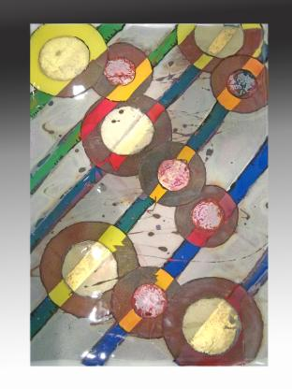
Tom Philabaum, Tucson
Philabaum received a Bachelor of Art in art and education from Southern Illinois University and a graduate degree from the University of Wisconsin. After moving to Tucson, he built his own glass-blowing studio, and earned a Master of Fine Arts degree in ceramics from the University of Arizona. He says “These collage paintings include high-fired paint, foil, wire, screen and metal scraps sandwiched between glass layers. They derive from a trip to Paris where I first saw exquisite glass paintings [called gemmail, a technique for layering and adhering pieces of colored glass onto a panel].”
www.philabaumglass.com

Slide 19
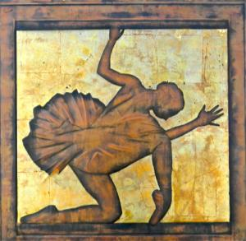
Daniel Pierre, Cornville
In 1978 Pierre received a scholarship to apprentice with renowned Arizona sculptor John Waddell. Today, he creates his own bronze figures, sculptures and ceramic works and is currently at work on a series of metal wall pieces and bronze sculptures from his studio in Northern Arizona. He says “this is a relief sculpture formed on a copper sheet using a technique known as chasing and repoussé. (The term repoussé means to work from the reverse side of the piece to create a relief on the front, while chasing is the opposite technique; the process can be used for things as small as jewelry to some of the largest sculptures in the world).”
Composed

Slide 20
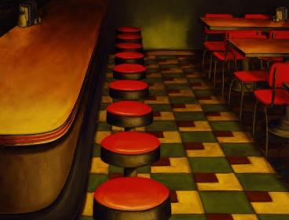
Red Rohall, Phoenix
Rohall has been a professional artist since 1979. He enjoys painting detailed realistic oil paintings of timeless roadside attractions such as old time diners, vintage motels, ice cream stands and the old ‘Main Streets’ of small towns located on or near Historic Route 66. He says “I paint in thin glaze layers; using the same methods and techniques as the ‘Old Masters.’ One painting frequently takes many months to complete. The finished paintings glow with a soft and special inner light. All my paintings are of real places with real stories to tell.”
www.redrohallartist.com
Copperville Cafe

Slide 21
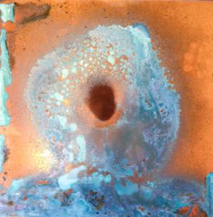
Ingrid Shults, Gilbert
Shults earned a Bachelor of Fine Arts degree from Northern Arizona University in Flagstaff and a Master of Fine Arts degree in studio arts from Purdue University in West Lafayette, IN. She is an artist, educator and graphic designer that uses a variety of media in her work. She says “Out of all of the metals I have worked with, copper feels most like a conversation. It can bend and be formed with ease, but it can also force its own nature onto the artist. I love that it is so strong and conductive, yet soft and malleable. It contains such a long history of production and consumption throughout history.”
www.flyingabbeystudio.com
Cosmic Consciousness

Slide 22
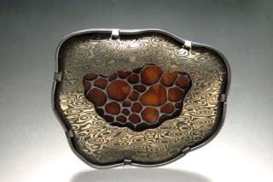
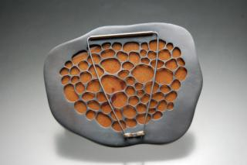
Michelle Startzman, Mesa
Startzman is originally from Tucson and is a metal smith, enamellist and teacher. She is currently an artist in residence and master instructor at Mesa Arts Center and adjunct instructor in metals at Central Arizona College. She says “The jewelry pieces are built with structural integrity, but with fragile materials such as glass that can easily be shattered if mistreated, much in the way that relationships can be damaged if not cared for. The aim of my work is to bring insight to the complexity of human relationships and the examination that is necessary to look beyond the surface to truly understand someone.”
www.michellestartzmanmetalwork.com

Slide 23
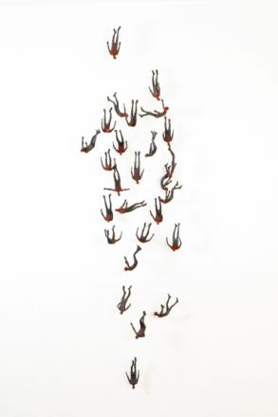
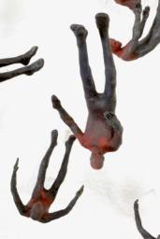
John Tuomisto-Bell, Phoenix
Tuomisto-Bell is the owner/operator of Tuomisto-Bell Studio Foundry, a full service bronze casting foundry and working studio. He says “Most of my sculptures are made of bronze, which is a metal alloy comprising mostly of copper. Copper based alloys have a rich history in art, which is one of the main aspects that drew me to it. It has great durability and the effects one can get with the patina process (coloration on the surface) are endless and fascinating. The ‘Falling Man’ series stems from the darker side of man, the lengths we will go to convince others our opinions are the truth. www.tuomistobell.com

Slide 24
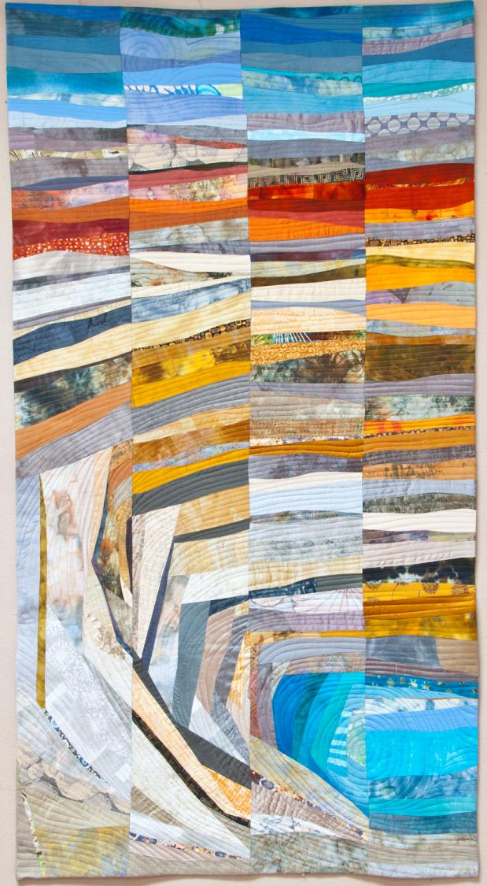
Janet Windsor, Tucson
Windsor had a long career as a graphic designer in Cincinnati before retiring. She recently moved to Tucson where she is pursuing her love of fiber art. Windsor has been sewing since she was twelve years old and found her graphic design skills have been helpful in creating her fiber designs. Windsor says “Like Arizona Gold” depicts a copper mine pit and “is made of hand dyed and commercial silks and cottons, pieced and quilted.” www.janetwindsor.com

