Slide 1
Symbols in Cloth and Color
by Mary Erickson, Ph.D., with Arizona art teacher Susanna Yazzie

Slide 2
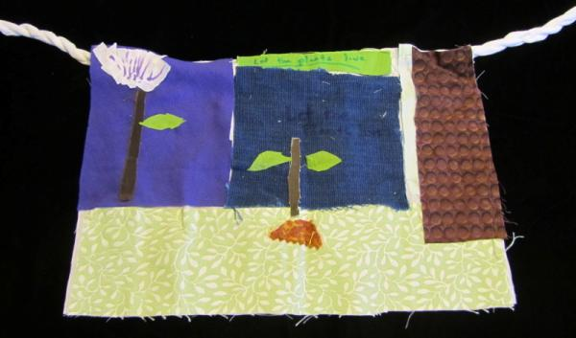
An elementary student made this “Eco-Flag,” which he titled “Let the Plants Live.” He used recycled cloth in cool, green, blue and purple colors to express his concern for the environment. Begin to think about ideas you might want to express in your own Eco Flag.

Slide 3
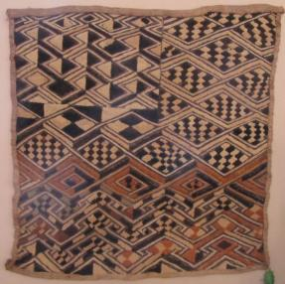
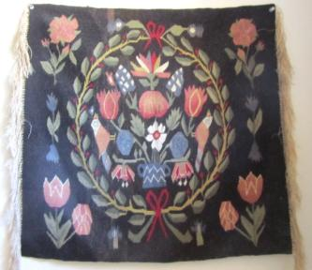
Things made of fibers, like clothing, tents, tablecloths and upholstery, are all around us. Today many of these things are made with artificial fiber like nylon or acrylic.
Before artificial fibers were invented, all over the world, people developed ways to make things using natural fibers.
African
Mexican
Swedish

Slide 4
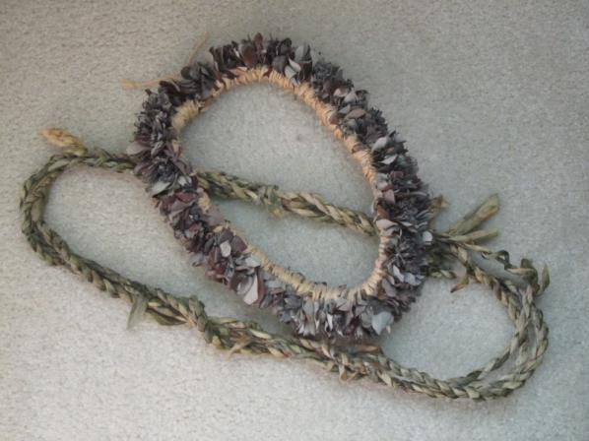
Hawaiian wreaths and leis (flower necklaces) are braided from fresh-cut leaves and flowers when they are still wet and bendable.

Slide 5
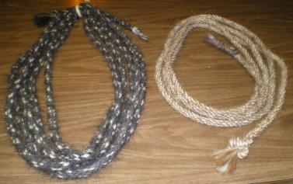
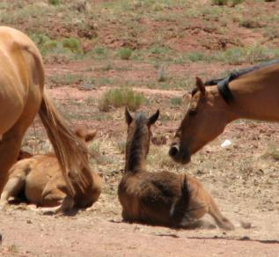
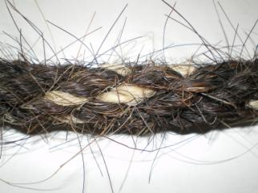
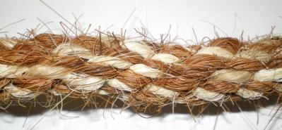
The hair from a horse’s mane and tail braided into a lariat makes a rope so strong that a horse cannot break it.

Slide 6
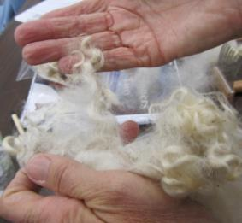
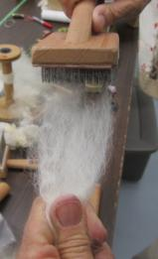
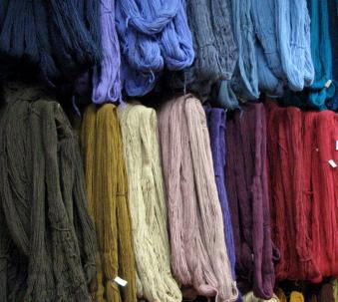
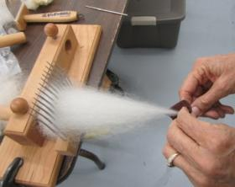
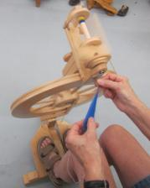
A single goat or sheep hair is tiny and fragile. But when many are combed and spun together they make strong yarn.

Slide 7
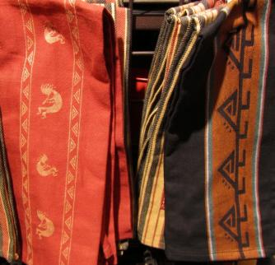
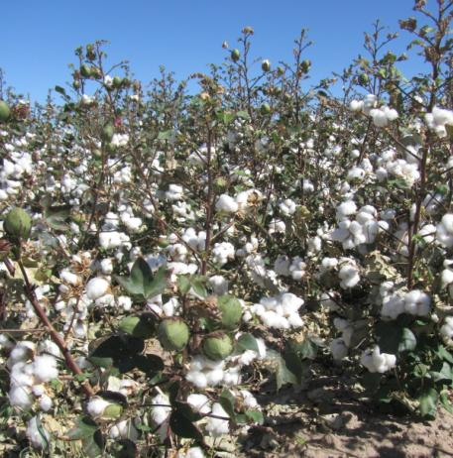
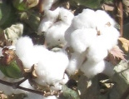
Cotton cloth is made from tiny fibers that surround and protect the seeds of a cotton plant.

Slide 8
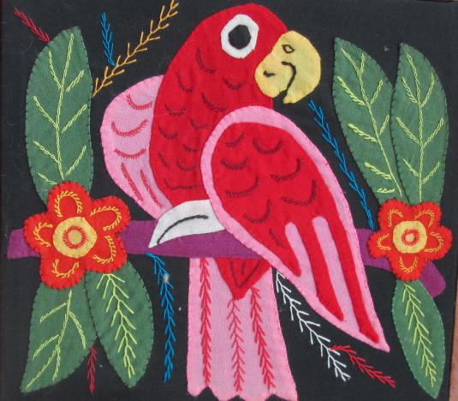
We often want the fabrics we use to be special. So we sometimes put them together in interesting ways and decorate them.

Slide 9
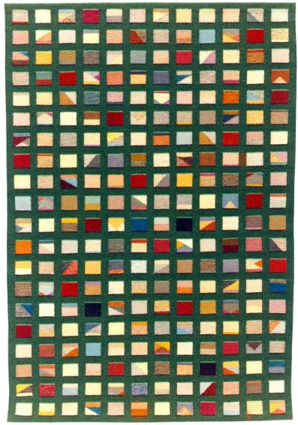
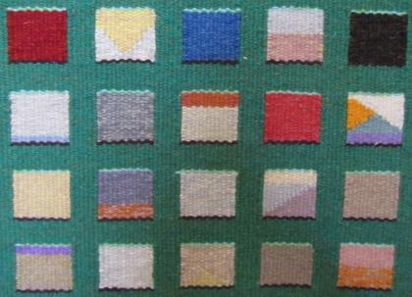
A tapestry is made by using different colors of yarn to weave the fabric itself.
Grace Eckert
Exercising One Option
Detail

Slide 10
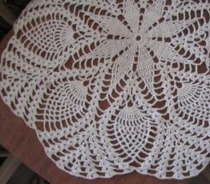
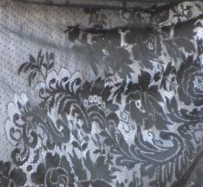
Lace usually is made with just one color of thread knotted together to make a pattern.
Macrame also is made by knotting cords.

Slide 11
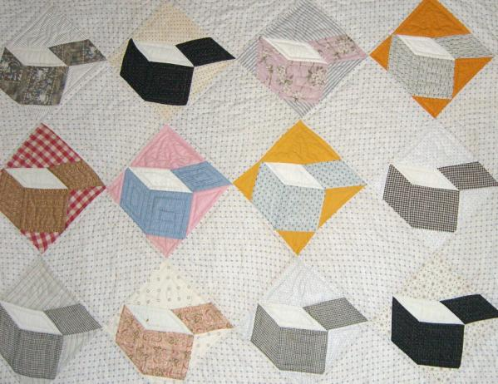
A pieced work is made by sewing together smaller pieces of cloth to make a larger piece - like a quilt.

Slide 12
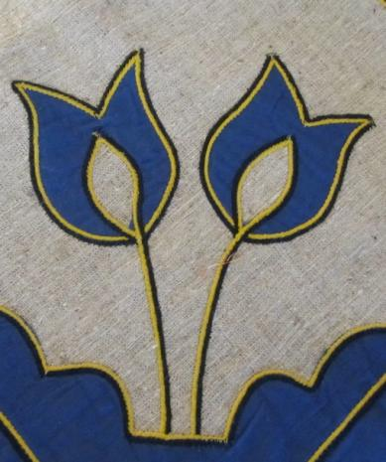
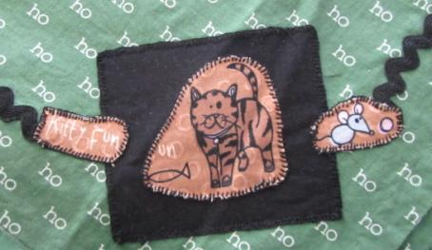
Applique is a technique of sewing one piece of cloth on top of another by applying a piece to a background.

Slide 13
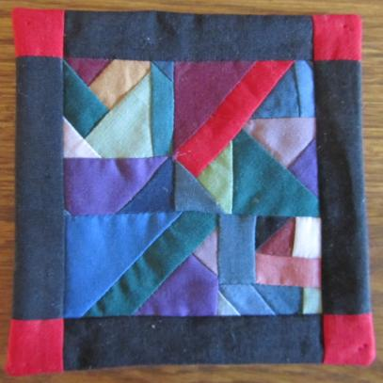
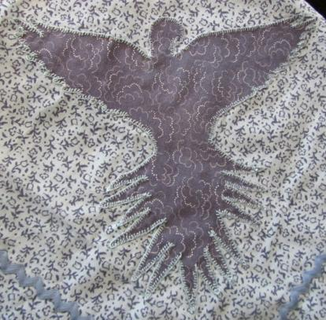
Both of these items are made of cloth. Which do you you think is applique and which do you think is pieced?
How can you tell?

Slide 14
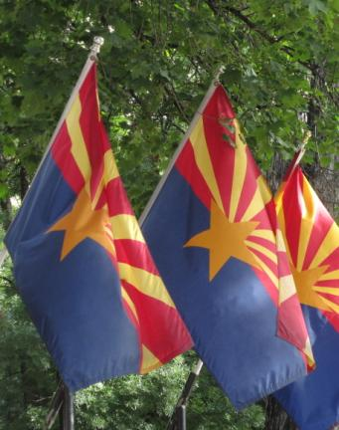
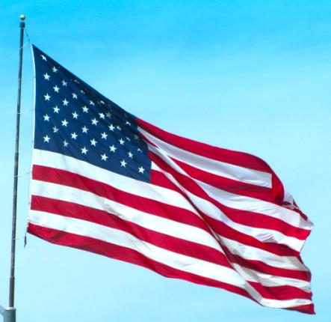
People sometimes use fabric pieces to express ideas that are import to them. Why are these pieces of fabric important to many people?

Slide 15
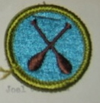
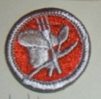
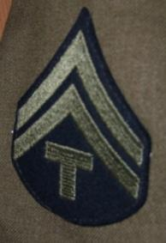
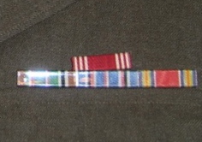
These embroidered badges symbolize the achievements of scouts.
These ribbons and patch on a uniform symbolize military rank and experience.

Slide 16
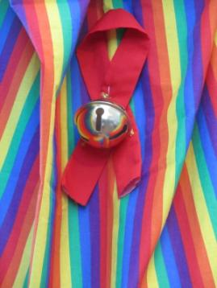
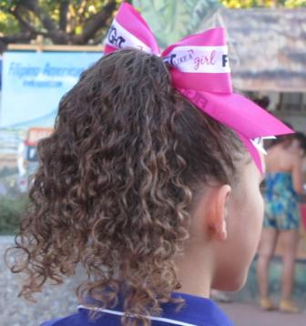
Some people use colored ribbons to express ideas. For example, a black ribbon can express a person’s sorrow over a death or a yellow ribbon can express support for people in the military.
What causes do you think these red and pink ribbons symbolize?

Slide 17
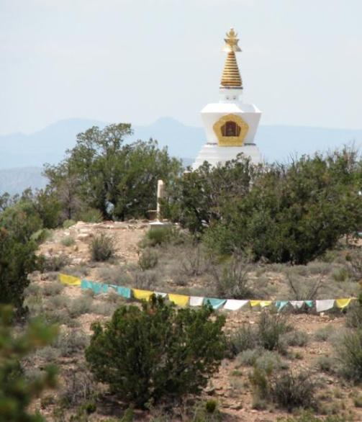
Buddhists from Tibet use prayer flags to express their good wishes.
See the prayer flags waving in the breeze at a Buddhist retreat in northern Arizona.

Slide 18
Each Tibetan prayer flag color symbolizes a different element of nature.
Blue = sky White = clouds
Red = sun/fire Green = plants/water
Yellow = earth/soil

Slide 19
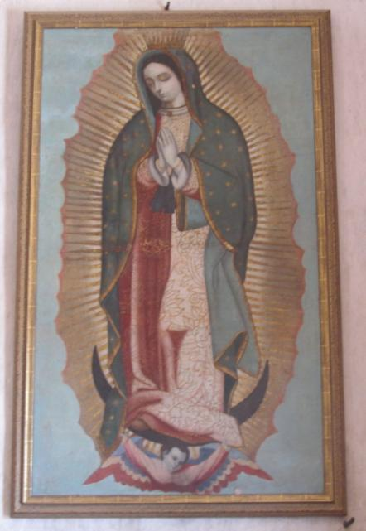
Other people symbolize other ideas with color. For example, the blue-green, star-covered cloak of the Virgin of Guadalupe stands for the heavens.
San Xavier del Bac Mission
On the Tohono O’odham
San Xavier Indian Reservation

Slide 20
In Navajo culture each of the four directions has its own color.
East = white
West = yellow
North = black
South = turquoise

Slide 21
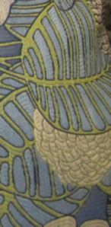
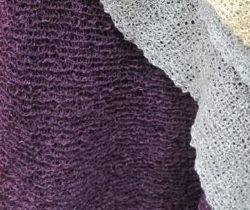
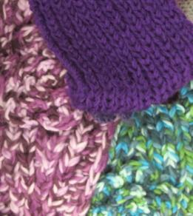
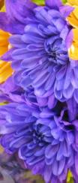
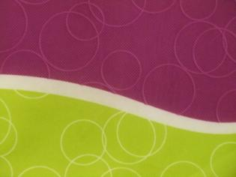
Blue, green and purple are cool colors, which are often used to symbolize nature.

Slide 22
Green, blue and purple are called cool colors because they all contain some blue.
Green is made of blue and yellow.
Purple is made of blue and red.

Slide 23
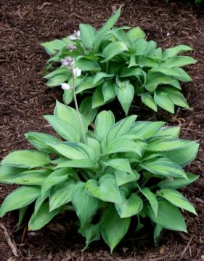
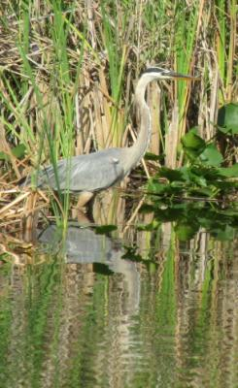
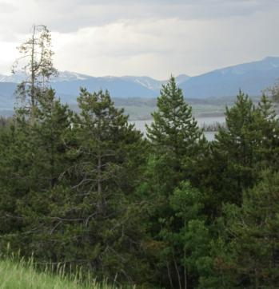
Have you ever heard of “going green”?
What do you think “green” means in this slogan?

Slide 24
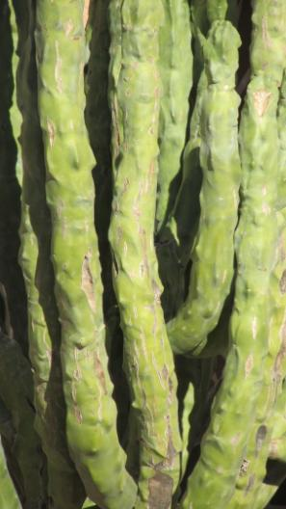
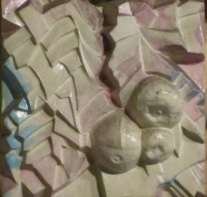
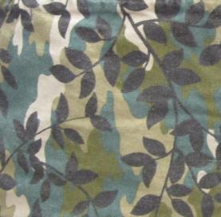
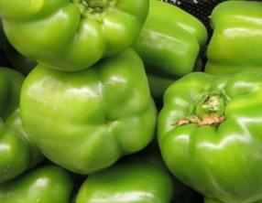
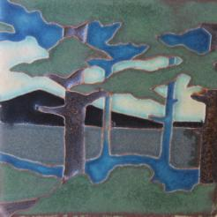
Green is one of the cool colors. It reminds us of growing things.

Slide 25
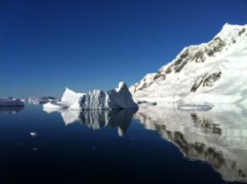
Blue is another cool color.
It reminds of of sky and water.

Slide 26
You will be making a Eco-Flag that:
expresses an idea showing your concern for the environment,
is constructed using recycled fabric made from natural fibers,
uses (sewn or glued) applique and
symbolizes nature with cool colors.

