Slide 1
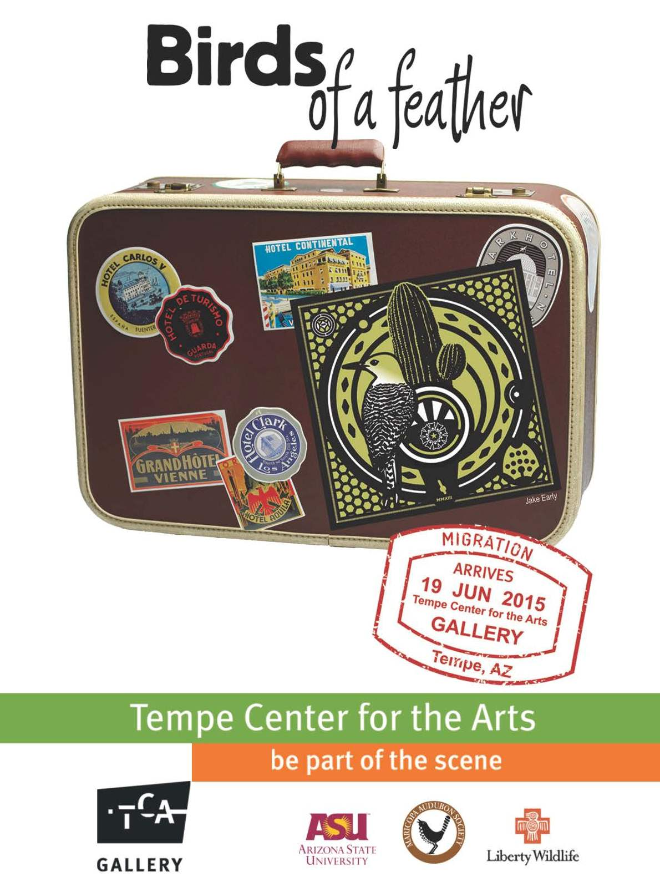
Exhibition Preview

Slide 2
Birds of a Feather
This summer exhibition celebrates the birds that make Arizona home or a migration stop to some exotic location. Featured artists come from around Arizona and the United States and work with a variety of media ranging from nature photography to abstract sculpture.
Thank you: ASU Art Museum, ASU School of Life Sciences, ASU Natural History Collections, ASU Ask a Biologist, Liberty Wildlife, Maricopa Audubon Society, Rover Elementary School in Tempe and St. Thomas School in Medina, WA.

Slide 3
Artists
Jake Early, Tempe
Vern Fetz,Phoenix
Edward Kennefick, Phoenix
Phil Lichtenhan, Tucson
Farraday Newsome, Mesa
Anne Peyton, Ahwatukee
Barbara Rudolph, Phoenix
Beth Shook, Gilbert
Nathaniel Smalley, Phoenix
With Jack DeLap, Seattle, WA
Tempe Teen Artists from: Tempe High School, Mountain Pointe High School, Marcos de Niza High School, McClintock High School and the New School for the Arts and Academics.

Slide 4
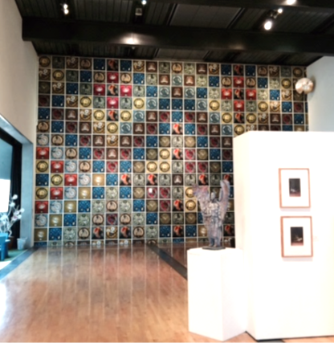
Jake Early, Tempe
Early is originally from Chico, CA. He has been a working artist, illustrator, graphic designer and printmaker for the past 22 years. Each of the 300+ serigraph prints in Early’s installation at the Tempe Center for the Arts was created by hand on a printing press he designed and built himself. He and TCA staff spent two days installing the wall piece which includes 15 different bird species.
“A constant theme in my work is a strong sense of place. I believe strongly in art and its ability to communicate ideas, transform public spaces and celebrate what is unique about local places and people. My goal is to honor local community spaces, landmarks, native plant and animal life and community pastimes.” www.jakeearlyart.com
Vermillion Flycatcher
serigraph print
Installation at TCA

Slide 5
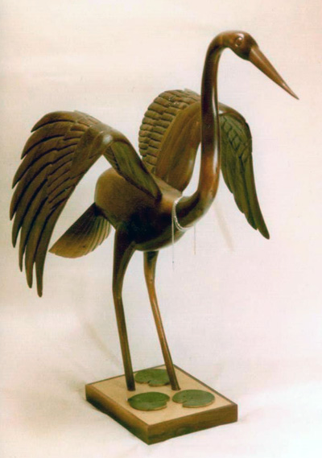
Vern E. Fetz, Phoenix (1926-2004)
Fetz was born in Globe and later resided in Phoenix. He received a Master’s degree from Arizona State College (now ASU). He spent much of his professional career designing and building local miniature golf courses. But a life long passion was wood carving. He was a self taught artist that took up whittling when he was young and liked carving airplanes from blocks of balsa wood. After retiring, Fetz enjoyed creating wood sculptures and making the rounds at various arts festivals selling his works. According to his wife, TCA docent Lenore Fetz, he was especially known for making angels, dragons and birds.
Heron Bird black walnut wood carving

Slide 6
Edward Kennefick, Phoenix
Kennefick was born in Gloucester, MA but moved with his parents to Arizona in 1969. He showed an interest in art and drawing from a young age. “These pieces are a departure from my usual two-dimensional work. The unglazed ceramic birds (handmade) are attached to the panels prior to painting. This small body of work explored themes of memory and nostalgia…within the context of my family’s story. The sparrow, emerged as a symbol of vulnerability, memory and change and were part of a larger personal narrative exploring intergenerational dynamics in the face of aging and mortality.”
Collective Memory: Studio 124
oil painting with & cast ceramics on wood panel

Slide 7
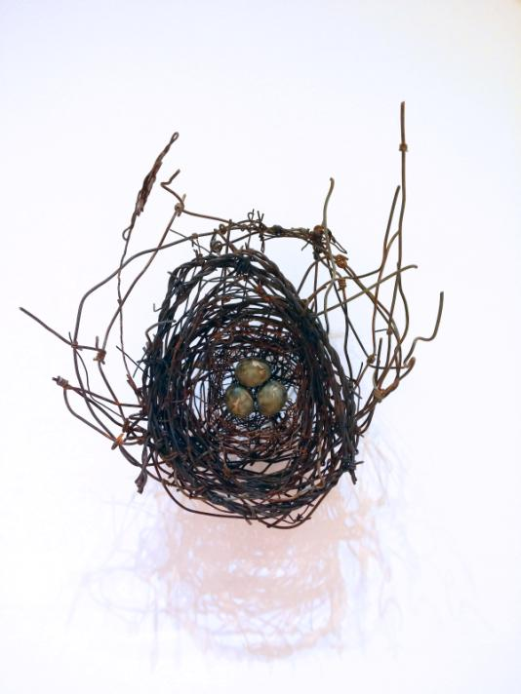
Phil Lichtenhan, Tucson
Lichtenhan was born in Tucson in 1952. He worked as a high school teacher for both public and private schools. He left teaching in 2001 to pursue his art career full time. Lichtenhan’s work features metal bird nests, constructed from items such as old fencing, barbed wire, metal mesh and handmade ceramic eggs. “As birds will use a variety of materials to construct their nests, I have collected man made discards to weave my nests. I find my materials everywhere including along the roadside and alleyways, inside the city or out in the desert. The hand fashioned high-fired clay eggs are glazed in a variety of ways producing natural and unnatural finishes and colors.”
www.phillichtenhan.com
Nest, #1151 mixed media

Slide 8
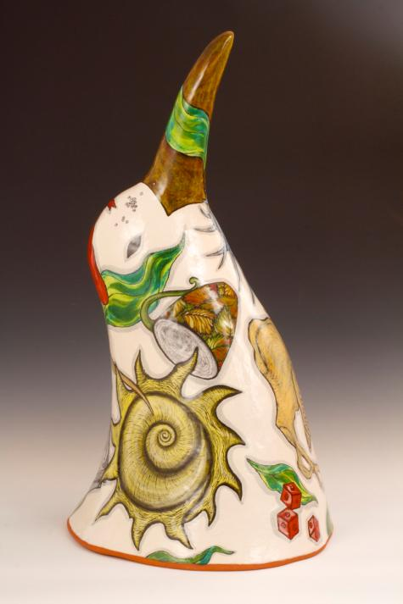
Farraday Newsome, Mesa
Newsome grew up in California. She currently lives in Arizona with fellow potter and husband Jeff Reich. Together they run Indigo Street Pottery in Mesa. “I have worked within the format of the ceramic vessel for thirty years, usually finding inspiration from nature. These large, glazed red terra cotta bird sculptures gaze upwards towards the sky in a passive and reflective state. Images such the eggs, watch, pelvis and shells represent biological time and fertility. The dice and cards suggest chance. The shark teeth, spiny agaves and poisonous datura seed represent danger.”
www.indigostreetpottery.com
Genetic Drift, Unseen Drift Series glazed terracotta

Slide 9
Anne Peyton, Phoenix
For more than twenty years, Peyton was a successful motorsports artist. But later, her lifelong love of nature brought her back to painting birds. Today, she and her husband spend countless hours viewing birds around the Southwest. She also volunteers at Liberty Wildlife, an organization that treats injured animals. Her specialty is assisting hawks and owls to become accustomed to people for educational and group settings.
“Observing birds and their habits is a way to discover more about their nature. Each of their actions means something for the bird and it is these actions and their meanings that I want to convey to the viewer.”
www.annepeytonart.com
Big Blue acrylic
(Bird: Great Blue Heron)

Slide 10
Barbara Rudolph, Phoenix
Rudolph earned a Bachelor of Arts degree in painting and printmaking from Arizona State University. She also studied painting in a realistic style in the U.S. and Mexico. She began her professional arts career in graphic design and later as a painter in the fine art publishing business. In the late 1990’s she began working on painting her own work full time and focuses primarily on intimate portraits of birds in her compositions.
“I realize how important ‘Art’ is in my life. I love to spend time in the studio creating paintings that will bring joy into people's lives. My inspiration for painting birds came from my late father who always loved birds.”
www.BarbaraRudolphFineArt.com
“On the Wild Side,” 32 x 44"
Oil on canvas

Slide 11
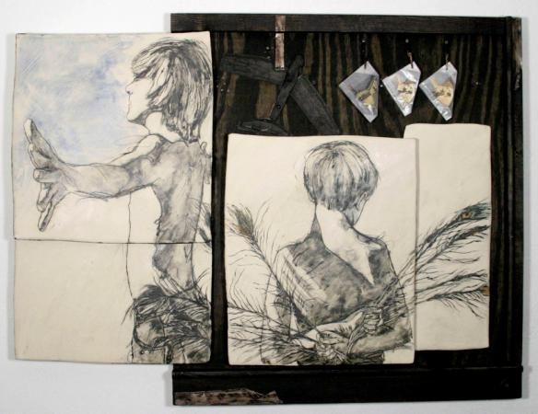
Beth Shook, Gilbert
Shook considers herself a native of the southwest. She first discovered her love of clay and the drawn line while studying at the University of Texas at El Paso. She later received a Master of Fine Arts degree from Arizona State University. She now lives and works in Gilbert with her family and a quirky border collie dog.
“Inspiration comes from my relationships with people, objects and faith. Clay provides the most immediate way to tell my story visually as it responds to manipulation. I include found objects and various other mediums to aid in the story telling process, furthering the overlap of color, texture and image.”
www.bethshookart.com
Too Much of Me to Fly clay, wood and found objects

Slide 12
Nathaniel Smalley, Phoenix
Smalley is a professional nature photographer. His study of photography began early in high school. Today, he leads photography workshops, tours and expeditions to various international destinations. Smalley is also a passionate conservationist. He has done extensive work with various organizations such as National Geographic, National Audubon Society and Arizona Highways.
“These photos take the viewer on a visual odyssey across Arizona, highlighting the unique beauty hidden throughout this great state that only our feathered friends can show to us. It is my privilege and honor to share these images with you.”
www.NathanielSmalleyPhotography.com
Spring Fancy, Hooded Merganser
photograph copyright: Nathaniel Smalley

Slide 13
Jack DeLap, Seattle, WA
DeLap was born and raised in Corona del Mar, CA. His interest in drawing birds and wildlife began at an early age. He spent much of his free time birding the local grasslands, marshes and chaparral. “I produce images in various media including graphite, pen, ink, acrylic and oils. But the current work in its final form was created freehand using a digital tablet and stylus (Wacom Cintiq 13” that attaches to my laptop and the Sketchbook Pro 6, by Autodesk software). My process involves field sketches, museum specimens and photographs to create an original composition that aims to capture aspects of the species’ natural history and physical form.” www.jackdelap.wordpress.com
Inca Doves Pyramiding to Stay Warm
digital drawing print

